Slide 1
Ancient Rome
History 101

Slide 2
Geography
Italy
Shaped like a giant boot
The Alps shelter Italy to the North
The toe and heel slice into the Mediterranean Sea
The Adriatic Sea lies to the East
Apennine Mts. run down the center of the peninsula

Slide 3
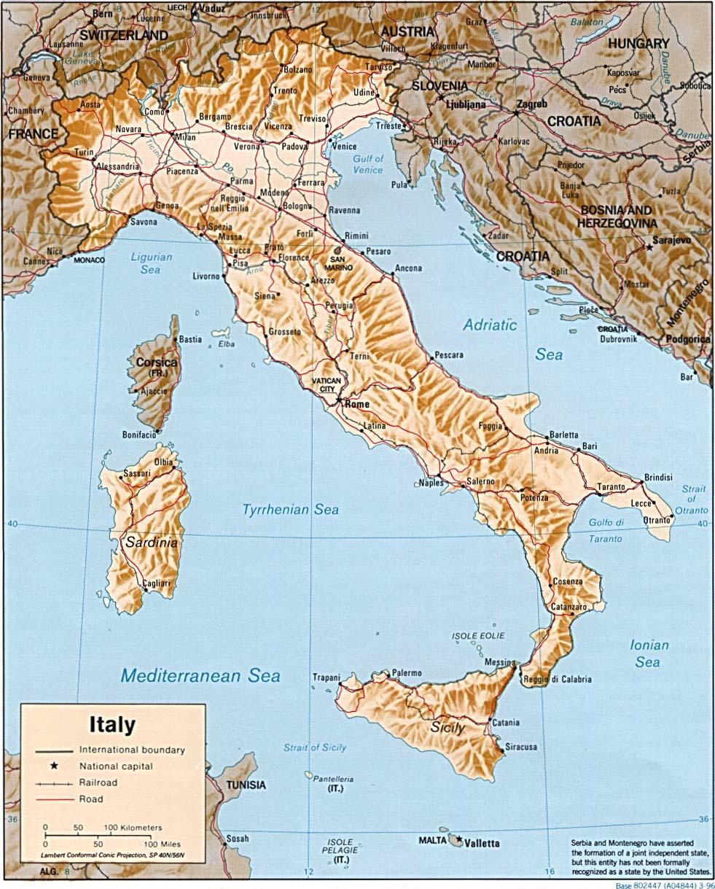

Slide 4
Legend of Rome
Romulus and Remus
abandoned by their parents as babies
Placed in a basket and set afloat
Basket lands ashore and is found by a female wolf who nurses the twins and cares for them briefly
Children are later found and raised by a shepherd
When older, they decide to build a city; quarrel over the location; Romulus kills Remus

Slide 5
Location
Rome
Built on 7 hills
Tiber River
15 miles inland from the coast
Advantages
Protected from sea invasions
Along shallow area of Tiber River
Few places to cross the river
Center of Trade Routes

Slide 6
Founding of Rome
Mid 700 B.C.
Latin's move into west-central Italy
This plain was called Latium
They built villages along the Tiber River
These villages unite to become Rome
Late 600 B.C.
Rome is captured by the Etruscans
Government features begin during this time

Slide 7
Roman Government Features
King (Etruscan) rules
King was elected by tribal chiefs
King selected a body of nobles (Romans) to advise him
They were called the Senate
In 509 the Romans revolt and the last Etruscan king was driven out. The Republic was founded.

Slide 8
Early Rome
Republic
Form of government in which voters elect officials to run the state
Only adult male citizens could vote or participate
Senate
Most influential and powerful
Public funds
Foreign policy
Court

Slide 9
Early Rome
Senate
Made up of 300 members
Appointed for life by consuls
Proposed laws and nominated consuls
Made up of only patricians
Magistrates
Elected Officials
Consuls
Chief Executives
Ran the Government

Slide 10
Early Rome
Consuls
Commanded the Army
Served one-year terms
Had veto power over other Consuls
Praetors
Helped the Consuls
During war they commanded the government
During peace they oversaw the Legal System

Slide 11
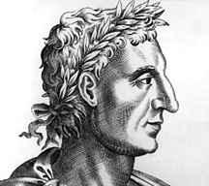
Early Rome
Censors
Registered citizens according to wealth
Appointed candidates to the Senate
Oversaw moral conduct of the citizens
Assemblies
Citizens that voted on laws & elected officails
Vote on war and peace
Served in Court
Elected 10 officials named tribunes

Slide 12
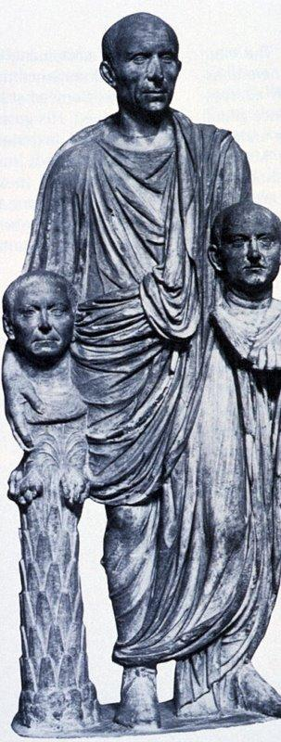
Conflict of Orders
Over time common people tried to win more rights
Early Republic was divided into 2 classes
Patricians
Powerful landowners who controlled government
They were nobles and they inherited their power
Plebeians
Most of the population
Mainly farmers and workers
They had few rights
They could vote but could not hold office

Slide 13
Plebeians
They did not know Roman laws
Laws were not written down
Judges where the only ones that knew the law
Over time they gained more rights
Through strikes
Join the Army, hold office, elect tribunes
Forced the Government to write out the laws

Slide 14
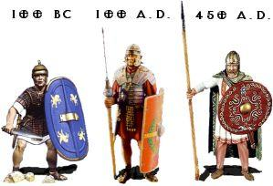
Republic Grows
By 265 B.C.
Rome controlled almost all of Italy
Through wise politics and a strong army
Every male citizen that owned land was required to serve in the military
Legion
6,000 citizens called Legionnaires
Auxilia
Noncitizens

Slide 15
Army/Politics
Well trained
Morale was usually high
Conquered People
Granted full citizenship
Cities close to Rome
Granted partial citizenship
Cities that were more distant
Could own property and marry
But not vote
Allies had to provide soldiers
Conquered people
Must provide land for Roman Farms
Help control these people
Spread Latin
Roman Law
Culture

Slide 16
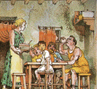
Family Life

Slide 17
Family Life
The average Roman family consisted of father, mother, children, married sons, their family, and slaves.
The person who decided who his children marry was the head of the house, the father (PATERFAMILIAS). The family was very important to the Romans.
Women were under control of their husbands but controlled how the house was run and were known as (MATERFAMILIAS).

Slide 18
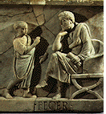
Roman Schools

Slide 19
Roman Schools
Rome didn't have any public schools. Most children went to private school or studied at home.
Their subjects were reading, writing, and arithmetic.
In many homes, the slaves taught the children.
Before the age of fourteen, they studied Latin and Greek.

Slide 20
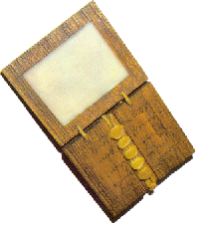
Roman Schools
Most schools had only one room and only one class.
There were about twelve pupils.
Romans had paper made from reeds, and wrote on animal skins, but this was too expensive for children to write on.

Slide 21
Roman Schools
Schoolboys would write on wax tablets with a pointed stick called a stylus. They then rubbed the wax smooth and started again.
A school would only have a few books.
Books had to be written by hand. They were usually made from one long piece of paper rolled around a stick. This was called a scroll.

Slide 22
Roman Houses
Rich people usually lived in a town house called a domus. Many of them also had a country house called a villa.
But most people living in towns and cities rented an apartment called a cenaculum.
Some were very big and fancy, but others had only one room. The poorest people lived on the top floors, which were built out of wood. These could catch fire easily and weren't very safe.

Slide 23
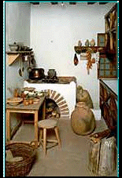
Roman Houses

Slide 24
Roman Houses
Apartments didn't have kitchens, so tenants had to buy ready-cooked food.
Private houses, had large kitchens with different fires for cooking different types of food.
Houses had central heating It warmed the rooms from under the floor.

Slide 25
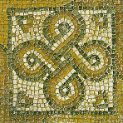
Roman Houses
Romans sometimes used small rugs, but no carpets. Expensive houses had patterned floors called mosaics, made from tiny pieces of stone.
Smooth wet plaster was spread over the floor. Tiny squares of bright stone were pressed into it to make a picture. The gaps between the squares were then filled in with plaster.
Most furniture that is still around today is made of marble or metal. They also had wooden furniture. Most beds were probably very plain and made from wood.

