Slide 1
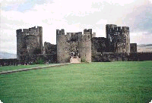
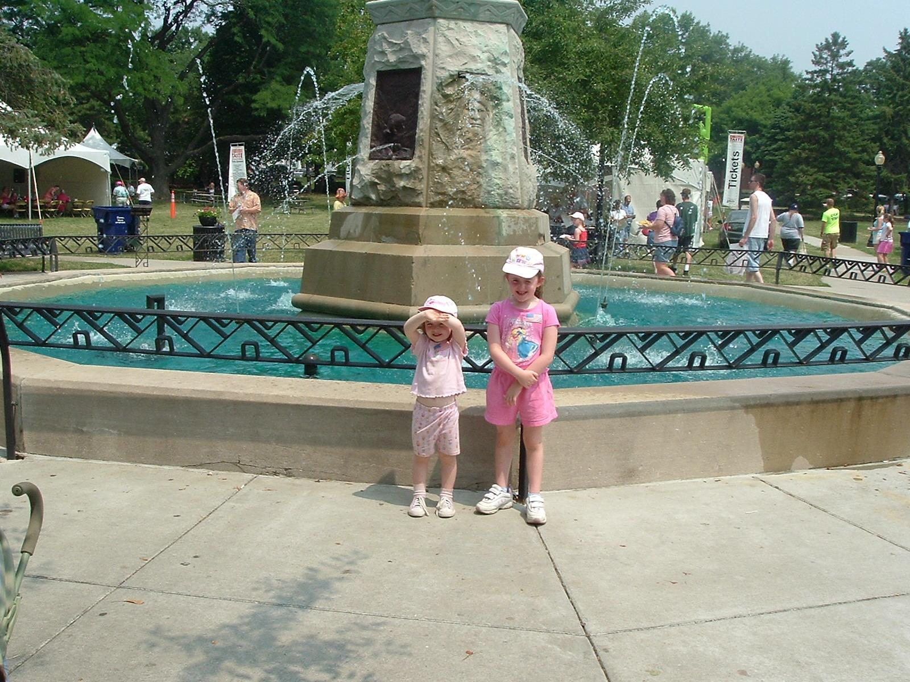
Living in a Castle

Slide 2
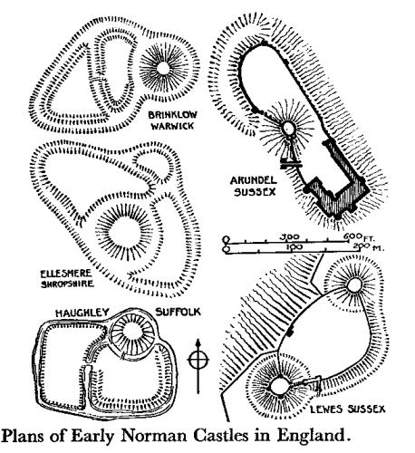
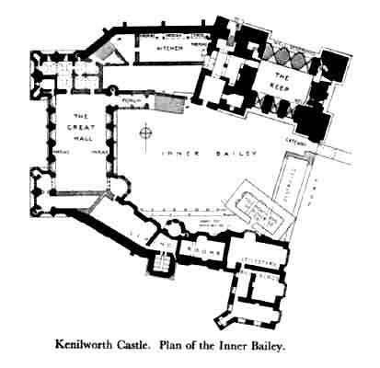
Castle Diagrams

Slide 3
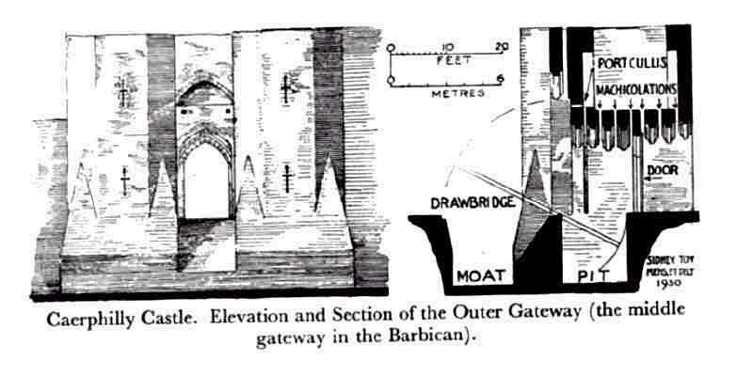
Built for Defense

Slide 4
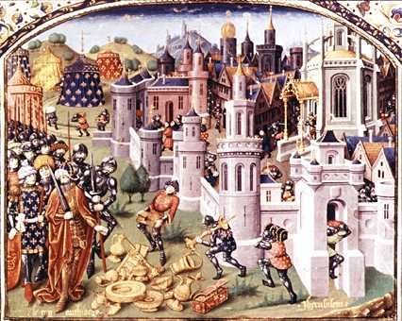
The Crusades- expeditions to “free the holy lands” from the muslims Cruciata means “marked with the Cross”

Slide 5
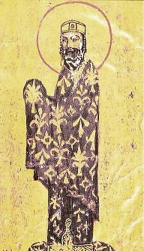
Events Leading to the Crusades
By 1089 Muslims had taken Jerusalem and were threatening the Byzantine Empire (Seljuq Turks)
Byzantine Emperor (Alexius I) asked the Pope (Pope Urban II) for help

Slide 6
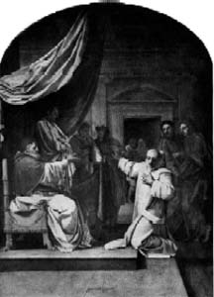
Pope Urban II
Called Knights to become crusaders
Promised the forgiveness of sins, freedom from debt, and choice of fiefs in conquered lands (Primogeniture- inheritance of first-born son)
Knights began organizing
armies

Slide 7
1st Crusade
Began in 1097; Led by Frankish princes and nobles
Had organized army
Captured Jerusalem in 1099 and mercilessly slaughtered Muslims, Jews and even some Christians
Seized land and created the Crusader States on strip of land along the Mediterranean
Most successful of the Crusades and energetic

Slide 8
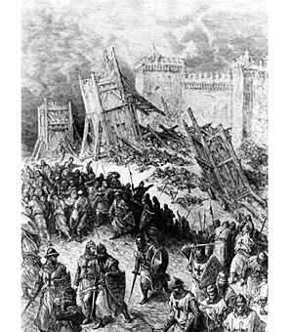
The Capture of Jerusalem

Slide 9
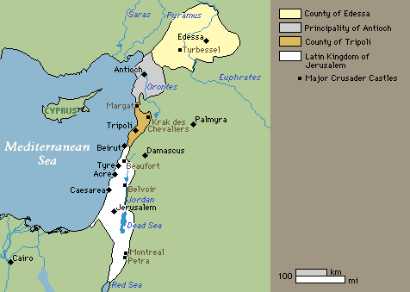
Crusader States

Slide 10
2nd Crusade
50 years after the first (1147)
Brought on by the Muslims attacking the Crusader States and the fall of Edessa
Led by Louis VII
Overall had little success

Slide 11
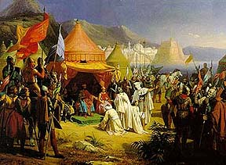
The Third Crusade
Led by Frederick Barbarossa, Phillip of France, and Richard the Lion-hearted

Slide 12
Third Crusade
Began in 1189 AD when Jerusalem was taken by the Muslims
Despite all the fighting, the Crusade failed to recapture Jerusalem
They did however win the right for Christians to visit Jerusalem

Slide 13
The 4th Crusade
1202 AD
Did not fight the Muslims
Captured and sacked Constantinople (fellow Christians)
Set up their own government
Thrown out in 1261 and Byzantine Emperor was restored

Slide 14
Results of the Crusades
Changes in Weapons and Warfare
Political Changes
Weakening of feudalism and growth of centralized government
Expansion of trade (ie spices, silks, precious stones, paper, glassware, foods)
Growth of ideas and knowledge

