Slide 1
Early Civilizations

Slide 2
Characteristics of a Civilization
Production of Surplus food
Some type of government
Specialization of Labor
Calender
Form of writing

Slide 3
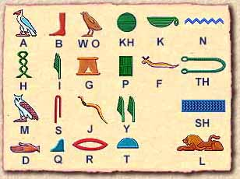
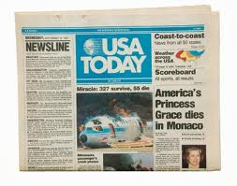
The Key to Understanding History

Slide 4
The Key to Understanding History
“Probably” the single most important advancement in the development of Western Civilization and Culture
The invention of writing (by the Sumerians)
Why??????????

Slide 5
What Is History, and Why?
Historians examine a variety of evidence.
Primary Sources (what are they??)
Examples
Manuscripts
Inscriptions
Statistics
Nonliterary Sources
Archaelogy
Jamestown Dig
Otzi the Iceman

Slide 6
Reliability: How do we know?
Historians must try to distinguish between reliable and unreliable evidence (How?)
Historians use evidence to establish facts or explain the meaning of their findings- (Examples)
A number of factors complicate our efforts to arrive at an accurate understanding of the past.

