Slide 1
Harappans
Early Civilization of the Indus River Valley

Slide 2
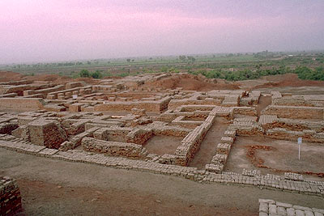
Early Civilization
Arose in the Indus River valley in 2500 B.C.
Flourished during the Bronze Age
Lasted until 1500 B.C.
Much of what we know comes from ruins of two cities
Mohenjo Daro and Harappa
Named after the first of these cities

Slide 3
The Cities
Archaeological digs at Harappa and Mohenjo Daro have revealed much about this civilization.
Both cities were large and carefully planned.
Wide streets crossed at right angles
Each city had a water system with public baths and brick sewers
Some two-story brick homes with bathrooms and garbage chutes
Each city had a citadel, or strong central fortress that was built on a brick platform
Storehouses in Harappa could hold enough to feed 35,000 people.

Slide 4
Drainage

Slide 5
Mohenjo-Daro
Largest of many cities that make up the Indus Civilization
City could have had as many as 40,000 inhabitants
Thought that if there was a capital city, Mohenjo-Daro would have been it.

Slide 8
Harappa
The city of Harappa had a sophisticated drainage system perhaps as early as 6,000 years before the present.

Slide 10
Storage
Ability of Harappan leaders to store and distribute surplus food shows careful evidence of planning
Suggests also that Harappans were threatened by invaders or crop-destroying floods
Indicates that the civilization was organized around a strong, central government.

Slide 12
Economics
In addition to the cities, archaeologists have uncovered many other sites along the Indus River Valley
Among these sites are seaports that give evidence of Harappan trading and commerce
Example: The port of Lothal had an enclosed brick shipping dock that was more than 700 feet long. There was also a gate that made it possible to load ships at high or low tide. At these ports, Harappans exported gold, copper, lapis lazuli, turquoise, timber, ivory, and cotton
Notes:
What does the presence of seaports tell us about this civilization?

Slide 14
Farming
Rich farmlands surrounded Harappa and Mohenjo Daro
Farmers grew cotton, wheat, barley, and rice
They raised cattle, sheep, pigs, and goats
Farmers built canals and ditches to irrigate their farms
Successful farming practices allowed Harappan farmers to raise surplus crops for storage and trade

Slide 15
Trade
City dwellers produced goods for trading
As early as 2300 B.C. they traded with people of the Tigris-Euphrates River valley
Indus River Valley craft workers were able to make many fine goods.
These included cotton cloth, pottery, bronze items, and gold/silver jewelry.

Slide 16
Written Language
Developed a written language, which is evidenced by pictographs.
Scholars have not been able to decipher and read this images
Most of the pictographs that have been found are personal seals that have names of individuals on them.
Writing has been found on clay pots and fragments
Scholars have been unable to connect this writing to any other language

Slide 17
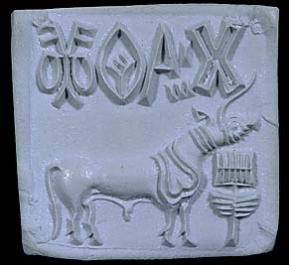
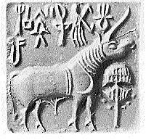
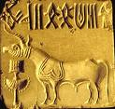

Slide 18
Religion
No temples, shrines, or religious writings have been found
Scholars believe that people worshiped a great god and used images of certain animals
These animals include bull, buffalo, and the tiger
Evidence indicates that a mother goddess symbolized fertility
May have held religious ceremonies in their homes or outdoors

Slide 19
Disappearance
We do not know how or why the Indus River Valley civilization disappeared.
Several reasons exist
Waters of the Indus River Valley have changed course in the past
Floods caused by these shifts destroyed settlements and would have made life difficult for farmers
Possible violence from invading forces also is evident
Major earthquake struck the region around 1700 B.C.

Slide 20
Disappearance
Several unburied skeletons were found in Mohenjo Daro
People abandoned their homes and possessions.
Indicates that some disastrous event occurred, but there is no evidence to support this theory.

Slide 21
Websites
http://www.mohenjodaro.net/Mohenjo-daroVSarea15.html
http://www.harappa.com/indus5/page_410.html

