Slide 1
What is meant by “ethical”?
Create your own definition.
List a set of Guidelines for Judeo-Christian ethics and behavior.

Slide 2
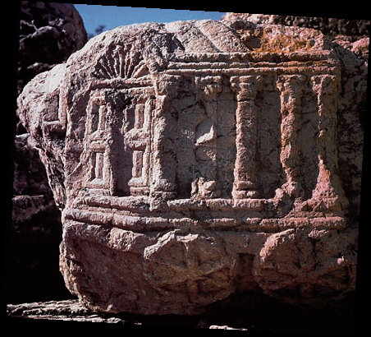
The Children of Israel

Slide 3
Political History of the Hebrews
The only source for much of the History of the Hebrews is the Bible (Why is this a problem??)
Moses led the Hebrews out of Egypt and into Palestine in the 13th Century BC (Exodus)
Think about other times in history where people were kept as slaves. Why did this exist? How did people free themselves?
Saul established a monarchy over the twelve Hebrew tribes.

Slide 4
Saul’s work was carried on by David and his son Solomon
After his death, Solomon’s kingdom broke into two halves: Israel and Judah.
Israel was wiped out by the Assyrians and Judah was conquered by the Babylonians (Diaspora)

Slide 5
The Evolution of Jewish Religion
The Covenant was a kind of contract between Yahweh and the Hebrews
Yahweh was the Jew’s only god (monotheism). Emphasized proper conduct→ Ethical Monotheism
The 10 Commandments were a step in the evolution of Hebrew Law (see page 45)
The Hebrews had a very different understanding of the nature of the divine than the Mesopotamians.
Religious leaders were important in in Judaism but not as important as the sacred texts they interpreted.
1st 5 books of the Bible→ Torah

Slide 6
Family Life in Israel
As the Hebrews moved from nomadism to settled agriculture, common ownership of land gave way to family ownership.
The development of urban life created new economic opportunities.
Social and economic developments prompted the compilation of the Torah and the Talmud.

Slide 7
Don’t Forget
Test Monday

