Slide 1
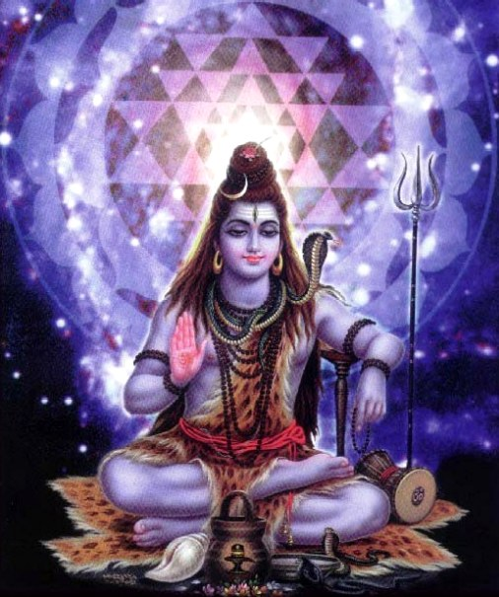
Hinduism and Buddhism
World History I

Slide 2
Overview
Hinduism is one of the World’s Oldest Religions
Native religion in India
Predates recorded history and has no human founder
Almost 1 billion Hindus around the world
(1 out of every 6 people in the world are Hindus

Slide 3
The Beginnings
Hinduism developed with the questioning of the Brahmins (priests of the Indo-Aryans)
Upanishads→ written explanations of the Vedic religion for the common person
Mahabharata and Ramayana are two epic poems that teach those who can’t read
Bhagavad Gita: one of the most famous Hindu epics- most famous of Hindu Scripture

Slide 4
Regarding God
Hinduism acknowledges the existence of many deities
Believes in only one Supreme God who is all-pervasive and transcendent (monism)
Maya- Hindu belief that the world we see is an illusion; maya is this illusion and if maya is accepted then salvation is impossible. Maya must be recognized and rejected.

Slide 5
Regarding Atma(soul)
Hindus believe that all living entities have a soul
Hinduism propounds the law of karma, cause and effect, wherein the fruits on an individual’s thoughts, words, and deeds are given by God.
ãtmã passes through infinite cycles of birth and death (reincarnation) until it realizes God and attains moksha.

Slide 6
Hindu Beliefs
Dharma – to live righteously - purity of diet, thought, and social interactions.
Kharma- good or bad force created by ones actions
Moksha- salvation
Reincarnation- cycle of birth, death, and rebirth
Nirvana- perfect peace

Slide 7
Hindu Beliefs: Ahinsa
Ahinsã is non-violence.
It encompasses respect and consideration for life and peaceful, harmonious living.
Ahinsã is the feeling that attempts to reduce harm to all living creatures.
Ahinsã is meant to be practiced by:
thought - not having thoughts of ill-will towards others
word - not using speech to slander or malign others
deed - not performing violent physical actions

Slide 8
Hindu Beliefs: Ahinsa and Self-defense
Ahinsã is the feeling that tries to reduce harm to all living creatures.
Sometimes, force or violence may in fact be necessary to prevent harm.
Suppose a train is heading towards a child who is standing in the middle of railroad tracks. We would be inclined to push the child out of the way to save his or her life.
Ahinsã recognizes the right to defend one’s self, family, community, and country through the most feasible and appropriate, yet least violent, means necessary.
However, defending oneself should never be used to justify violence that is not provoked or warranted.

Slide 9
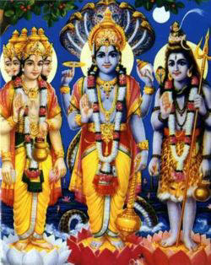
Hinduism Beliefs
Brahman→ Hindu God
-Brahma: creator
-Vishnu: preserver
-Shiva: destroyer
Notes:
Maya- Hindu belief that the world we see is an illusion; maya is this illusion and if maya is accepted then salvation is impossible. Maya must be recognized and rejected
Reincarnation- rebirth of souls; souls don’t die, but soul is reborn into another form
Dharma- one’s moral duty in this life so that the soul can advance in the next life
Karma- good or bad force created by a person’s actions; people who fulfill their dharma gain good karma and are born into a higher social group in the next life, however people who do not live moral lives will be born into a lower class or as a animal
**Do any of you believe in karma?
Nirvana- a point in which the soul reaches perfect peace spiritually; at this point the cycle of reincarnation is complete and the soul reuniteds with Brahman
**Hindu belief stresses an importance on respect for all forms of life
Practices:
-yoga= set of mental and physical exercises designed to bring the body and soul together; frees the mind of thoughts about the body
-festivals/celebrations
-sacred animals= cows are protected by law (provide pwer for plows and carts and produce milk and butter for food)

Slide 10
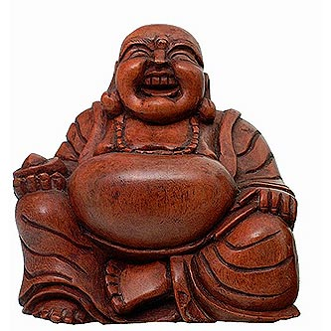
Buddhism
One of world’s great religions
Founded by Siddhartha Gautama-who will later be known as “Buddha” which means “the Enlightened One”

Slide 11
Sidhartha Gautama
Indian prince that lived a sheltered life
According to legend, while on a journey he saw an old man, a sick man, a poor man, and a corpse. Distressed at the suffering in the world, Gautama left his family to seek enlightenment.
Spent time trying various ways to reach enlightenment. Finally, sat beneath a tree and vowed not to move until he had attained enlightenment. Days later, he arose as the Buddha - the "enlightened one.“ Spent the remaining 45 years of his life teaching the path to liberation from suffering (the dharma).

Slide 12
Buddhism Beliefs
The Four Noble Truths
1. All human life involves suffering & sorrow
2. Desire for a life of pleasure & material gain causes suffering & sorrow
3. Renouncing desire frees people from suffering & helps their souls attain nirvana
4. The Eightfold Path leads to renunciation or denial of desire & attainment of nirvana

Slide 13
Buddhism Beliefs
The Eightfold Path
-Right Views
-Right Intentions
-Right Speech
-Right Action
-Right Living
-Right Effort
-Right Mindfulness
-Right Concentration

Slide 14
The Followers
Theravada Buddhism
Buddha is a great teacher/leader
atheistic and philosophical in nature
focuses on monastic life and meditation as means to liberation.
Mahayana Buddhism
Buddha is a god and savior;
prominent in China and Japan
incorporates several deities, celestial beings, and other traditional religious elements.
In Mahayana, the path to liberation may include religious ritual, devotion, meditation, or a combination of these elements

Slide 15
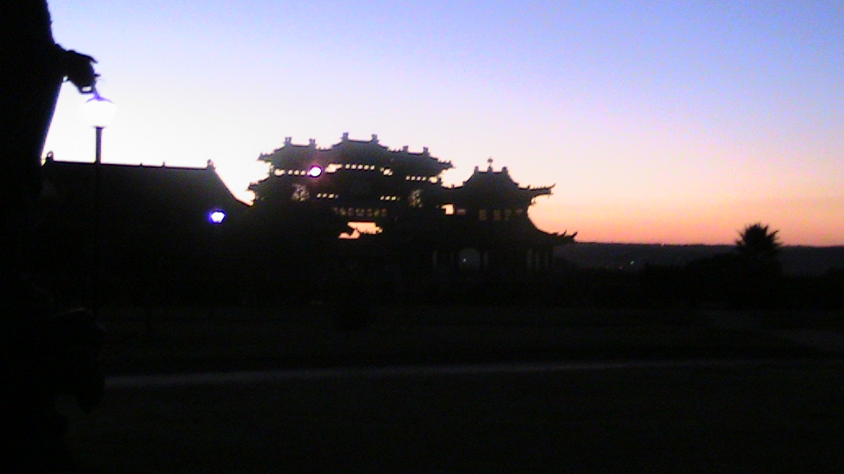

Slide 16
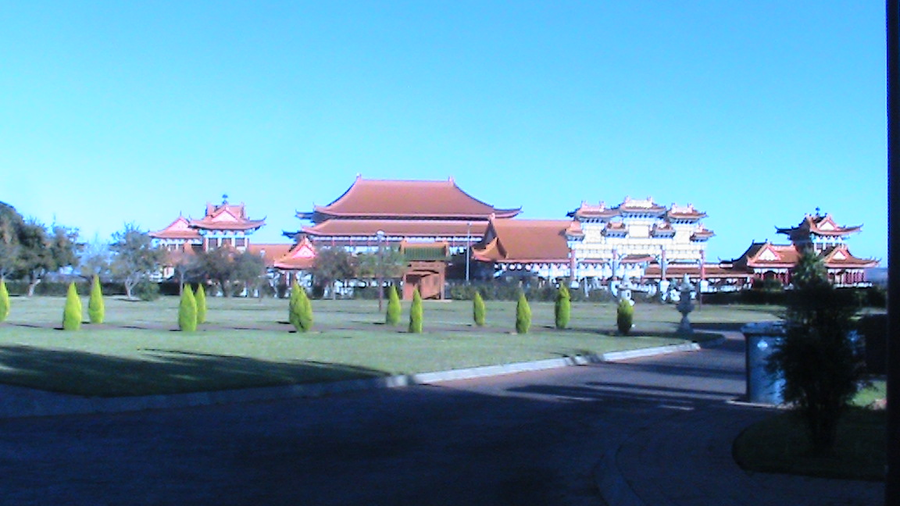

Slide 17
