Slide 1
Chapter 4
The Hellenistic World, 336–146 B.C.

Slide 2
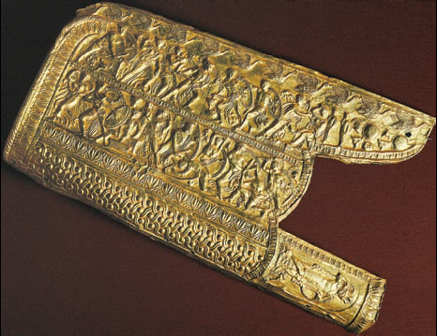
This gilded case for a bow and arrows indicates that Alexander’s success came at the price of blood.
Archaeological Museum Salonica/Dagli-Orti/The Art Archive

Slide 3
Alexander and the Great Crusade
Alexander proclaimed the invasion of Persia a great crusade.
Alexander won three major battles at the Granicus River, Issus, and Gaugamela.
After his defeat of the Persians, he led his forces as far east as the Indus River.
After hard fighting at the Hyphasis River, his troops refused to go further.
Alexander died in Babylon in 323 b.c.

Slide 4
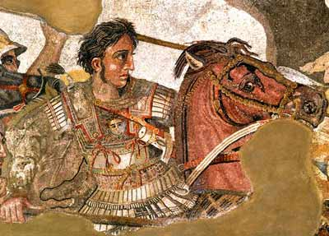

Slide 5
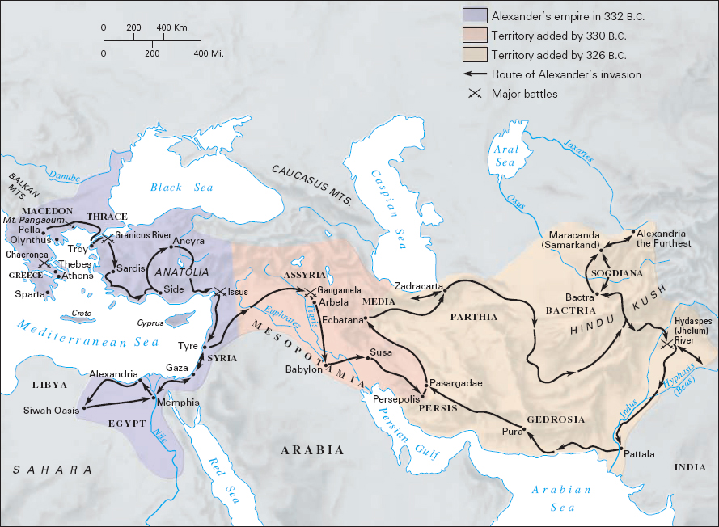
This map shows the course of Alexander’s invasion of the Persian Empire and the speed of his progress. More important than the great success of his military campaigns was his founding of Hellenistic cities in the East.

Slide 6
Alexander’s Legacy: Political
After Alexander’s death and the murder of his son, his empire was broken up into several kingdoms and leagues.
City-states were replaced by larger political units.
The Hellenistic period was marked by almost constant warfare.

Slide 7
The Spread of Hellenism
The development of new kingdoms brought with it the resurgence of monarchy.
The concept of monarchy, however, never replaced the ideal of the polis.
The Hellenistic city differed from the old Greek polis.
It was not self-governing.
It was not as culturally homogenous as the old polis.

Slide 8
Alexander’s Legacy: Cultural
Alexander’s cities and colonies spread Greek culture throughout Asia Minor and even into India.
Greek theaters, temples, and libraries sprang up throughout the Mediterranean world.

Slide 9
Men and Women in Hellenistic Monarchies
Hellenistic kingdoms offered Greeks many employment opportunities as soldiers and officials.
Greeks played key roles in the governments of Hellenistic cities.
Greeks were recruited to bring Greek art and culture to Asia.
Women began to participate more in political and economic life.
Armies were professionalized.

Slide 10
Greeks and Easterners
Greek culture spread among Eastern elites, but not the masses.
The vast majority of Hellenized Easterners took only the externals of Greek culture, while retaining essential aspects of their own ways of life.

Slide 11
Hellenism and the Jews
The relationship between Greeks and Jews illustrates this trend.
Hellenism and Judaism usually met on friendly terms.
Few Jews became citizens, preferring to follow their own religion rather than worship the gods of the city.

Slide 12
The Economic Scope of the Hellenistic World
Commerce
Industry
Agriculture

Slide 13
Commerce
The East was brought into the Greek sphere of economics.
Alexander’s conquests developed trade routes with India and Italy.
The Greeks sent their oil, wine, and fish to the north shore of the Black Sea in return for grain.
The slave trade flourished.

Slide 14
Industry
Hellenistic agriculture and industry underwent significant changes.
There were few industrial innovations in the Hellenistic Age.
a) The inventions of mathematicians and other thinkers failed to produce corresponding technological innovations.
b) Cheap labor left little motivation for innovation.

Slide 15
Agriculture
Hellenistic kings paid special attention to agriculture.
Much of their revenue was derived from the produce of royal lands.
Some kings sought out and supported agricultural experts.

Slide 16
Hellenistic Intellectual Advances
Religion in the Hellenistic World
Philosophy and the People
Hellenistic Science
Hellenistic Medicine

