Slide 1
The Origins of Judaism
Section 6

Slide 2
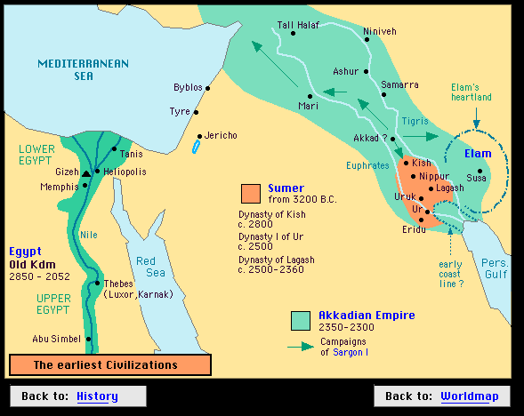
History
Canaan
Abraham
Sumer
Led his people to Northern Canaan
Jacob (Israel)
Abraham’s Grandson
12 Tribes of Israel

Slide 3
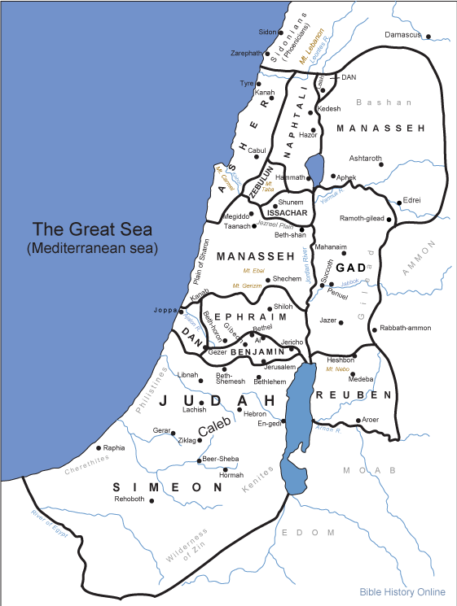

Slide 4
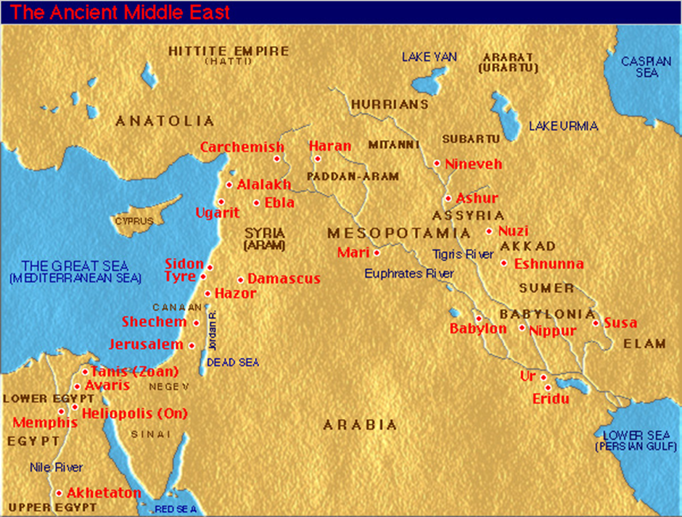
Exodus
Left Canaan
Escape drought and famine
Peaceful
Expelled
Enslaved for 400 years

Slide 5
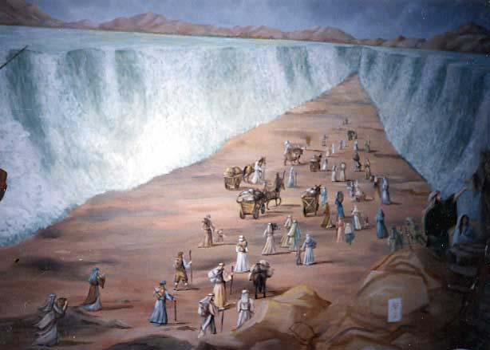
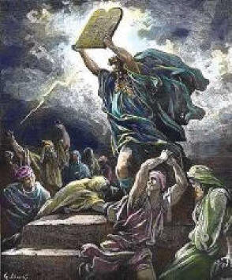
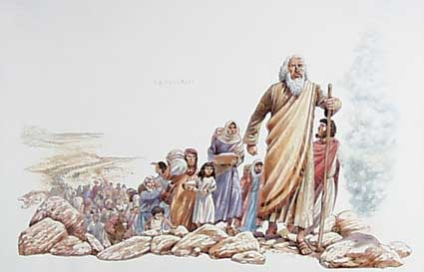
Moses & The Exodus
Moses led the Exodus (escape of Hebrews from Egypt)
Mount Sinai
10 Commandments
Yahweh
Covenant – Solemn agreement
Canaan was promised to their ancestors

Slide 6
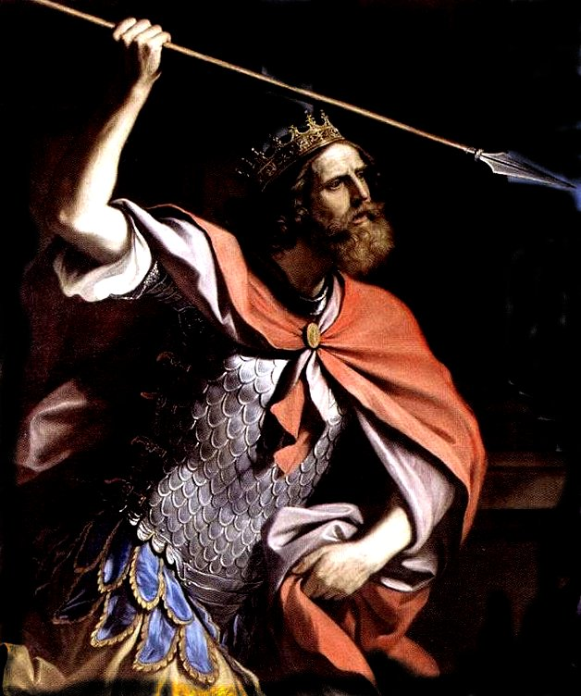
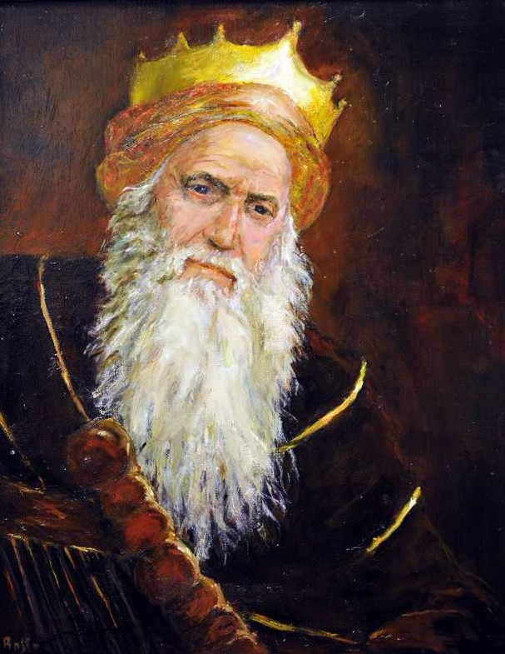
Israel
Nomads for 40 year
12 Tribes
Saul
First to unite the kingdom
David
Capital Jerusalem
Solomon
Trade with Arabia
Incredible Wealth

Slide 7
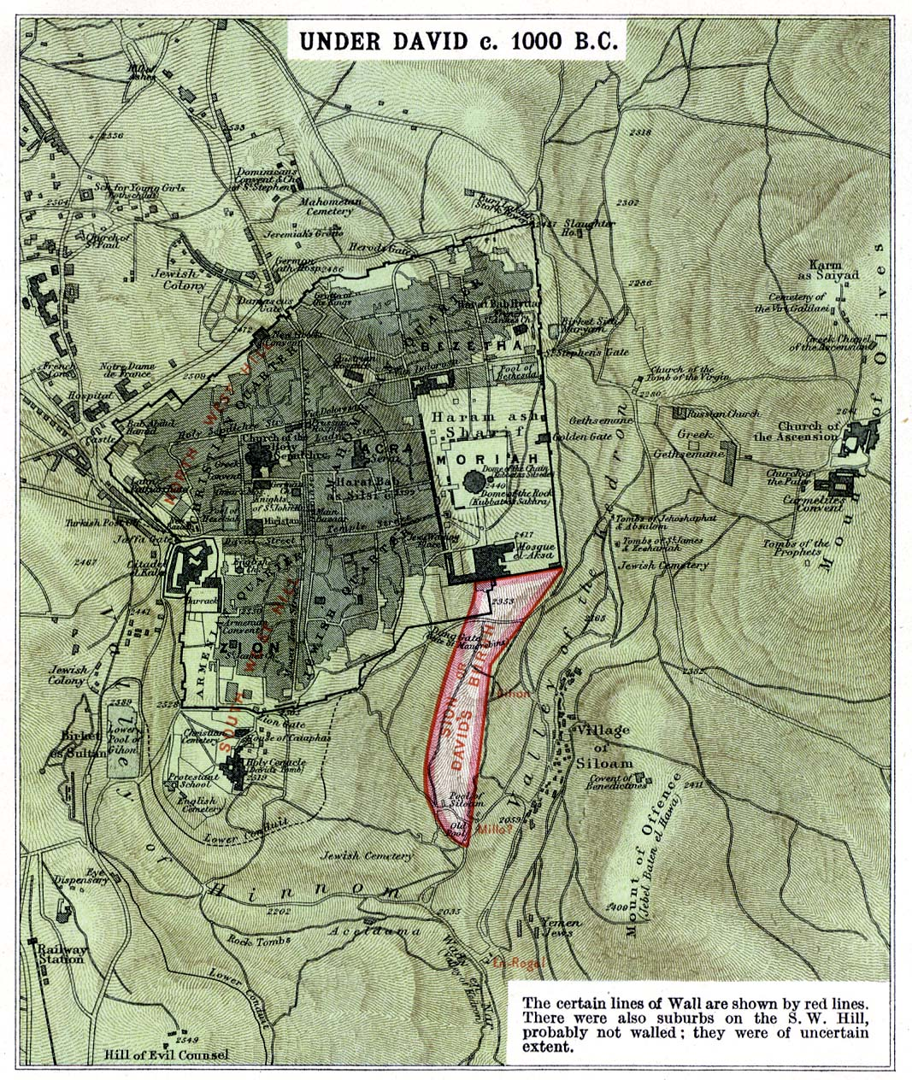

Slide 8
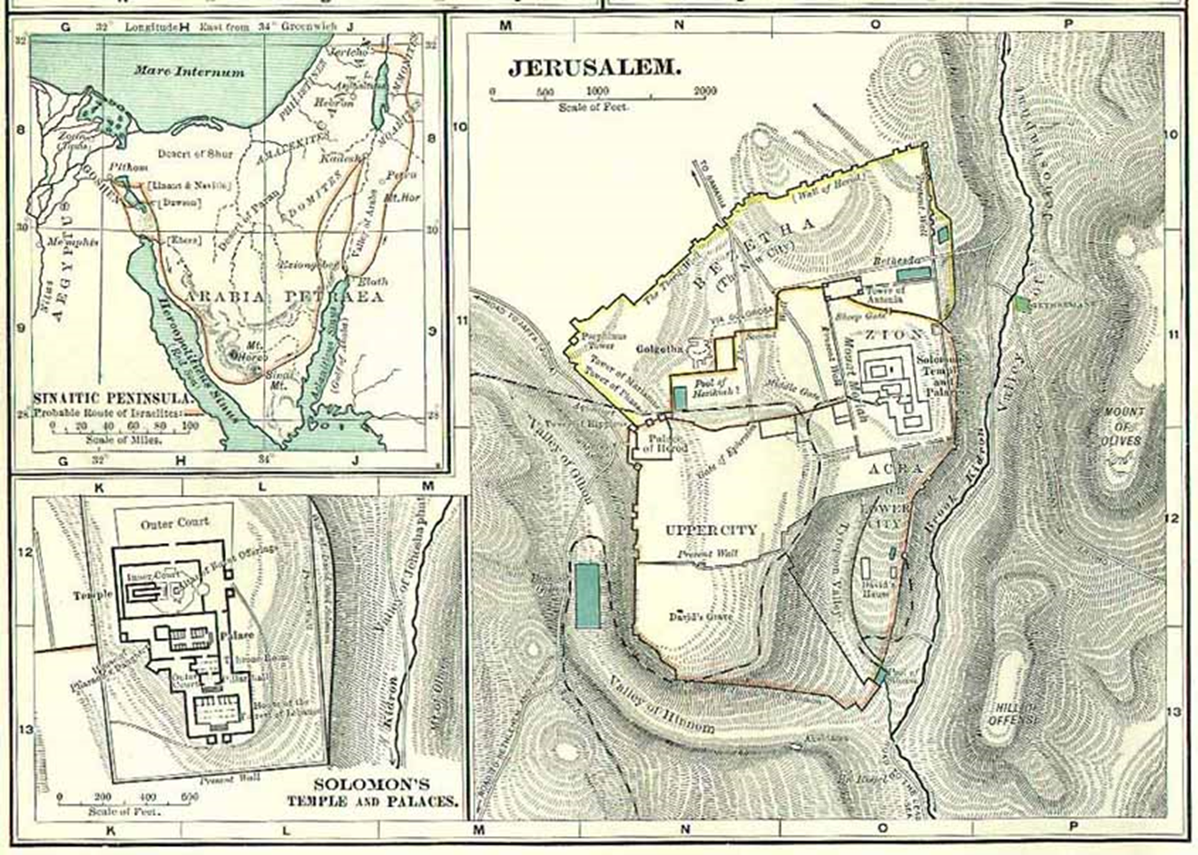

Slide 9
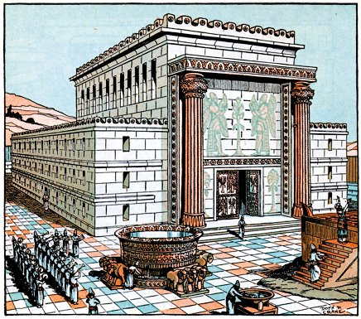

Slide 10
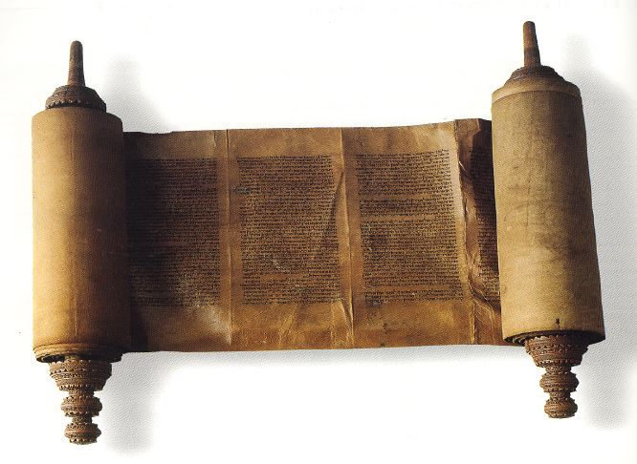
Religion
1st 5 books of the Bible -> Torah
Monotheistic – Yahweh
Ethical Monotheism Emphasized proper conduct
Different understanding of religion than the Mesopotamians
Yahweh lived in the hearts of worshippers, not slaves, but serve Him out of love
Other’s gods were more powerful than humans but has some human qualities
Yahweh was spiritual
Leaders had no claims to divinity

Slide 11
Don’t Forget
Test Monday

