Slide 1
The Church of the 16th Century

Slide 2
Dominance
Spiritual
Political
Economical
Military
Artistic

Slide 3
Abuses
Simony
Focus on Gaining Wealth
Moral Decline
Selling of Indulgences

Slide 4
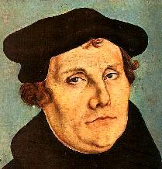
Martin Luther
1483-1546

Slide 5
Early Life
Born in Eisleben on Nov. 10th, 1483

Slide 6
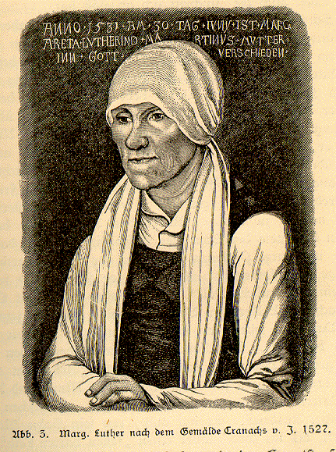
Parents
Father: Hans Luther, a saxon miner who became a mine foreman. He wanted what was best for his son. Pushed him to become a lawyer.
Margareta Luther, Martin’s mother who died in 1531.

Slide 7
Luther’s Turn to Religion
Luther attended Law School to please his parents.
Began to study law in 1505
Narrow escape of death in July of 1505
Enters the monastary
Is ordained in 1507
Attends the university of Wittenberg and receives his doctorate in 1511

Slide 8
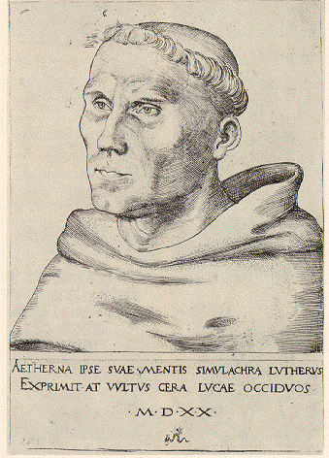
Self-Doubt
Obsessed with salvation
Felt he was not “good enough” and would suffer for his sins.
Tried a variety of methods to “win” forgiveness.
Joining monastary
Prayer
Pilgrimage
Self-flagellation

Slide 9
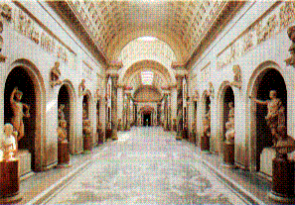
Pilgrimage to Rome- 1510

Slide 10
Study of the Bible
Study of the bible is the center of his work
Focused on the writings of St. Paul
Found his teachings started to diverge from the teachings of the Church
Came to a realization when he read passages in the bible that indicated man had no power over his own salvation- only God had that power.

Slide 11
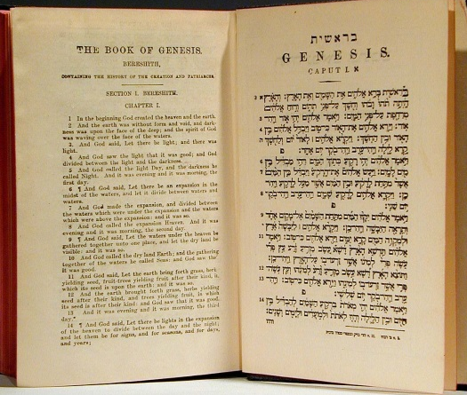
Rom 3:28: "We maintain therefore that a man is justified by faith apart from the works of the law."
Rom 5:1-2: "Being therefore justified by faith, we have peace with God through our Lord Jesus Christ; through whom we also have our access by faith into this grace in which we stand….”
Gal 2:15-16: “We, being Jews by nature, and not Gentile sinners, yet knowing that a man is not justified by the works of the law but through faith in Jesus Christ, even we had to become believers in Christ Jesus, that we might be justified by faith in Christ, and not by the works of the law, because no one will be justified by the works of the law.”
Gal 3:11-12: “Now that no man is justified by the law before God is evident for ‘The righteous will live by faith.’ The law is not of faith but ‘The man who does them will live by them.’”

Slide 12
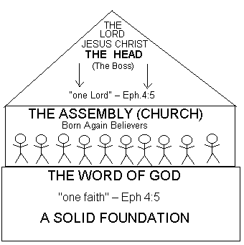
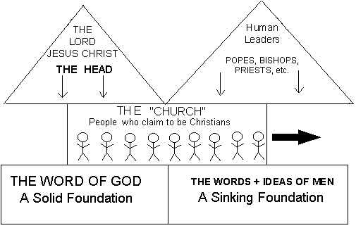
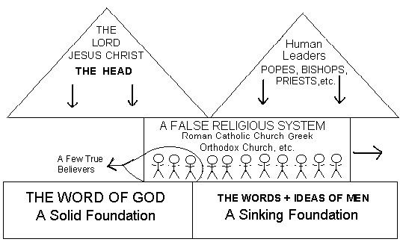
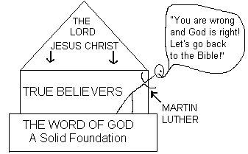
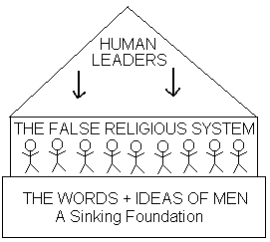
The Problem of Authority
Luther’s discovery uncovered the problem of authority. Is the Bible the sole basis for religious authority (as Luther claimed) or are the Bible and Church tradition the basis for authority (as the Roman Catholic Church claimed)? Here’s how one Protestant denomination today characterizes Luther’s contribution to Reformation theology:

Slide 13
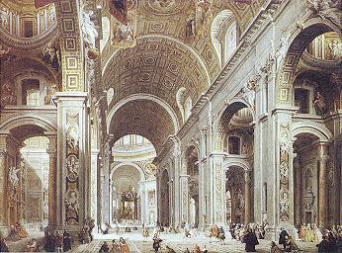
Sale of Indulgences
Indulgences- a forgiveness of sins through a donation to the church
A practice abused by the church and used as a fundraiser to help Pope raise money for his cathedral.
One of the Pope’s salesmen was Johann Tetzel, a man very good at his job.

Slide 14
Johann Tetzel(1460-1519)
Preacher and salesman of papal indulgences.
He combined the elocutionary gifts of a revivalist orator with the shrewdness of an auctioneer.
He painted in lurid colors the terrors of purgatory, while he dwelt on the cheapness of the indulgence which would purchase remission and his prices were lowered as each sale approached its end.
He hid himself in the Dominican convent at Leipzig in fear of popular violence, and died there on the 4th of July 1519.

Slide 15
Posting of the 95 Theses
A member of Luther’s congregation asks Luther about indulgences that Tetzel is selling
Luther states that Tetzel is wrong and asks him to stop this in his congreation
Tetzel continues and Luther posts 95 Theses to the Church door in Wittenberg

Slide 16
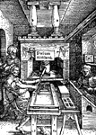
Controversy Spreads
Luther’s intent is to REFORM (or fix) theses problems in the Church- NOT to create a new religion
Reason this controversy spreads from a theological dispute between two rival monks is the printing press.
Luther’s ideas (95 Theses) are printed and posted in German- common people read them and are influenced by them

Slide 17
Diet of Worms
Luther, who through the church's excommunication was practically declared a heretic, was invited to Worms by the Emperor. Both the church and Emperor wanted Luther to recant his teachings while he was there. The princes who supported Luther hoped that through the forthcoming events the political power of Rome over Germany would be weakened.

Slide 18
Diet of Worms
Luther began his trip to Worms on April 2, 1521.
He arrived in Worms on April 16 and was also cheered and welcomed by the people.

Slide 19
Break from the Church
Luther refuses to recant: "Unless I am convinced by Scripture and plain reason - I do not accept the authority of the popes and councils, for they have contradicted each other - my conscience is captive to the Word of God. I cannot and I will not recant anything for to go against conscience is neither right nor safe. God help me. Amen."

Slide 20
Escape
When Luther lleft Worms, the emperor imposed an Imperial Act: Luther is declared an outlaw (he may be killed by anyone without threat of punishment).
On the trip home, Elector Friedrich the Wise allowed Luther to be kidnapped on May 4 (Luther knew about it beforehand). This took place on the one hand to guarantee Luther's safety and on the other hand to let him disappear from the scene for a short while; there were even rumors of Luther's death. This action also helped the Elector not to endanger himself because he could have been held liable for protecting an outlaw and heretic.

Slide 21
ISSUE | MEDIEVAL ROMAN CATHOLIC CHURCH | MARTIN LUTHER
Salvation | Faith plus good works required for salvation | Faith alone the basis for salvation
Religious authority | Religious authority rests with the Church | Bible is the basis for religious authority
Man’s relationship to God | Church served as intermediary between God and man | Priesthood of all believers (no intermediary required)
Sacraments | Baptism, penance, Holy Eucharist, Confirmation, Marriage, Holy Orders. Extreme Unction Sacraments, dispensed by the Church, are essential for salvation | Baptism, Holy Eucharist
Communion | Transubstantiation: Process whereby the bread and wine is transformed into the body and blood of Christ | Consubstantiation: Process whereby the bread and wine and the body and blood of Christ are both present
Calling | Limited to religious vocations | Broader concept of calling made secular life respectable
Church government | Hierarchical (Pope, cardinals, archbishops, priests, laymen) | Challenged papal authority
Civil government | Church has authority in religious matters; state has authority in temporal matters. If there is a conflict, Church authority takes precedence. | Denied the right of rebellion (e.g., the Peasants Revolt)

Slide 22
DOCTRINAL DIFFERENCES BETWEEN PROTESTANTS AND CATHOLICS
PROTESTANTS | CATHOLICS (COUNCIL OF TRENT)
JUSTIFICATION BY FAITH: Christ's sacrifice atones for all sins, and it is only necessary to believe in it to be saved. There is nothing humans can do by their own efforts to add or detract from it. | Both FAITH AND GOOD WORKS (acts of devotion, charity, the sacraments, etc.) are necessary for salvation.
The PRIESTHOOD OF ALL BELIEVERS: All believers have equal access to God and no other earthly intermediaries are needed. This does not mean that the flock does not need teachers, but there are no special sacramental functions belonging to any particular class. | The CATHOLIC PRIESTHOOD is necessary as only priests can perform the sacraments necessary for spiritual health and correctly interpret the meaning of scripture.
The SCRIPTURES AS THE ONLY SOURCE OF TRUE DOCTRINE: Studying and understanding the scriptures is therefore important to all believers. Translating the Bible into the vernacular tongues and making it available to all is essential. | SCRIPTURE IS ONLY ONE WAY IN WHICH DOCTRINE IS REVEALED. The decisions of church councils, encyclicals from the Pope, tradition, etc., are all part of it. Only the priesthood of the church can correctly interpret the meaning of scripture. Do not try this at home.
The LORD'S SUPPER IS SYMBOLIC and the body and blood of Christ are not physically present. To believe otherwise is to commit idolatry. | The EUCHARIST IS A MYSTERY in which the sacrifice of Christ is reenacted; the bread and wine become spiritually transformed into the true body and blood of the Lord.
NO HEAVENLY INTERMEDIARIES ARE NEEDED to intercede with God. Although the Virgin Mary, saints, and angels are all in heaven, they should not be the objects of prayer or veneration. The making of images encourages idolatrous worship that should be directed at the more abstract concept of God. | Although the saints and angels should not be worshipped, their INTERCESSION IS VALUABLE AND NECESSARY to helping the Christian to achieve salvation. The Virgin Mary is especially honored by God, and should be also by believers. Religious images should not be worshipped, but they help to inspire devotion. (These fine points were often lost on the average peasant.)
God's foreknowledge and omnipotence mean that EVERYONE IS PREDESTINED TO THEIR FATE: either to be or not to be one of the elect. Human action avails nothing. | GOD'S OMNIPOTENCE DOES NOT RESTRICT HUMAN WILL, and each individual is still responsible for earning their own salvation.
The Bible only documents TWO SACRAMENTS: BAPTISM AND THE LORD'S SUPPER (so called to distinguish the Protestant practice from the Catholic Eucharist) | There are SEVEN SACRAMENTS: Baptism, Holy Eucharist (see above), Penance (confession/ absolution), Confirmation, Marriage, Holy Orders, Extreme Unction (last rites). Of these, Baptism can be performed by anyone in an emergency and marriage (a historical newcomer to the list) is technically bestowed by the two partners on one another. All the rest can only be performed by a priest or bishop

Slide 23
Luther Meets Katherine Von Bora
Martin Luther found peace when he married an ex-nun named Katharine von Bora, whom he had helped to escape from her convent in an empty fish barrel and had taken refuge in Wittenberg.

Slide 24
Katharine von Bora
Katharine von Bora was born in 1499, the daughter of an impoverished nobleman.
In 1504 she went to a convent school
She entered the convent in 1508.
In 1515 she took her vows and became a nun
In 1523 she left the convent and ended up in Wittenberg.
By June 1525, echoing a trend across Europe as former nuns and monks married, she became Mrs Martin Luther.

Slide 25
Married Life for Luther
Katharine was 16 years younger than Martin
together they had six children.
Luther doted on his large family but was able to devote himself to the simpler pleasures of life, gardening, writing music.
Katharine took over the household, particularly the household expenses;
Luther's household included not only his wife and six children, but also one of Katharine's relatives and after 1529 six of Luther's sister's children. Luther also housed students in his home to help the family's financial situation.

