Slide 1
Taking notes is a key part of the research process because it helps you learn, and allows you to see your information in a useful visual way

Slide 2
There are as many ways to take notes as there are people. Everyone has a slightly different method. Some prefer to type notes on a computer, some choose to use notecards, and others like a good ‘ol pen and paper. The specific tool you use to take your notes isn’t as important as the notes themselves. Choose the method that’s the most comfortable for you.

Slide 3
Things that all good notes systems will allow you to have:
Information about the source so you can find it again – You’ll want to write down the author, title, date published, publisher, and URL (if it’s a website).
A way to group notes – You’ll want to be able to organize your notes in a visual way so you can arrange them in an order that makes sense.
Spaces for you to write down quotes (direct text straight from the source), comments (your thoughts and questions), and paraphrasing (information from the text in your own words).

Slide 4
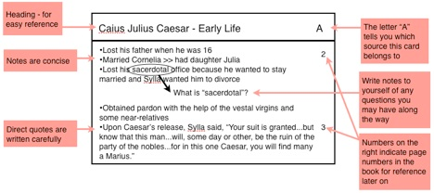

Slide 5
Skim your entire source before you read it in detail. Skimming will help you understand how the document is laid out and what the main ideas are.
Search for the subject headings in the material you’re reading and write them in your notes. They’ll help you find relevant information faster, and they’ll provide you with reference points when you review your notes later.
Write down every fact or note that may be of use to you in your paper. Don’t write down things you already know or would never include in your finished work.

Slide 6
Break down the text into small groups of paragraphs. Read each group one-by-one, taking notes between groups. Breaking up the text into smaller, bite-sized pieces will help you process the information.
Don’t write down information from the text word-for-word. This takes too much time and prevents you from using your higher brain functions to filter out and process important information.
If a source is too dense or has too many dates, don’t feel like you need to write every bit of information down. Make a note of where the dense parts are and move on.

Slide 7
