Slide 2
What Happened to Pompeii?
Destroyed by a volcano in 79 AD
Many of the people died by inhaling poisonous gases (although evidence now suggests many died from high temperatures).
The town itself was not touched by hot lava but covered by ashes and pumice stones

Slide 3
How do we know so much about the people there?
Pompeii was well-preserved under the ash
It remain untouched for 100’s of years
Care was taken to preserve the city

Slide 4
How does this knowledge benefit us?
It shows how ordinary life was for people during this time
It gives insight to their lives

Slide 5
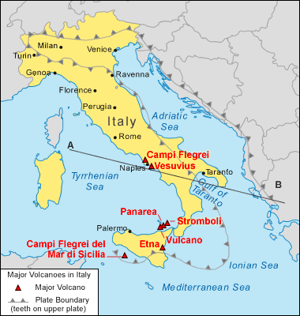

Slide 6
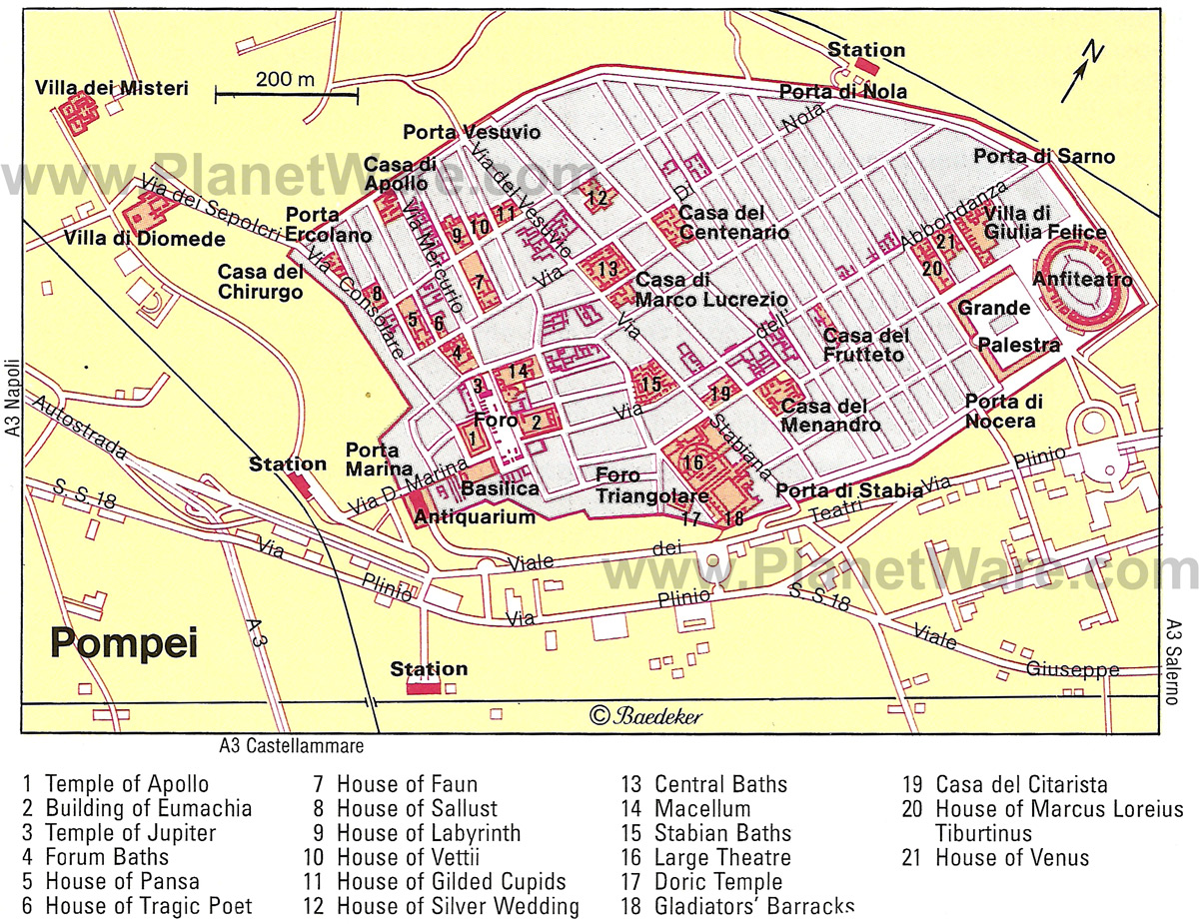

Slide 7
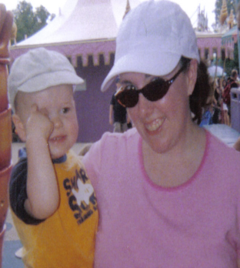

Slide 8
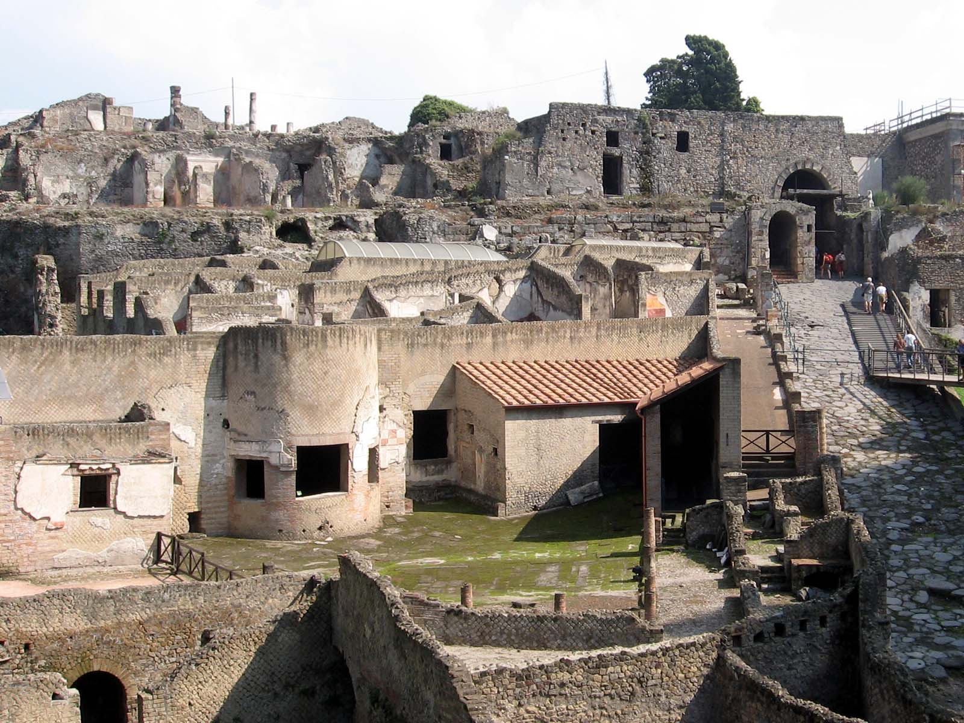

Slide 9
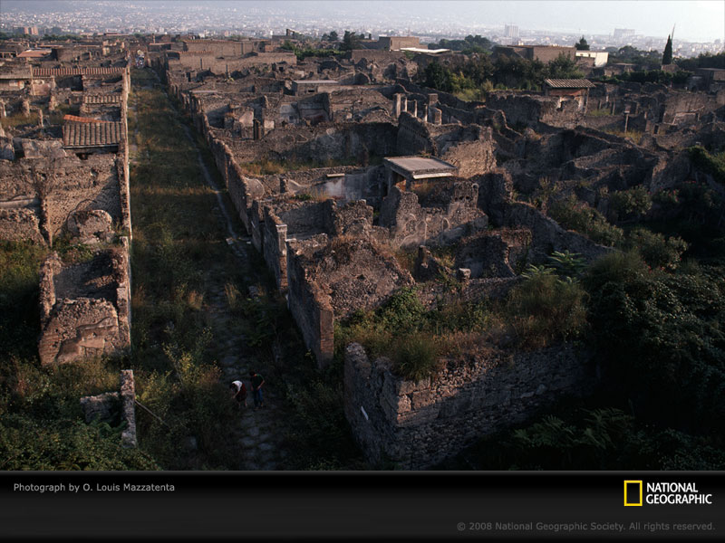

Slide 11
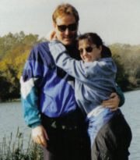

Slide 13
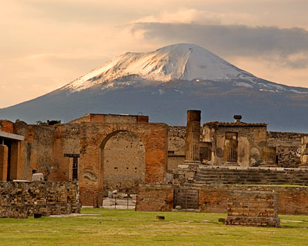

Slide 14
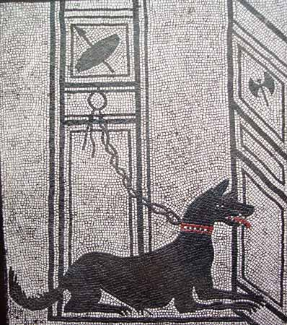

Slide 15

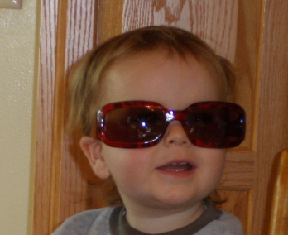

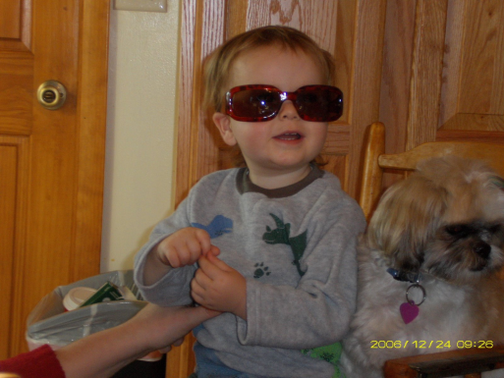

Slide 22
Definitions
Archeology- the study of a culture, usually prehistoric, through the remains left by ancient humans
Hominids- early human and humanlike creatures
Artifact- object made/used by man
Culture- the way of life of a group of people

Slide 23
Limited Evidence- evidence, such as artifacts, about which little evidence is given, requiring scientists to make educated guesses
Nomads- people who wander from place to place
Agriculture- the raising of crops for food

Slide 24
Domestication- the taming of animals such as cattle, goats, sheep, and pigs
Hunter-Gatherers- early people who went out and hunted animals for food and gathered plants
Donald Johanson- led a team in Ethiopia that found one of the earliest remains of a hominid skeleton which was named “Lucy”
Mary Leakey- anthropologist that found parts of a skeleton dating back 3.7 million years

Slide 25
Neanderthals- early homo sapiens that lived during the old stone age; buried their dead
Cro-Magnons- group of early people appearing about 35,000 years ago in Europe; famous for their “cave paintings”
Neolithic Agricultural Revolution- long gradual shift from food gathering to food producing

Slide 26
Notes
When does “History” begin??
  History begins with a cultures written records. However, written history is relatively new (5000 years) that information of earlier cultures is obtained from archaelogical methods
What information can be learned from archaeology?
  What people ate
  Size of families
  Types of jobs
  Health of people
  wealth

Slide 27
What methods do archaeologists use to date sites??
Stratigraphy- the layering of deposits; the order of deposits is used as a means of dating (relatively) the layers as well as the contents of the layers

Slide 30
Radiocarbon Dating-
  All living things absorb carbon when they are alive. After they die they stop absorbing carbon. Carbon has a ½ life of 5730 years, which means half of it will “decay” in 5730 years. Scientists can measure this rate to find out how old an object is.
  Two problems—1)only measures organic objects; 2) very inaccurate after 40,000 years

Slide 31

Neanderthal
130k-35k years ago
Animal skins
Fire for warmth and cooking**
Improved tools
Buried their dead (with food and tools)**

Slide 32
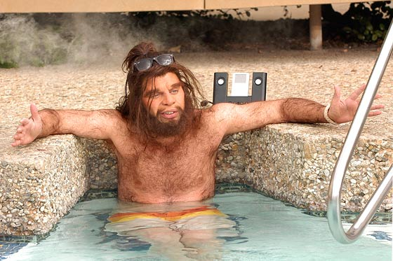
Cro-Magnons
35,000-10,000 years ago
Better weapons and tools
Artwork (caves)
What happened to them??

Slide 33
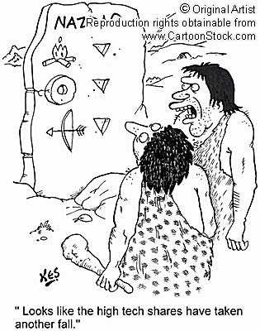
Stone Age

Slide 34
Stone Age
Begins with the development of tools
Began 2.5 million years ago
Divided into three parts
  Paleolithic
  Mesolithic
  Neolithic

Slide 35
Paleolithic
Means “old stone age”
From about 2.5 millions years ago to about 12 thousand years ago

Slide 36
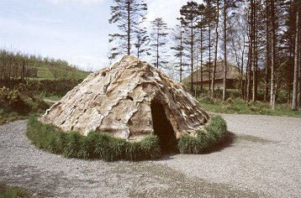
Mesolithic
Means “middle stone age”
Lasted 12k to 10k years ago
Elements of this period include:
  Use of bow and arrow
  Fishhooks, fishspears, and harpoons
  Taming of dogs

Slide 37
Neolithic
Means “new stone age”
Lasted from about 10k to 4k years ago
Elements of this period include:
  Stone tools made by polishing and grinding instead of chipping
  Specialized tools
  Agriculture and domestication of animals

