Slide 1
Chapter 1
Origins, CA 400,000–1100 B.C.

Slide 2
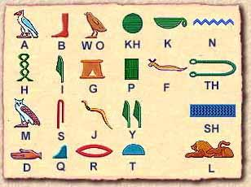
The Key to Understanding History

Slide 3
The Key to Understanding History
“Probably” the single most important advancement in the development of Western Civilization and Culture
The invention of writing by the Sumerians
Why??????????

Slide 4
The Invention of Writing and the First Schools
Writing appears to have begun at Sumer
Sumerian pictographic form evolved by the fourth millennium into cuneiform writing.
The writing system was so complicated that only professional scribes mastered it
Scribal schools flourished throughout Sumer
These schools were also centers of learning set the standard for all of Mesopotamia.

Slide 5
Understanding Western History
Describing the West
The “West” as a concept has a very long history, one that began with the Greeks and Romans.
Greco-Roman ideas about the West were passed on to people who lived in western and northern Europe.

Slide 6
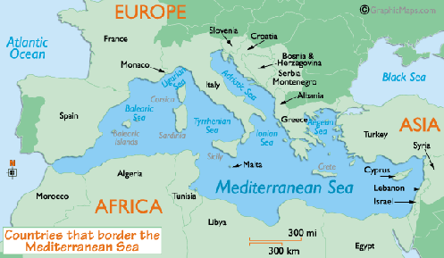
West Vs. East- What does it mean??
Geography

Slide 7
Understanding Western History
In the early twentieth century, many intellectual and educational leaders encouraged the establishment of college and university courses focusing on “western civilization.”
After World War II, divisions between East and West changed again.

Slide 8
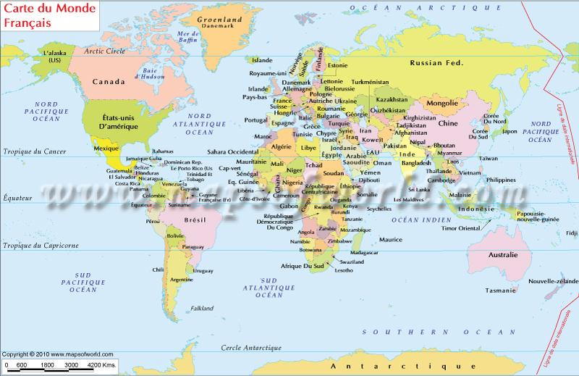
West Vs. East- What does it mean??
Culture and Tradition

Slide 9
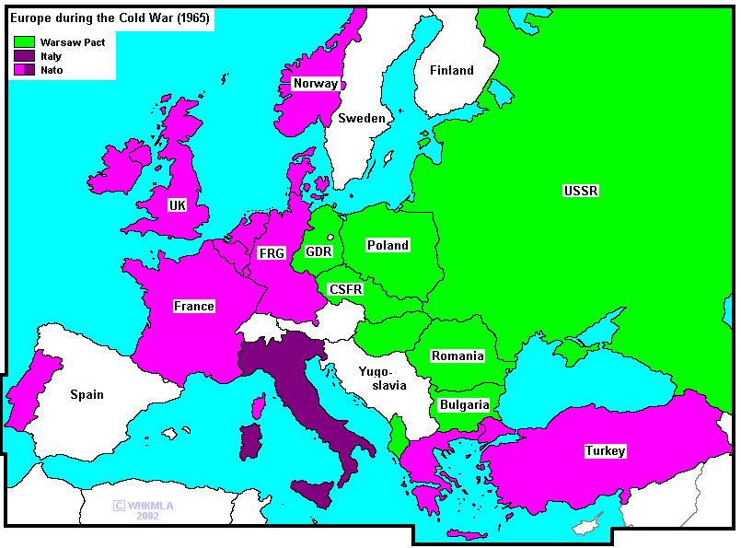
West Vs. East- What does it mean??
Economic and Political Systems

Slide 10
What Is History, and Why?
Historians examine a variety of evidence.
Primary Sources (what are they??)
Examples
Manuscripts
Inscriptions
Statistics
Nonliterary Sources
Archaelogy
Jamestown Dig
Otzi the Iceman

Slide 11
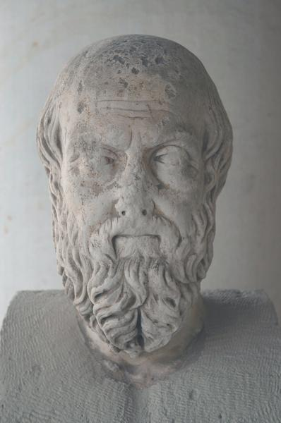
What Is History, and Why?
“History” comes from the Greek word historie.
Herodotus- Greek researcher and storyteller who was the world's first historian.
In The Histories, he describes the expansion of the Achaemenid empire under its kings Cyrus the Great, Cambyses and Darius I the Great, culminating in king Xerxes' expedition in 480 BCE against the Greeks.
Herodotus‘ book also contains ethnographic descriptions of the peoples that the Persians have conquered, fairy tales, gossip, legends, and a humanitarian morale.

Slide 12
Reliability: How do we know?
Historians must try to distinguish between reliable and unreliable evidence (How?)
Historians use evidence to establish facts or explain the meaning of their findings- (Examples)
A number of factors complicate our efforts to arrive at an accurate understanding of the past.(what??)

Slide 13
From Caves to Towns: The Neolithic Contribution
1. From perhaps 400,000 to 7,000 b.c., early human beings survived as hunter-gatherers in extended family units.
2. This period is known as the Paleolithic, or “Old Stone Age,” from the primitive stone tools and weapons these people produced.
3. Around 7,000 b.c., an obvious transformation began: some hunter-gatherer societies began to rely chiefly on agriculture for their subsistence.
4. Neolithic peoples contributed a great deal to the development of human society, including systematic agriculture, writing, sedentary living, and improved tools and weapons.
5. Stonehenge and other stone circles scattered throughout Great Britain, Ireland, and Brittany were built by Neolithic societies that must have been prosperous, well organized, and centrally led.

Slide 14
Take a Moment…
Why do the earliest civilizations develop around rivers or lakes?
How does geography affect a civilization?

Slide 15
Mesopotamian Civilization
The Invention of Writing and the First Schools
Mesopotamian Thought and Religion
Sumerian Social and Gender Division

Slide 16
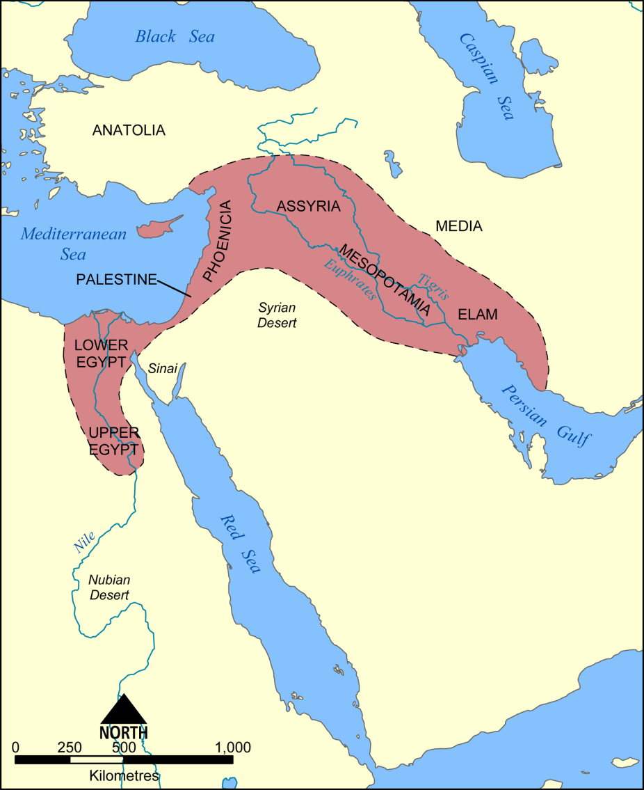
Geography of Fertile Crescent
A strip of fertile land which is well suited for farming
Much like Egypt, societies revolved around flooding waters to irrigate fields
No isolation→ invaders of many kinds
Notes:
*The Fertile Crescent begins at the Isthmus of Suez and arcs through Southwest Asia to the Persian Gulf
*the Fertile Crescent had no isolation of natural barriers, unlike Ancient Egypt, which made it prone to many invaders. What about this areas location made it so suitable for invasion?

Slide 17
Fertile Crescent
Major geographic features of this area?
-Tigris and Euphrates Rivers
Mesopotamia→ the Tigris-Euphrates Valley
Tigris-Euphrates flooding
A time of repeated migration and conquest
Notes:
*The flooding of the Tigris and Euphrates Rivers was very unpredictable, unlike the Nile. How would this impact religion of the people of the Fertile Crescent?
*tribes of wandering herders would travel throughout the Fertile Crescent, living off the grasses and other plant life. They would invade the areas of the valley, building empires along the way. As the people of these empires grew weak, new invaders would conquer them, building their own new empires.

Slide 18
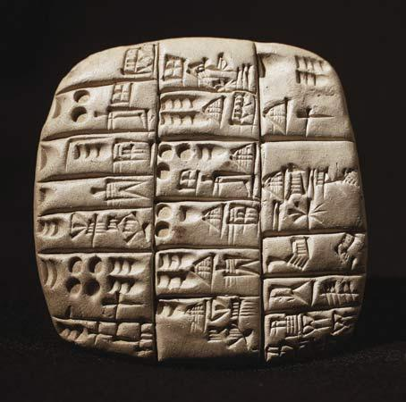
Sumer
Origins→ nomadic people migrated to Sumner
Writing
-pictographs: picture writing
-cuneiform: wedge shaped
Architecture
-arch
-ziggurats
Science
-wheels→ watch, compass
-lunar calendar
Notes:
*not a lot is known about the origins of the people of Sumner, but most likely nomadic people migrated into the area and mingled with the people already there
*Writing: pictographs→ one of the earliest forms of writing
cuneiform→ writers used a wedge-shaped tool called a stylus. As a result most signs were wedge shaped.
Sumerians had about 600 cuneiform signs
*Architecture: arch→ invented one of the strongest forms in a building; curved structure over an opening
ziggurats→ most striking Sumerian buildings were temples known as ziggurats; made of baked brick in layers much like a wedding cake. The top served as a shrine to a Sumerian god.
*Science: wheels→ may have been the first people to develop and use the wheel; used a system of numbers based on 60
lunar calendar→ had to add a month every few years to make it work (360 days in a year)

Slide 19
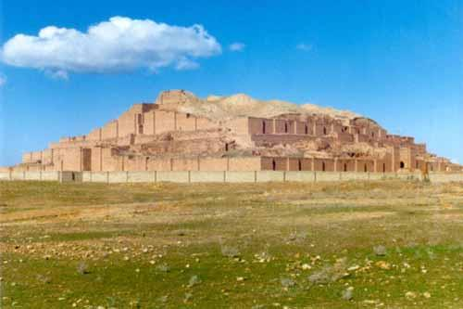
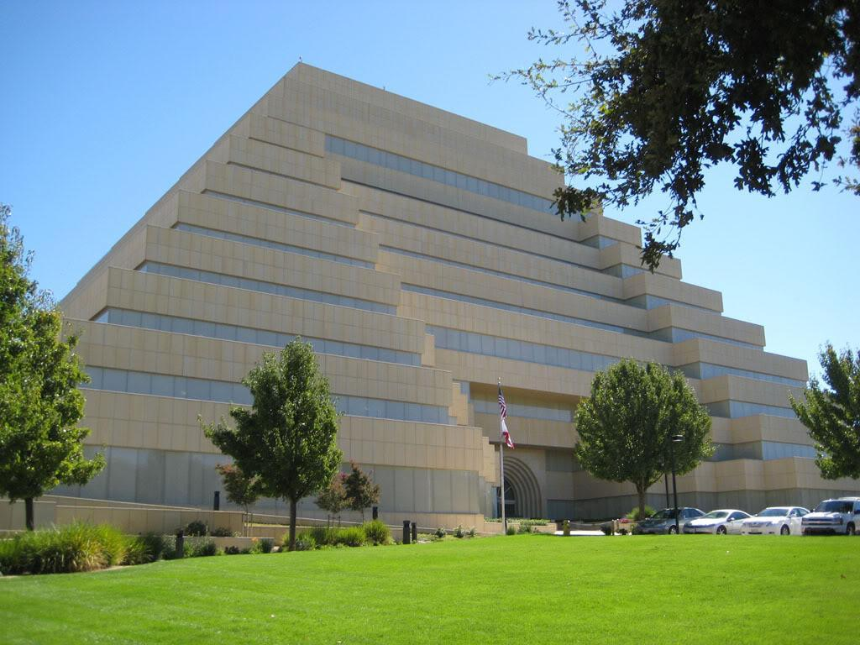
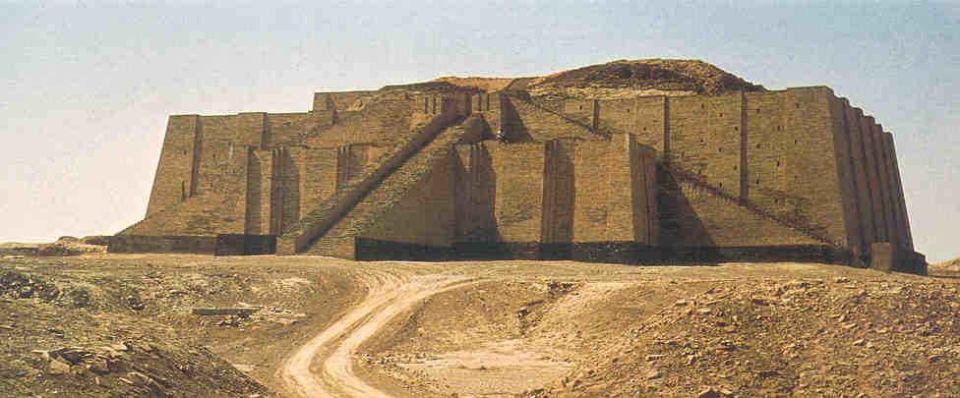

Slide 20
Sumerian Society
City-States: a town or city and the surrounding land controlled by it
Ur, Erech, and Kish
Top→ Kings, high priests, nobles
Middle→ lower priests, merchants, scholars
Bottom→ peasant farmers, slaves
Notes:
*Sumerians developed city-states, a form of community
-believed the land in each city-state belonged to one or more gods

Slide 21
The Spread of Mesopotamian Culture
The Triumph of Babylon
Life Under Hammurabi

Slide 22
The Ancient Middle East: Debating Hammurabi’s Code
Hammurabi’s Code is one of the oldest written records that we have (ca. 1728 – 1686 BC). The Code is actually a series of laws written by a Babylonian king named Hammurabi. These laws were engraved on a huge stone pillar that was excavated in the early 20th century. Hammurabi claimed the gods called on him to “make justice visible in the land.” There are 282 laws, organized by subjects. They cover a wide range of offenses. Hammurabi made an effort to make the laws fair, but different standards of justice and “fairness” applied to different people. In other words, status counted.

Slide 23
The Ancient Middle East: Debating Hammurabi’s Code
Divide class into two groups: one pro and one con. Give students 5-6 minutes to get together to work on prepping debate. Think about the pros and cons of each. Begin formal debate. (handout on HC)

Slide 24
Debate: Hammurabi’s Code
Consider the following questions and be able to support your answers logically: Where the laws appropriate for the time period? How were they fair or unfair? Which people were favored by the laws and which where not? How is the Code of Hammurabi similar to or different from the Ten Commandments? Have society’s problems changed or remained the same?

Slide 25
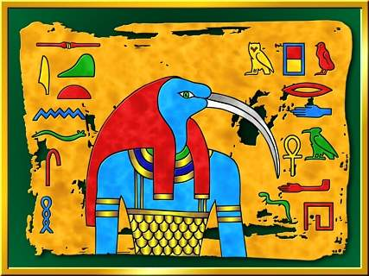
Women in Religion in Ancient Egypt
What do you think about the article?

Slide 26
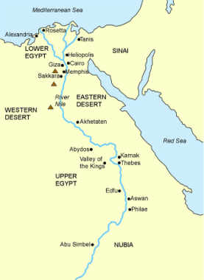
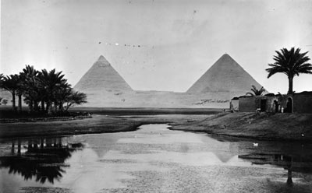
Egypt, the Land of the Pharaohs (3100–1200 B.C.)

Slide 27
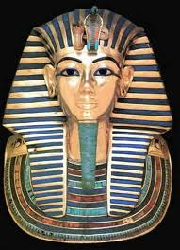
The God-King of Egypt
Egyptian society revolved around the life-giving waters of the Nile River
Regular flooding and fertility of soil made agriculture dependable and productive.
By 3100 BCE there were some forty agricultural communities along the Nile.
Sometime around 3100 BCE Egypt was united under the rule of a single great king or “Pharaoh” (def)
Egyptian religion was polytheistic and connected to the environment.

Slide 28
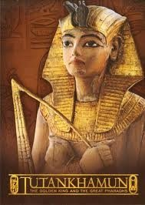
The Pharaoh was viewed as both man and god. He was a conduit to the gods.
The Pharaoh’s presence assured the people that the gods cared for them.
The Pharaoh’s ostentation reflected his power.
Famous pyramids attest to the power and prestige of the pharaoh
The most powerful gods were Amon, associated with the annual floods and Ra, the sun god.

Slide 29
The Pharaoh’s People
Common people were at the mercy of the government officials.
The agricultural year was routine and dependable.
Egyptian society featured a mixture of freedom and constraint.
To ancient Egyptians, the pharaoh embodied justice and order.

Slide 30
The Hyksos in Egypt (1640–1570 B.C.)
Around 1800 BC people whom the Egyptians called the Hyksos began to settle in the Nile Delta.
The Egyptians portrayed the Hyksos as a wandering horde but they were probably just nomads looking for good land.
The Hyksos brought with them skills such as bronze making and casting. They introduced the chariot to the Egyptians. Ruled Egypt for about 160 years
Little is known about them because eventually the Egyptians overthrew the Hyksos and destroyed any reference to them

Slide 31
The New Kingdom: Revival and Empire (1570–1075 B.C.)
Following a period of domination, a new line of pharaohs extended Egyptian rule. This was a time of Empire Building
Egypt build large armies and war fleets
Conquered large areas such as Palestine, Phonecia, Syria, Nubia, etc. Rulers began to build large statues of themselves and temples (ie Temple of Karnack)

Slide 32
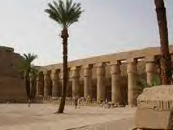
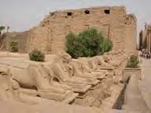
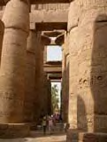
Temple of Karnack

Slide 33
The Hittites and the End of an Era (CA 1640–1100 B.C.)
The Coming of the Hittites (CA 1640–1200 B.C.)
The Fall of Empires and the Survival of Cultures (CA 1200 B.C.)

Slide 34
Egypt, the Land of the Pharaohs (3100–1200 B.C.)
The God-King of Egypt
The Pharaoh’s People
The Hyksos in Egypt (1640–1570 B.C.)
The New Kingdom: Revival and Empire (1570–1075 B.C.)

Slide 35
The Hittites and the End of an Era (CA 1640–1100 B.C.)
The Coming of the Hittites (CA 1640–1200 B.C.)
The Fall of Empires and the Survival of Cultures (CA 1200 B.C.)

