Slide 1

The Brain, Learning, and Memory
What is the connection between the brain, learning, and memory?

Slide 2
I Went On A Picnic
Lexis- sandwhiches
Taylor- Grapes
David- OJ
Tiffany- Umbrella
Cody- a pickle
Dakota- lemons
Noura- apples
Fletcher- bagles
Nicole- cheese
Broc- donuts
Jackie- bacon
Kota- watermelon
Eric- cherries
Morgan- blanket
Lilly- candy
Dylan- fish

Slide 3
How Does Memory Work?
An Information-Processing Model
Here is a simplified description of how memory works:
Encoding
Encoding: the information gets into our brains in a way that allows it to be stored
Storage: the information is held in a way that allows it to later be retrieved
Retrieval: reactivating and recalling the information, producing it in a form similar to what was encoded
Storage
Retrieval
Notes:
Click to reveal bullets.

Slide 4
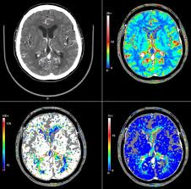
Three Stages of Memory
Sensory
Short-term
Long-term

Slide 5
Sensory memory
  A memory system that momentarily preserves extremely accurate images of sensory information
  Visual, auditory, and olfactory information
  Transfers to short-term memory
  Information that is not quickly passed to short-term memory is gone forever

Slide 6
The Encoding and Processing of Memory:
Sensory Memory
We very briefly capture a sensory memory, analogous to an echo or an image, of all the sensations we take in.
How brief? Sensory memory consists of about a 3 to 4 second echo, or a 1/20th of a second image.
Evidence of auditory sensory memory, called “echoic” memory, can occur after someone says, “what did I just say?” Even if you weren’t paying attention, you can retrieve about the last eight words from echoic memory.
Notes:
Click to reveal bullets.
Instructor: you might ask, “why do you think sensory memory is more brief for images than for sounds?”
Possible answers include:
images contain much more information than echoes; it would overwhelm us to store all the details our eyes capture. This is also part of the reason why attention selects important details to process.
so these sensory memories don’t interfere with new images coming in. Otherwise, every experience would be like watching a flashbulb, the afterimage would blind you to what comes next. Echoic memory, though, can be held longer because so much of our experience has little competing auditory input.
Additional comments you can make about the last point: this echoic memory phenomenon allows people to pretend or even convince themselves that they were paying attention when they merely had their ears operating.

Slide 7
Short-Term Memory
  A limited capacity memory system involved in the retention of information for brief periods
  stores seven single or chunked items for 30 seconds without repetition
  solves problems through reasoning process (example: organizing facts into a coherent essay)
What is the difference between sensory memory and short-term memory?

Slide 8
Encoding Memory
Capacity of Short-Term and Working Memory
Working Memory, which uses rehearsal, focus, analysis, linking, and other processing, has greater capacity than short-term memory. The capacity of working memory varies; some people have better concentration.
Test: see how many of these letters and numbers you can recall after they disappear.
No need for a hyphen before the V.
If some information is selected from sensory memory to be sent to short-term memory, how much information can we hold there?
George Miller (b. 1920) proposed that we can hold 7 +/-2 information bits (for example, a string of 5 to 9 letters).
More recent research suggests that the average person, free from distraction, can hold about:
7 digits, 6 letters, or 5 words.
Test:
  V M 3 C A Q 9 L D
Notes:
Click to reveal bullets. Click again to show sidebar. Click to start the test. When you see the word “Test”, the next click starts the letter animation.
Click again to show the letters.
Instructor: observant students might see the list in the third bullet point and notice: 5 words > 7 letters. This means we can recall MORE than 6 letters if we can cluster them into words, which we’ll soon call “semantic processing.” Experiments by Lloyd Peterson, Margaret Peterson, and Hermann Ebbinghaus (which we’ll cover later in the chapter) made this processing difficult by using nonsense syllables instead of words.

Slide 9
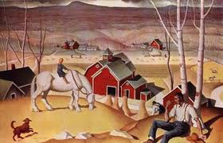
Review the picture for 5 seconds and see what you remember.

Slide 10
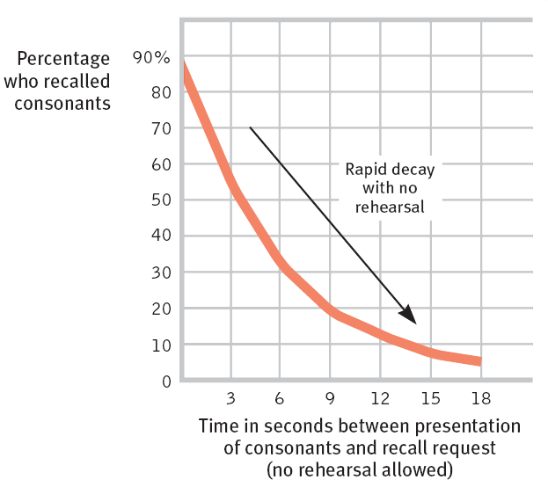
Duration of Short-Term Memory (STM)
Lloyd Peterson and Margaret Peterson wanted to know the duration of short term memory? Their experiment (1959):
People were given triplets of consonants (e.g., “VMF”).
To prevent rehearsing, the subjects had to do a distracting task.
People were then tested at various times for recall.
Result: After 12 seconds, most memory of the consonants had decayed and could not be retrieved.
Notes:
Click to reveal bullets.
Instructor: if you want to test students’ familiarity with the reading, you can ask, “what was the distracting task?”...(counting backward from 100 by 3’s).

Slide 11
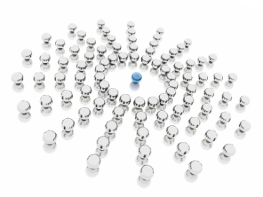
Long-term Memory
The ability to transfer information from short- to long-term memory is relevant to the learning process.
  People use attention, repetition, and association with past learning to encode information.
  Neurologically, encoding
  happens when information
  is repeatedly processed
  in the hippocampus.
How do you encode information into long-term memory?

Slide 12
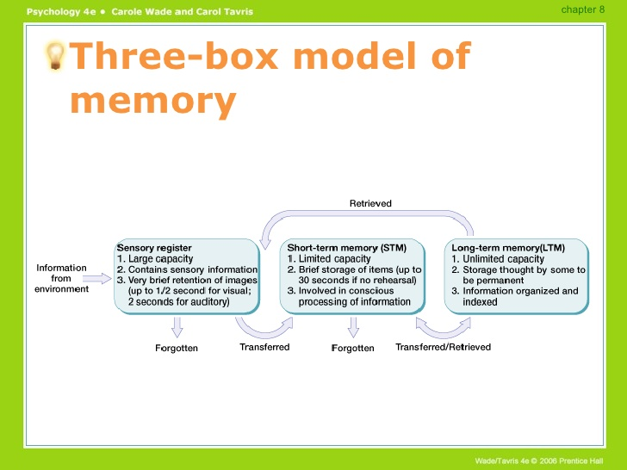

Slide 13
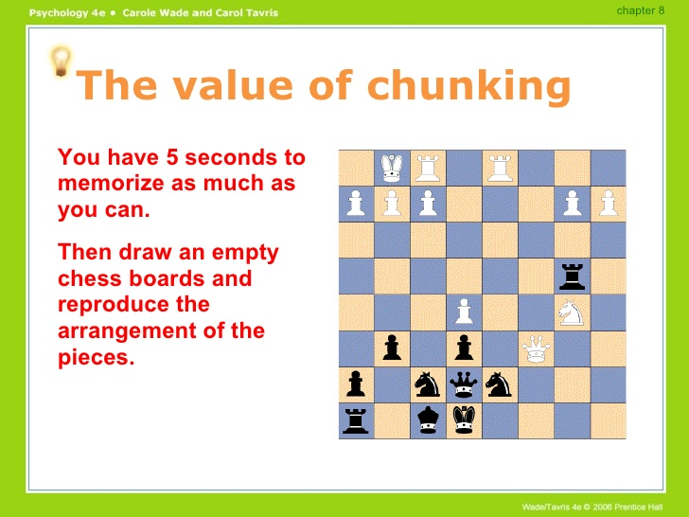

Slide 14
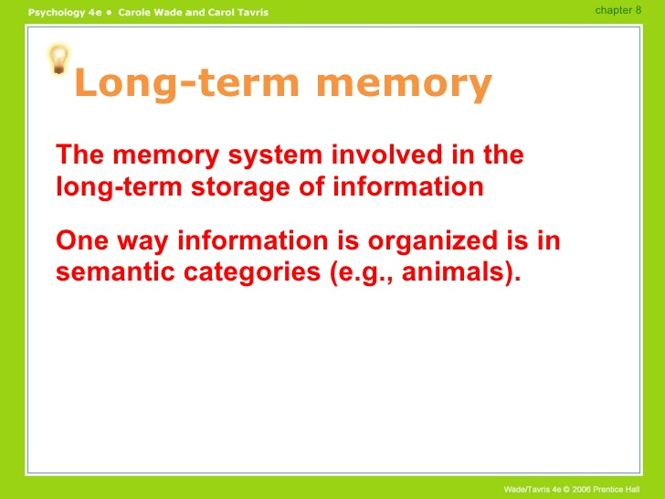

Slide 15
Reproductive Memory vs. Productive Memory
reproductive
productive
Reproduce information exactly as stored
Learning vocabulary lists, math formulas, telephone numbers and important historical dates
Producing information and processing it.
Is not recalling information word for word but key concepts.
Must make inferences
Remembers key points and whats important.
Can create “false” memories.

Slide 16
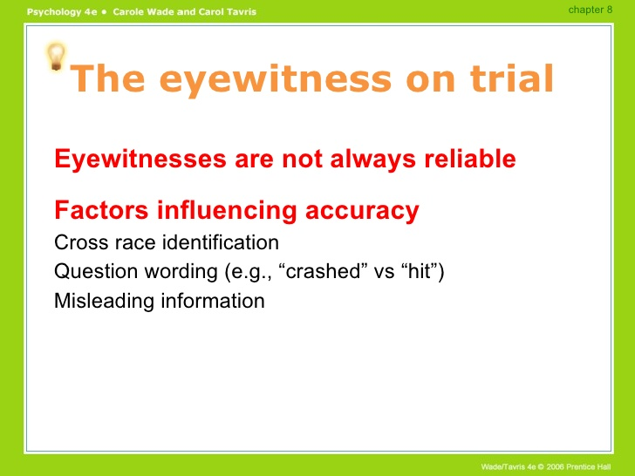

Slide 17
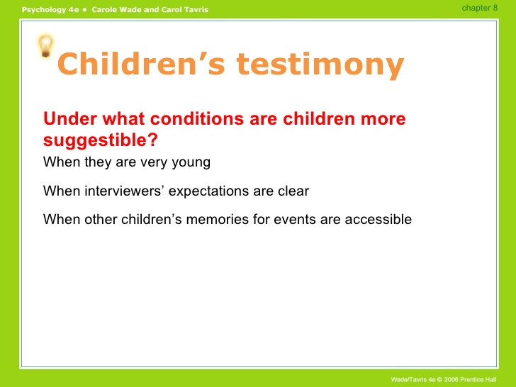

Slide 18
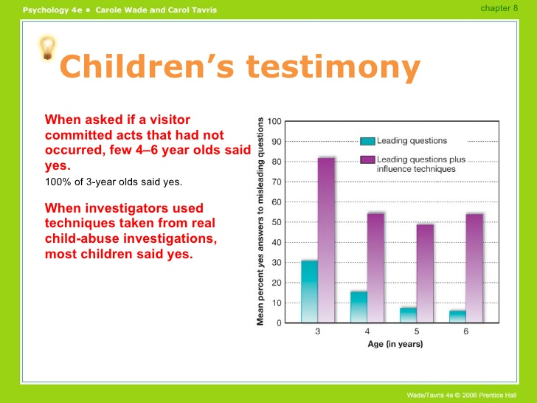

Slide 19
