Slide 1

Psychology 2e
Chapter 1
The Science of Psychology

Slide 2
Module 1
Psychology: Historical
Development and Perspectives

Slide 3
Learning Objectives
  1.1 Define psychology as a field of study, and identify psychology’s four primary goals as a science.
  1.2 Describe how psychology developed as a science.
1.3 Describe the perspectives used to understand psychology today.
  1.4 Explain how psychology developed as a scientific discipline.
  1.5 Describe the important subfields of psychology.
1.6 Discuss the value of research with human and nonhuman animals.
1.7 Describe the role psychology plays in improving both society and people’s lives.
Notes:
Slide 2 is list of textbook LO numbers and statements

Slide 4
What Is Psychology?
Learning Objective 1.1: Define psychology as a field of study, and identify psychology’s four primary goals as a science.
Psychology: the scientific study of behavior and mental processes
  Behavior: outward or overt actions and reactions
  Mental processes: internal, covert activity of our minds
Prevents possible biases from leading to faulty observations.
Precise and careful measurement

Slide 5
Four Goals of Psychology (1 of 2)
Learning Objective 1.1: Define psychology as a field of study, and identify psychology’s four primary goals as a science.
Description
  What is happening?
    observing a behavior and noting everything about it
Explanation
  Why is it happening?
  Theory: general explanation of a set of observations or facts

Slide 6
Four Goals of Psychology (2 of 2)
Learning Objective 1.1: Define psychology as a field of study, and identify psychology’s four primary goals as a science.
Prediction
  When will it happen again?
Control
  How can it be changed?
    Involves changing or modifying an undesirable behavior to a desirable one

Slide 7
Measuring Consciousness
Learning Objective 1.2: Describe how psychology developed as a science.
Wilhelm Wundt’s Psychology Laboratory
  Germany in 1879
  Attempted to apply scientific principles to the study of the human mind
  Believed that consciousness could be broken down into thoughts, experiences, emotions, and other basic elements
  Developed the technique of objective introspection: the process of objectively examining and measuring one’s thoughts and mental activities
    Observations need to be clear and precise, but unbiased

Slide 8
Structuralism
Learning Objective 1.2: Describe how psychology developed as a science.
Edward Titchener
  Wundt’s student; brought structuralism to America
  Believed that objective introspection could be used on thoughts as well as on physical sensations
Margaret F. Washburn
  Titchener’s student; first woman to earn a P h.D in psychology
  Published a book on animal behavior, The Animal Mind (Washburn, 1908).
Structuralism died out in the early nineteen hundreds.

Slide 9
Functionalism (1of 2)
Learning Objective 1.2: Describe how psychology developed as a science.
Functionalism as proposed by William James
  How the mind allows people to function in the real world – how they work, play, and adapt to their surroundings
  Influenced by Darwin’s ideas on natural selection: the passing of traits to offspring
Contribution of Women
  Mary Whiton Calkins: earliest research in the area of human memory and the psychology of the self

Slide 10
Functionalism (2 of 2)
Learning Objective 1.2: Describe how psychology developed as a science.
African American and Hispanic contribution to early psychology
  Francis Cecil Sumner: chair of the psychology department at Howard University
  Kenneth and Mamie Clark: showed the negative effects of school segregation on African American children
  Jorge Sanchez: intelligence testing and cultural biases
Influenced the modern fields of:
  Educational psychology
  Industrial/organizational psychology
  Evolutionary psychology

Slide 11
Influential Approaches (1 of 2)
Learning Objective 1.2: Describe the perspectives used to understand psychology today.
Sigmund Freud’s Theory of Psychoanalysis
  Unconscious mind with repressed threatening urges and desires, which, in trying to surface, created the nervous disorders
  Importance of early childhood experiences

Slide 12
Influential Approaches (2 of 2)
Learning Objective 1.2: Describe the perspectives used to understand psychology today.
Pavlov, Watson, and the Dawn of Behaviorism
  Ivan Pavlov demonstrated that a reflex could be conditioned (learned)
  Watson focused on observable behavior only – that can be directly seen and measured
    Phobias learned through the process of conditioning
    Case of “Little Albert”: a baby taught to fear a white rat
  Watson’s student, Mary Cover Jones, introduced counterconditioning, and was an early pioneer of behavior therapy.
  Behaviorism has influenced the development of cognitive psychology

Slide 13
Modern Perspectives (1 of 5)
Learning Objective 1.3: Describe the perspectives used to understand psychology today.
Psychodynamic perspective: modern version of psychoanalysis
  More focused on the development of a sense of self and discovery of motivation behind a person’s behavior rather than sexual motivation

Slide 14
Modern Perspectives (2 of 5)
Learning Objective 1.3: Describe the perspectives used to understand psychology today.
Behavioral Perspective
  Remains very influential
  B. F. Skinner developed the theory of operant conditioning – of how voluntary behavior is learned
    Behavioral responses followed by pleasurable consequences get strengthened or reinforced

Slide 15
Modern Perspectives (3 of 5)
Learning Objective 1.3: Describe the perspectives used to understand psychology today.
Humanistic Perspective
  Often called the “third force” in psychology, its a reaction to both psychoanalytic theory and behaviorism
  Holds the view that people have free will, the freedom to choose their own destiny, and strive for self-actualization
  Focus on people’s ability to direct their own lives
  Early founders:
    Abraham Maslow
    Carl Rogers

Slide 16
Modern Perspectives (4 of 5)
Learning Objective 1.3: Describe the perspectives used to understand psychology today.
Cognitive Perspective
  Focuses on memory, intelligence, perception, thought processes, problem solving, language, and learning
    Includes the relatively new field of cognitive neuroscience which uses tools like MRI, fMRI, and PET for imaging the structure and activity of the living brain
Sociocultural Perspective
  Focuses on the relationship between social behavior and culture
  Cross-cultural research: contrasts and comparisons of a behavior or issue are studied in at least two or more cultures

Slide 17
Modern Perspectives (5 of 5)
Learning Objective 1.3: Describe the perspectives used to understand psychology today.
Biopsychological Perspective
  Attributes human and animal behavior to biological events occurring in the body, such as genetic influences, hormones, and the activity of the nervous system
  Part of the study of the physical structure, function, and development of the nervous system
Biopsychosocial Perspective
  Holistic approach: explains how genetics, behaviors, and environmental aspects interact to explain an individual
Evolutionary Perspective
  Focuses on the biological bases of universal mental characteristics that all humans share

Slide 18
Positive Psychology
Learning Objective 1.4: Explain how psychology developed as a scientific discipline.
Martin Seligman, founder of positive psychology
  shifts focus away from the negative and focuses on strengths, well-being, and the pursuit of happiness
No one perspective has all the answers; some are more scientific (behavioral and cognitive), some based more on human behavior
Eclectic perspective
  Bits and pieces of several perspectives are used to best fit a particular situation.
Notes:
18

Slide 19
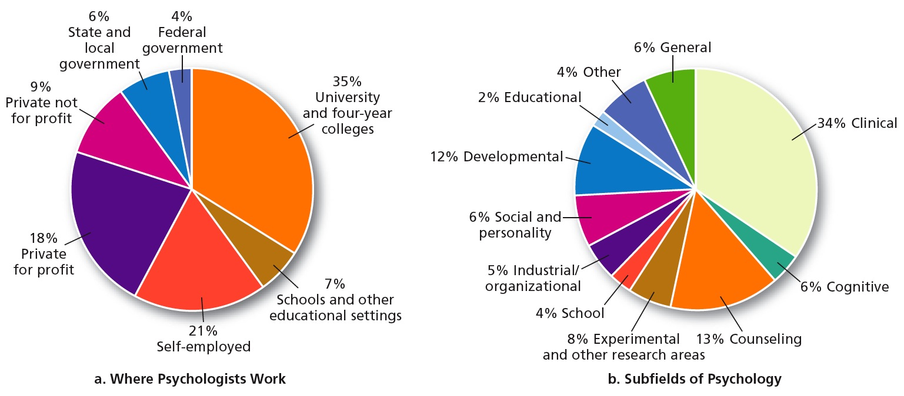
Psychological Professionals (1 of 2)
Learning Objective 1.5: Describe the important subfields of psychology.
Psychologist
  Undergoes intense academic training, has a doctorate degree, chooses a specialization from the different subfields as shown in figure (b) below:

Slide 20
Psychological Professionals (2 of 2)
Learning Objective 1.5: Describe the important subfields of psychology.
Psychiatrist
  Medical doctor who has specialized in the diagnosis and treatment of psychological disorders
Psychiatric Social Worker
  Has a Master’s degree, is trained, and focuses on environmental conditions that can have an impact on mental disorders, such as poverty, overcrowding, stress, and drug abuse

Slide 21
Research
Learning Objective 1.6: Discuss the value of research with human and nonhuman animals.
Basic research – for the sake of gaining scientific knowledge
    Example: how many “things” a person can hold in memory at any one time
Applied research – aimed at answering real-world, practical problems
    Example: use information from the basic researcher’s memory study to develop a new study method for students.

Slide 22
Role of Psychology in Society
Learning Objective 1.7: Describe the role psychology plays in improving both society and people’s lives.
Psychologists can aim to improve the daily lives of people in the following ways:
  research into tough social issues and work on strategies to minimize racial prejudice and violence
  research on human factors psychology and contribute to engineering improvements
  understand developmental issues during childhood, strengthen school curriculum, and guide parents’ approach to raising children
  help people work through difficult personal issues and overcome the challenges of psychological disorders

Slide 23
Module 2
Research Methods and Ethics

Slide 24
Learning Objectives
  2.1 Describe the scientific method and how it is applied to psychology.
  2.2 Describe and compare the various research methods.
  2.3 Define procedures used to improve the validity of research findings.
  2.4 Identify ethical standards for research in psychology with human participants.
  2.5 Discuss the purpose of nonhuman animal research in psychology.
  2.6 Identify ethical guidelines for research in psychology with nonhuman animals.

Slide 25
Psychology and the Scientific Method
(1 of 3)
Learning Objective 2.1: Describe the scientific method and how it is applied to psychology.
Scientific Method
  System of gathering data so that bias and error in measurement are reduced

Slide 26
Psychology and the Scientific Method
(2 of 3)
Learning Objective 2.1: Describe the scientific method and how it is applied to psychology..
Steps in the Scientific Method:
  Formulating the question: identifying something interesting in your surroundings for which you would like to have an explanation
  Forming a hypothesis: tentative explanation of a phenomenon based on observations
    Overcoming confirmation bias by seeking out for information that might contradict the biases (or hypotheses)
  Testing the hypothesis

Slide 27
Psychology and the Scientific Method
(3 of 3)
Learning Objective 2.1: Describe the scientific method and how it is applied to psychology.
Steps in the Scientific Method (continued):
  Drawing conclusions
    Outcome 1: your measurements supported your initial observations
    Outcome 2: your hypothesis was not supported and you need to go back to square one and think of another possible explanation for what you have observed
    It is related to the goal of prediction that enables educated guesses about future similar scenarios
  Reporting your results: let others know what you find
    Lack of support for the experiment could be due to poorly designed study or factors not under your control
    Use the results of findings to modify or control behavior

Slide 28
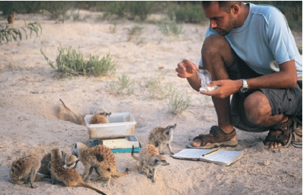
Descriptive Methods (1 of 10)
Learning Objective 2.2: Describe and compare the various research methods.
Naturalistic Observation
  Watching animals or humans behave in their normal environment
  Major advantage: realistic picture of behavior

Slide 29
Descriptive Methods (2 of 10)
Learning Objective 2.2: Describe and compare the various research methods.
Naturalistic Observation: Disadvantages
  Observer effect: the tendency of people or animals to behave differently when they know they are being observed
    Participant observation: a naturalistic observation in which the observer becomes a participant in the group being observed (to reduce observer effect)

Slide 30
Descriptive Methods (3 of 10)
Learning Objective 2.2: Describe and compare the various research methods.
Naturalistic Observation: Disadvantages
  Observer bias: the tendency of observers to see what they expect to see
    Blind observers: people who do not know what the research question is (to reduce observer bias)
      Having more than one observer can facilitate comparison of various observations

Slide 31
Descriptive Methods (4 of 10)
Learning Objective 2.2: Describe and compare the various research methods.
Laboratory Observation
  Watching animals or humans behave in a laboratory setting
  Advantages
    control over environment
    allows use of specialized equipment

Slide 32
Descriptive Methods (5 of 10)
Learning Objective 2.2: Describe and compare the various research methods.
Laboratory Observation: Disadvantage
  An artificial situation may result in artificial behavior.
Descriptive methods lead to the formation of testable hypotheses.

Slide 33
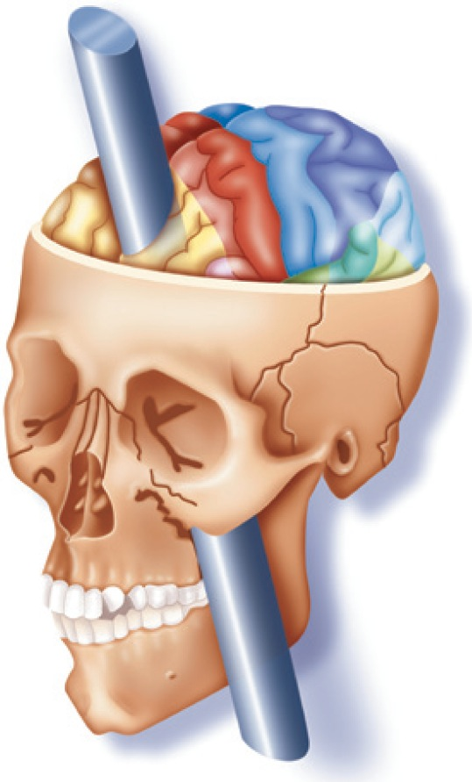
Descriptive Methods (6 of 10)
Learning Objective 2.2: Describe and compare the various research methods.
Case Study
  Study of one individual in great detail
  Advantage
    tremendous amount of detail
    only way to get certain kinds of information
    good way to study rare conditions
  Disadvantage
    cannot apply to others
  Famous case study: Phineas Gage

Slide 34
Descriptive Methods (7 of 10)
Learning Objective 2.2: Describe and compare the various research methods.
Surveys
  Used when psychologists want to know very personal things
  Researchers ask a series of questions about the topic under study
  Can be conducted in person in the form of interviews or on the telephone, the Internet, or with a questionnaire
Given to a Representative Sample
  A randomly selected sample of subjects from a larger population of subjects but with the same general characteristics of the larger group

Slide 35
Descriptive Methods (8 of 10)
Learning Objective 2.2: Describe and compare the various research methods.
Survey Advantages
  Data from large numbers of people
  Study covert behaviors
Survey Disadvantages
  Researchers have to ensure that they have a representative sample or their results will not be meaningful.
  People are not always accurate.
  People may deliberately give a more socially correct answer rather than their true opinion in order not to offend anyone (courtesy bias).

Slide 36
Descriptive Methods (9 of 10)
Learning Objective 2.2: Describe and compare the various research methods.
Survey Disadvantages
  Wording of survey questions and the order in which they appear on the survey can affect the outcome.

Slide 37
Descriptive Methods (10 of 10)
Learning Objective 2.2: Describe and compare the various research methods.
Thinking Critically about Psychology
  Critical “scientific” thinking can help sort out “real-world” problems.
  It can help evaluate claims that may be false.

Slide 38
Finding Relationships (1 of 4)
Learning Objective 2.2: Describe and compare the various research methods.
Correlations: Finding Relationships
  Measure of the relationship between two or more variables
  Variable: anything that can change or vary

Slide 39
Finding Relationships (2 of 4)
Learning Objective 2.2: Describe and compare the various research methods.
Correlations : Finding Relationships
  Measures of two variables go into a mathematical formula and produce a correlation coefficient (r), which represents two things:
    Direction of the relationship
    Strength of the relationship

Slide 40
Finding Relationships (3 of 4)
Learning Objective 2.2: Describe and compare the various research methods.
The correlation coefficient ranges from
-1.00 to +1.00.
The closer to +1.00 or -1.00, the stronger the relationship between the variables.
  No correlation = 0.0
  Perfect correlation = -1.00 or +1.00

Slide 41
Finding Relationships (4 of 4)
Learning Objective 2.2: Describe and compare the various research methods.
Positive correlation: variables increase in the same direction
  As one increases, the other increases.
  As one decreases, the other decreases.
Negative correlation: variables have an inverse relationship
  As one increases, the other decreases.
Correlation does not prove causation!

Slide 42
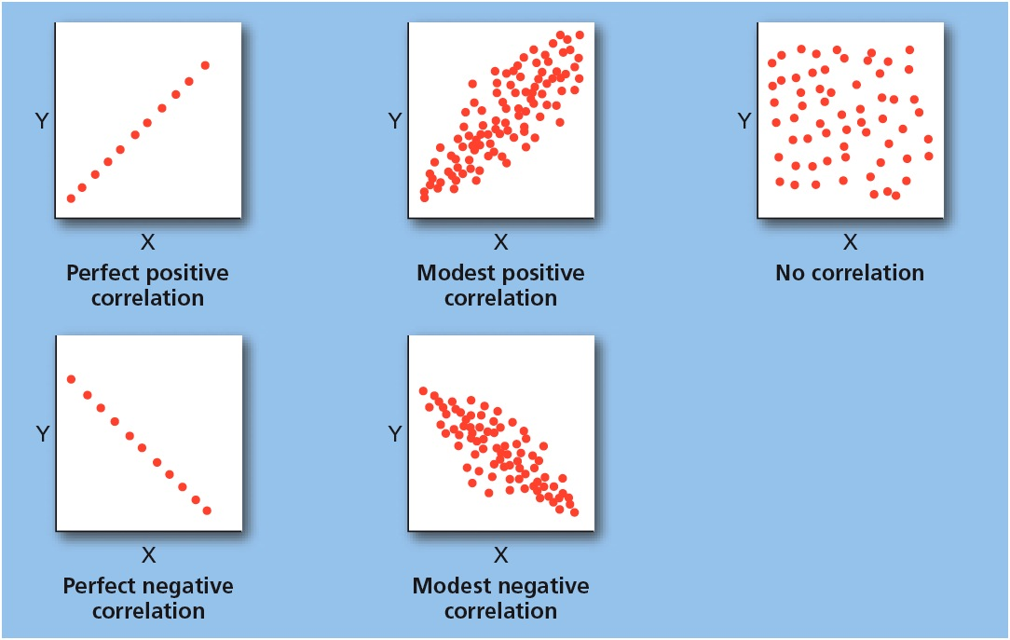
Figure 2.1: Scatterplots Showing Direction and Strength of Correlation
Notes:
It should be noted that perfect correlations, whether positive or negative, rarely occur in the real world.

Slide 43
The Experiment (1 of 8)
Learning Objective 2.2: Describe and compare the various research methods.
Experiment
  A deliberate manipulation of a variable to see whether corresponding changes in behavior result, allowing the determination of cause and effect relationships
Selection
  Random selection of sample from a certain population
Operational Definition
  Definition of a variable of interest that allows it to be directly measured

Slide 44

The Experiment (2 of 8)
Learning Objective 2.2: Describe and compare the various research methods.
Independent Variable (IV)
  The variable in an experiment that is manipulated by the experimenter
Dependent Variable (D V)
  The variable in an experiment that represents the measurable response or behavior of the subjects in the experiment

Slide 45
The Experiment (3 of 8)
Learning Objective 2.2: Describe and compare the various research methods.
The Groups
  Subjects in an experiment who are subjected to the independent variable
  Confounding variables: variables that interfere with each other and their possible effects on some other variable of interest
  Researchers have to control the possible effects of confounding variables – best way is to have two groups
    Experimental group
    Control group

Slide 46
The Experiment (4 of 8)
Learning Objective 2.2: Describe and compare the various research methods.
Experimental Group
  Subjects in an experiment who are exposed to the independent variable
Control Group
  Subjects in an experiment who are not subjected to the independent variable and get either no treatment or some kind of treatment that should have no effect
  Used to control for the possibility that other factors might be causing the effect that is being examined

Slide 47
The Experiment (5 of 8)
Learning Objective 2.3: Define procedures used to improve the validity of research findings.
The Importance of Randomization
  The process of assigning subjects to the experimental or control groups randomly, so that each subject has an equal chance of being in either group
  Controls for confounding (extraneous, interfering) variables
  Random assignment: each participant has an equal chance of being assigned to each condition

Slide 48
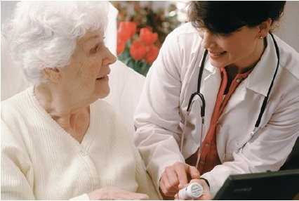
The Experiment (6 of 8)
Learning Objective 2.3: Define procedures used to improve the validity of research findings.
Experimental Hazards and Controlling for Effects
  Likely problems when studying people, because people are influenced by biases about what’s going on in an experiment

Slide 49
The Experiment (7 of 8)
Learning Objective 2.3: Define procedures used to improve the validity of research findings.
Placebo Effect
  The phenomenon in which the expectations of the participants in a study can influence their behavior
Experimenter Effect
  Tendency of the experimenters’ expectations for a study to unintentionally influence the results of the study

Slide 50
The Experiment (8 of 8)
Learning Objective 2.3: Define procedures used to improve the validity of research findings.
Single-Blind Study
  Subjects do not know whether they are in the experimental or the control group (reduces placebo effect).
Double-Blind Study
  Neither the experimenter nor the subjects know which subjects are in the experimental or control group (reduces placebo effect and experimenter effect).

Slide 51
Ethics in Psychological Research (1 of 6)
Learning Objective 2.4: Identify ethical standards for research in psychology with human participants.
Institutional Review Boards (IRB)
  Groups of psychologists or other professionals who look over each proposed research study and judge it according to its safety and consideration for the participants in the study

Slide 52
Ethics in Psychological Research (2 of 6)
Learning Objective 2.4: Identify ethical standards for research in psychology with human participants.
Common Ethical Guidelines
  Rights and well-being of participants must be weighed against the study’s value to science.
  Participants must be allowed to make an informed decision about participation.
  Deception must be justified.
  Participants may withdraw from the study at any time.

Slide 53
Ethics in Psychological Research (3 of 6)
Learning Objective 2.4: Identify ethical standards for research in psychology with human participants.
Common Ethical Guidelines (continued):
  Participants must be protected from risks or told explicitly of risks.
  Investigators must debrief participants, telling the true nature of the study and expectations of results.
  Data must remain confidential.

Slide 54
Ethics in Psychological Research (4 of 6)
Learning Objective 2.4: Identify ethical standards for research in psychology with human participants.
Common Ethical Guidelines (continued):
  If for any reason a study results in undesirable consequences for the participant, the researcher is responsible for detecting and removing, or correcting, these consequences.

Slide 55
Ethics in Psychological Research (5 of 6)
Learning Objective 2.5: Discuss the purpose of nonhuman animal research in psychology.
Animal research helps to draw conclusions about human behavior and answers questions we could never investigate with human research
Looking at long-term effects becomes much easier since animals live shorter lives
Scientists have more control over animals’ diet, living arrangements, and even genetic relatedness
Animals can be used for experiments after researchers conduct correlational studies with people

Slide 56
Ethics in Psychological Research (6 of 6)
Learning Objective 2.6: Identify ethical guidelines for research in psychology with nonhuman animals.
Ethical considerations when dealing with animals in research.
  The focus is on avoiding exposing animal subjects to unnecessary pain or suffering.
  Animals are used in approximately 7 percent of psychological studies.

Slide 57
Module 3
Statistics

Slide 58
Learning Objectives
  3.1 Define descriptive statistics and explain how they are used to analyze data.
  3.2 Interpret graphical representations of data.
  3.3 Define correlation coefficients and explain how they are interpreted.
  3.4 Explain inferential statistics.
  3.5 Explain how validity and reliability relate to data analysis.
  3.6 Describe forms of qualitative data and explain how they are used by research psychologists.
Notes:
Slide 2 is list of textbook LO numbers and statements

Slide 59
Statistics in Data Analysis (1 of 2)
Learning Objective 3.1: Define descriptive statistics and explain how they are used to analyze data.
Statistics
  Branch of mathematics concerned with the collection and interpretation of numerical data
  Help psychologists:
    Summarize the information from a study or experiment
    Make judgments and decisions about the data
Descriptive Statistics
A way of organizing numbers and summarizing them so that patterns can be determined.

Slide 60
Statistics in Data Analysis (2 of 2)
Learning Objective 3.1: Define descriptive statistics and explain how they are used to analyze data.
Inferential Statistics
  Statistical analysis of two or more sets of numerical data to reduce the possibility of error in measurement
  Helps to determine if the differences between the data sets are greater than chance variation would predict

Slide 61
Descriptive Statistics (1 of 4)
Learning Objective 3.1: Define descriptive statistics and explain how they are used to analyze data.
  Descriptive Statistics
  Way of organizing numbers and summarizing them so that patterns can be determined

Slide 62
Descriptive Statistics (2 of 4)
Learning Objective 3.1: Define descriptive statistics and explain how they are used to analyze data.
Two main types:
Measures of central tendency: Used to summarize the data and give you one score that seems typical of your sample.
Measures of variability: Used to indicate the range of data.

Slide 63
Descriptive Statistics (3 of 4)
Learning Objective 3.1: Define descriptive statistics and explain how they are used to analyze data.
Measures of Central tendency
Three types
  The Mean
    Most commonly used
    Doesn’t work for extreme scores
  The Median
    Falls in the middle of an ordered distribution of scores
    Average of the two middle scores if the number is even
  The Mode
    Simplest of all the measures
    Most frequent score becomes the central measure

Slide 64
Descriptive Statistics (4 of 4)
Learning Objective 3.1: Define descriptive statistics and explain how they are used to analyze data.
Measures of Variability
Used to discover how “spread out” the scores are from each other.
  The more the scores cluster around the central scores, the smaller the measure of variability will be.
Two ways to measure variability
  Range – difference between the highest and lowest scores in distribution.
  Standard Deviation – statistical measure of average deviation from the mean score.

Slide 65
Table 3.1: Intelligence Test Score for 10 People

Slide 66
Representing Data (1 of 5)
Learning Objective 3.2: Interpret graphical representations of data.
Researchers choose the graphs or charts that most accurately represents the data they have found.
  Frequency Distributions
  The Normal Curve (bell curve)

Slide 67
Representing Data (2 of 5)
Learning Objective 3.2: Interpret graphical representations of data.
Frequency Distributions
A table or graph that shows how often different numbers, or scores, appear in a particular set of scores.
  Histogram – graph that shows a frequency distribution.
  Polygon – line graph that shows a frequency distribution.

Slide 68
Representing Data (3 of 5)
Learning Objective 3.2: Interpret graphical representations of data.
Normal Curve
  Allows researchers to see the shape of a set of data easily
  Scores decreases as the curve extends from the mean
  Used as a model for things that can be measured like intelligence, height, or weight at a larger perspective
  Useful because it has very specific relationships to measures of central tendency and to the standard deviation
  Shaped like a bell – also called bell curve

Slide 69
Representing Data (4 of 5)
Learning Objective 3.2: Interpret graphical representations of data.
Skewed distributions – not equal on both sides of a central score with the highest frequency.
The scores are concentrated toward one side of the distribution.

Slide 70
Representing Data (5 of 5)
Learning Objective 3.2: Interpret graphical representations of data.
Skewed distributions
  Not equal on both sides of a central score with the highest frequency.
  The scores are concentrated toward one side of the distribution.
    Negatively skewed – concentration of scores in the high end of the distribution.
    Positively skewed – concentration of scores in the low end of the distribution.

Slide 71
Figure 3.1: A Histogram
Notes:
Histograms, or bar graphs, provide a visual way to look at data from frequency distributions. In this graph, for example, the height of the bars indicates that most people drink between 4 and 8 glasses of water (represented by the five highest bars in the middle of the graph).

Slide 72
Table 3.2: A Frequency Distribution

Slide 73
Figure 3.2: A Polygon
Notes:
A polygon is a line graph that can represent the data in a frequency distribution in much the same way as a bar graph but allows the shape of the data set to be easily viewed.

Slide 74
Figure 3.3: A Normal Curve
Notes:
The normal curve, also known as the bell curve because of its unique
shape, is often the way in which certain characteristics such as intelligence or weight are represented in the population. The highest point on the curve typically represents the average score in any distribution.

Slide 75
Figure 3.4: A Frequency Polygon
Notes:
The normal curve, also known as the bell curve because of its unique shape, is often the way in which certain characteristics such as intelligence or weight are represented in the population. The highest point on the curve typically represents the average score in any distribution.

Slide 76
Finding Relationships (1 of 2)
Learning Objective 3.3: Define correlation coefficients and explain how they are interpreted.
Correlation – a measure of the relationship between two or more variables.
  Use formula to determine correlation coefficient (strength and direction of relationship between variables).

Slide 77
Finding Relationships (2 of 2)
Learning Objective 3.3: Define correlation coefficients and explain how they are interpreted.
Positive correlation coefficient – variables move in the same direction.
  As one increases, the other increases; as one decreases, the other decreases.
Negative correlation coefficient – an inverse relationship where variables move in opposite directions.
  As one increases, the other decreases.

Slide 78
Inferential Statistics (1 of 3)
Learning Objective 3.4: Explain inferential statistics.
Inferential statistics
  Statistical analysis of two or more sets of numerical data to reduce the possibility of error in measurement
  Help determine if the differences between the data sets are greater than chance variation would predict
  Look for differences in group measurements that are statistically significant

Slide 79
Inferential Statistics (2 of 3)
Learning Objective 3.4: Explain inferential statistics.
All inferential statistics look for differences in group measurements that are statistically significant.
  Statistical significance – way to test differences to see how likely those differences are to be real and not just caused by the random variations in behavior that exist in everything animals and people do.

Slide 80
Inferential Statistics (3 of 3)
Learning Objective 3.4: Explain inferential statistics.
Helps researchers discover whether effects are caused by experimental manipulation or by chance.
  Researchers are satisfied when tests indicate there is a 95 percent likelihood that their experimental results did not occur by chance.
  In scientific journals, significance is represented by an equation: p < .05, indicating that the probability that these results have occurred by chance is less than 5 out of 100, thus the results are statistically significant.

Slide 81
Statistical Concepts
Learning Objective 3.5: Explain how validity and reliability relate to data analysis.
Research results should be valid and reliable
  Reliability – the tendency of a test to produce the same scores again and again each time it is given to the same people.
  Validity – the degree to which a test actually measures what it is supposed to measure.
Statistical analysis is one of a psychologist’s most important and helpful tools.

Slide 82
Qualitative Data (1 of 2)
Learning Objective 3.6: Describe forms of qualitative data and explain how they are used by research psychologists.
Offers a holistic view of the subject being studied
More subjective in nature
In-depth and may be used to determine common themes (factors) and insights that experiments cannot be used to obtain
Used to prompt ideas for experiments or other ideas for further investigation of the topic

Slide 83
Qualitative Data (2 of 2)
Learning Objective 3.6: Describe forms of qualitative data and explain how they are used by research psychologists.
Different forms:
  Interviews
  Self reports by participants
  Responses to open-ended questions on a survey
  Source material like journals or diaries
  Anecdotes

