Slide 1

Psychology 2e
Chapter 2
The Biological Perspective

Slide 2
Module 4
Nervous System

Slide 3
Learning Objectives
  4.1 Describe the parts of the neuron and understand the basic process of neural transmission.
  4.2 Describe the major divisions of the human nervous system.
  4.3 Identify the mechanisms of, and the importance of, plasticity of the nervous system, and describe advances made in neuroscience.
  4.4 Explain how the endocrine glands interact with the nervous system.
  4.5 Outline how hormones influence behavior and mental processes.
  4.6 Explain how hormones interact with the immune system.
Notes:
Slide 2 is list of textbook LO numbers and statements
3

Slide 4
Structure of Neuron (1 of 3)
Learning Objective 4.1: Describe the parts of the neuron and understand the basic process of neural transmission.
Neuron: the basic cell that makes up the nervous system and that receives and sends messages within that system
Parts of a Neuron
  Dendrites:
    Branch-like structures that receive messages from other neurons
    Attached to the soma
  Soma:
    The cell body of the neuron; contains the nucleus
    Maintains the life of the cell

Slide 5
Structure of Neuron (2 of 3)
Learning Objective 4.1: Describe the parts of the neuron and understand the basic process of neural transmission.
Parts of a Neuron (continued)
  Axon:
    Tube-like fiber attached to the soma
    Carries electrical messages from the cell body (soma) to the terminal knobs
    End of the axon branches into terminals with axon terminal bulbs that communicate with other nerve cells by releasing neurotransmitter
  Myelin sheath:
    Fatty substances produced by certain glial cells
    Coats the axons of neurons to insulate, protect, and speed up the neural impulse.

Slide 6
Structure of Neuron (3 of 3)
Learning Objective 4.1: Describe the parts of the neuron and understand the basic process of neural transmission.
Multiple sclerosis (MS)
  The myelin sheath is destroyed
  Leads to diminished or complete loss of neural functioning in those damaged cells, particularly associated with muscle control and movement
  Symptoms include fatigue, changes in vision, balance problems, and numbness, tingling, or muscle weakness in the arms or legs

Slide 7
Generating the Message: Neural Impulse (1 of 2)
Learning Objective 4.1: Describe the parts of the neuron and understand the basic process of neural transmission.
A neuron at rest is electrically charged due to the presence of ions inside the cell
Ions: charged particles located inside and outside the cell’s semiliquid solution
  Inside neuron – negatively charged
  Outside neuron – positively charged
  Difference in charges creates an electrical potential
Initial state of the cell – resting potential; the cell is at rest and ions channels are closed

Slide 8
Generating the Message: Neural Impulse (2 of 2)
Learning Objective 4.1: Describe the parts of the neuron and understand the basic process of neural transmission.
Neural impulse received generates action potential
  Action potential: electrical charge reversal that proceeds down the axon causing a chain reaction
  Takes one-thousandth of a second
Action potential travels down to the terminal bulbs

Slide 9
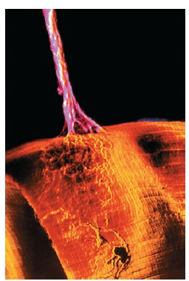
The Synapse
Electron micrograph of a motor neuron making contact with muscle fibers
Notes:
9

Slide 10
Neurotransmission: Sending the Message to Other Cells (1 of 2)
Learning Objective 4.1: Describe the parts of the neuron and understand the basic process of neural transmission.
Once a neural signal reaches the axon terminal bulbs, it enlarges to a giant scale
  Presynaptic terminal bulb comprises sac-like synaptic vesicles containing neurotransmitters
The space between two neurons is the fluid-filled synaptic gap
On the other side of the synaptic gap are the dendrites with receptor sites of another neuron

Slide 11
Neurotransmission: Sending the Message to Other Cells (2 of 2)
Learning Objective 4.1: Describe the parts of the neuron and understand the basic process of neural transmission.
Action potential (signal) travels through the axon bulbs – synaptic vesicles release neurotransmitters in the synaptic gap
Neurotransmitters carry the signal to the receptor sites of the adjacent neuron (lock-and-key fit)

Slide 12
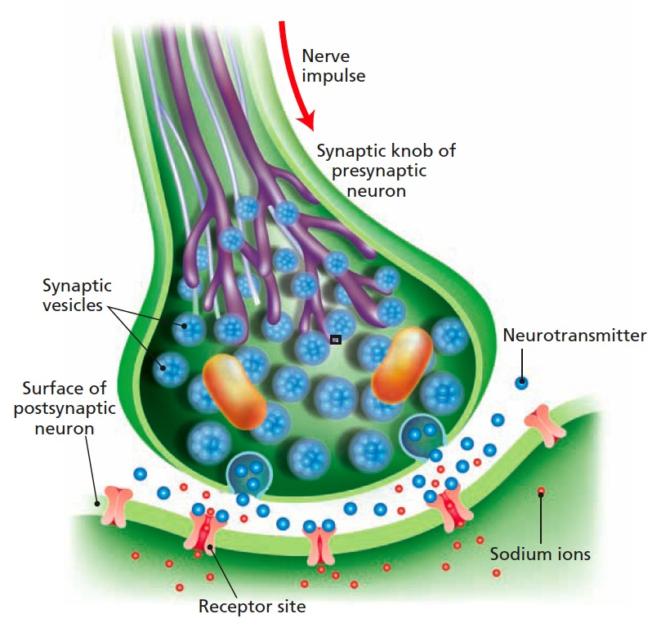
Figure 4.1 The Synapse
The nerve impulse reaches the axon terminal bulb
Triggers release of neurotransmitters from the synaptic vesicles
Molecules of neurotransmitter cross the synaptic gap to fit into the receptor sites that fit the shape of the molecule
Opening of ion channel letting sodium ions in
Notes:
12

Slide 13
Neurotransmitters (1 of 2 )
Learning Objective 4.1: Describe the parts of the neuron and understand the basic process of neural transmission
The first neurotransmitter identified: acetylcholine (ACh)
  Found at the synapses between neurons and muscle cells
  Stimulates the skeletal muscles to contract and slows contractions in the heart muscle
  Blocked acetylcholine receptor sites lead to paralysis
  Excessive acetylcholine causes convulsions and possible death

Slide 14
Neurotransmitters (2 of 2 )
Learning Objective 4.1: Describe the parts of the neuron and understand the basic process of neural transmission.
Chemical substances can affect neuronal communication.
  Agonists: mimic or enhance the effects of a neurotransmitter on the receptor sites of the next cell, increasing or decreasing the activity of that cell
  Antagonists: block or reduce a cell’s response to the action of other chemicals or neurotransmitters
Endorphins: pain-controlling chemicals in the body
  bind to receptors that open the ion channels on the axon

Slide 15
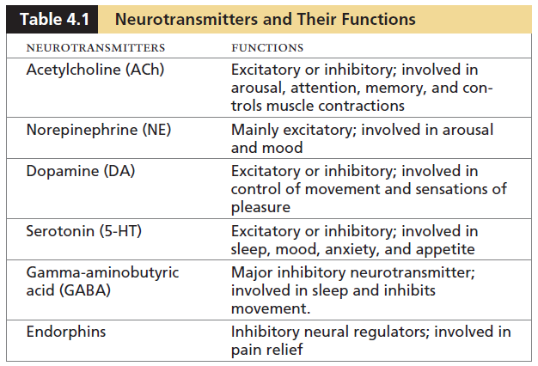
Table 4.1 Neurotransmitters and Their Functions
Notes:
15

Slide 16
Cleaning Up the Synapse
Learning Objective 4.1: Describe the parts of the neuron and understand the basic process of neural transmission.
Neurotransmitters are flushed from the receptor sites before next stimulation
Some drift away through diffusion
Reuptake: process by which neurotransmitters are taken back into the synaptic vesicles

Slide 17
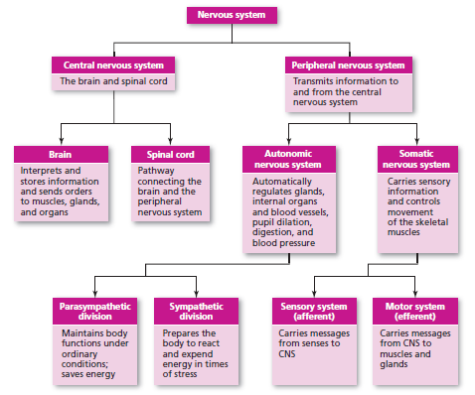
Figure 4.2 An Overview of the Nervous System
Notes:
17

Slide 18
Central Nervous System (1 of 2)
Learning Objective 4.2: Describe the major divisions of the human nervous system.
Central nervous system (C N S): part of the nervous system consisting of the brain and spinal cord
  Brain: the core of the nervous system
  Spinal cord:
    A long bundle of neurons composed of a lighter outer section and a darker inner section
    Outer section carries messages from the body up to the brain and from the brain down to the body
    Inner section made of cell bodies separated by glial cells – responsible for very fast, lifesaving reflexes

Slide 19
Central Nervous System (2 of 2)
Learning Objective 4.2: Describe the major divisions of the human nervous system.
Three basic types of neurons involved in spinal cord reflexes:
  Afferent neurons (Sensory neurons): carry messages from the senses to the spinal cord
  Efferent neurons (Motor neurons): carry messages from the spinal cord to the muscles and glands
  Interneurons: connect the afferent neurons to the motor neurons
    Found in the center of the spinal cord that receives information from the sensory neurons and sends commands to the muscles through the motor neurons
    Interneurons make up the bulk of the neurons in the brain

Slide 20
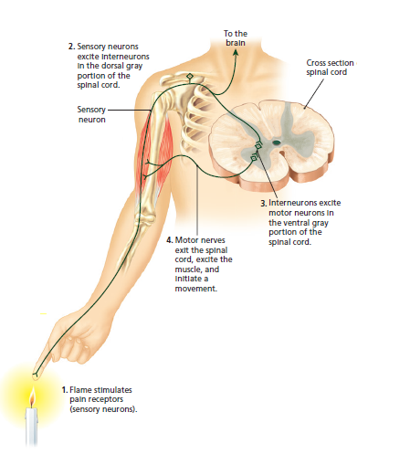
Figure 4.3 The Spinal Cord Reflex
The pain from the burning heat of the candle flame stimulates the afferent nerve fibers
The message is carried up to the interneurons in the middle of the spinal cord
The interneurons then send a message out by means of the efferent nerve fibers, causing the hand to jerk away from the flame: a reflex arc
Notes:
20

Slide 21
Damage to the Central Nervous System
Learning Objective 4.3: Identify the mechanisms of, and the importance of, plasticity of the nervous system, and describe advances made in neuroscience.
Neurons in the brain and spinal cord are capable of repairing themselves
Neuroplasticity: the ability to constantly change both the structure and function of cells in response to experience or trauma

Slide 22
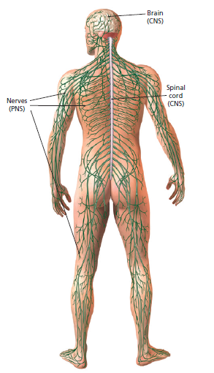
Figure 4.4 The Peripheral Nervous System
Notes:
22

Slide 23
The Peripheral Nervous System
Learning Objective 4.3: Identify the mechanisms of, and the importance of, plasticity of the nervous system, and describe advances made in neuroscience.
Peripheral nervous system (P N S): all nerves and neurons that are not contained in the brain and spinal cord, but that run through the body itself
Two types:
  Somatic nervous system: voluntary responses
  Autonomic nervous system: involuntary responses

Slide 24
The Somatic Nervous System
Learning Objective 4.3: Identify the mechanisms of, and the importance of, plasticity of the nervous system, and describe advances made in neuroscience.
Somatic nervous system:
  Sensory pathway: nerves coming from the sensory organs to the C N S; consists of sensory neurons
  Motor pathway: nerves coming from the C N S to the voluntary or skeletal muscles of the body; consists of motor neurons

Slide 25
The Autonomic Nervous System (1 of 2)
Learning Objective 4.3: Identify the mechanisms of, and the importance of, plasticity of the nervous system, and describe advances made in neuroscience.
Autonomic Nervous System (ANS): controls the organs, glands, and involuntary muscles
Comprise large groups of neurons near the spinal column
Two divisions
  Sympathetic division: “fight-or-flight system”
    Allows to deal with a range of extreme emotions and stressful events
    Various body organs are stimulated
    Adrenal glands are stimulated to release certain stress-related hormones that target organs like heart, muscles, and lungs to increase further efficiency

Slide 26
The Autonomic Nervous System (2 of 2)
Learning Objective 4.3: Identify the mechanisms of, and the importance of, plasticity of the nervous system, and describe advances made in neuroscience.
  Parasympathetic division: “eat-drink-and-rest” system
    Restores the body to normal functioning after arousal and is responsible for the day to day functioning of the organs and glands
    Adrenal glands are stimulated to release certain stress-related hormones that target organs like heart, muscles, and lungs to increase further efficiency

Slide 27
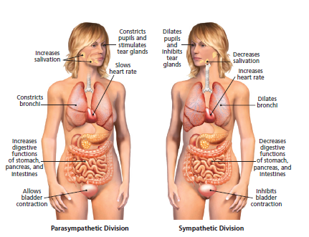
Figure 4.5 Functions of the Parasympathetic and Sympathetic Divisions of the Nervous System
Notes:
27

Slide 28
Endocrine Glands
Learning Objective 4.4: Explain how the endocrine glands interact with the nervous system.
General characteristics:
  Secrete hormones (chemicals) directly into the bloodstream to affect behavior rapidly
  Endocrine communication is generally slower due to the time it takes hormones to travel to target organs
  They fit into the receptor sites of target organs and affect their functions
Major endocrine glands include pineal gland, thyroid gland, pancreas, gonads, and adrenal glands

Slide 29
Endocrine Glands
Learning Objective 4.4: Explain how the endocrine glands interact with the nervous system.
Pituitary gland: “master gland”
  Located directly above the brain stem, below the hypothalamus
  Hypothalamus controls the glandular system by releasing hormones to the pituitary
  Hormones from pituitary affect other endocrine glands
  Growth hormone: controls and regulates the increase in size

Slide 30
Endocrine Glands
Learning Objective 4.4: Explain how the endocrine glands interact with the nervous system.
Pineal gland:
  Located in the brain, near the back, directly above the brain stem
  Secretes a hormone called melatonin, which helps track of day length (and seasons), regulating the sleep–wake cycle in humans

Slide 31
Endocrine Glands
Learning Objective 4.4: Explain how the endocrine glands interact with the nervous system.
Thyroid gland
  Located inside the neck
  Secretes hormones that regulate growth and metabolism
  Plays a crucial role in body and brain development
  Thyroxin: a hormone that controls how fast the body burns its available energy

Slide 32
Endocrine Glands
Learning Objective 4.4: Explain how the endocrine glands interact with the nervous system
Pancreas: controls the level of blood sugar in the body by secreting insulin
  Insulin: breaks down sugar in the bloodstream
  Secretion of too little insulin results in diabetes; too much leads to hypoglycemia

Slide 33
Endocrine Glands
Learning Objective 4.4: Explain how the endocrine glands interact with the nervous system
Gonads: the sex glands; secrete hormones that regulate sexual development and behavior as well as reproduction
  Ovaries: the female gonads
  Testes: the male gonads

Slide 34
Endocrine Glands
Learning Objective 4.4: Explain how the endocrine glands interact with the nervous system.
Adrenal glands: endocrine glands located on top of each kidney
  Secrete epinephrine and norepinephrine to deal with stress; aids in sympathetic arousal

Slide 35
The General Adaptation Syndrome
Learning Objective 4.5: Outline how hormones influence behavior and mental processes.
Hans Selye studied the sequence [General Adaptation Syndrome (GAS)] of physiological reactions that the body goes during stress
Three stages
  Alarm
  Resistance
  Exhaustion

Slide 36
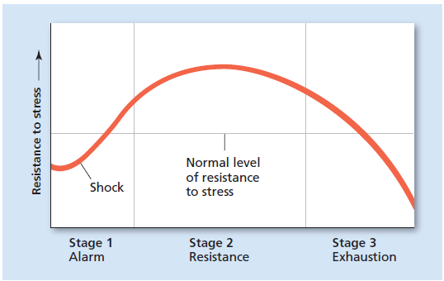
Figure 4.6 General Adaptation Syndrome
In the alarm stage, resistance drops at first as the sympathetic system quickly activates
Resistance then rapidly increases as the body mobilizes its defense systems
In the resistance stage, the body is working at a much increased level of resistance, using resources until the stress ends or the resources run out
In the exhaustion stage, the body is no longer able to resist as resources have been depleted, and at this point disease and even death are possible
Notes:
36

Slide 37
Immune system (1 of 2)
Learning Objective 4.6: Explain how hormones interact with the immune system.
Immune system: cells, organs, and chemicals of the body that respond to attacks from diseases, infections, and injuries
  Stress triggers the same response in the immune system that infection triggers
  Confers stress toleration
Psychoneuroimmunology: the study of the effects of psychological factors on the immune system

Slide 38
Immune system (2 of 2)
Learning Objective 4.6: Explain how hormones interact with the immune system.
Heart disease: stress puts people at higher risk for coronary heart disease (C H D)
  Stress builds up a waxy substance called plaque in the arteries of the heart
Cancer: collection of diseases that can affect any part of the body
  Cancer cells divide without stopping
  Results in tumor

Slide 39
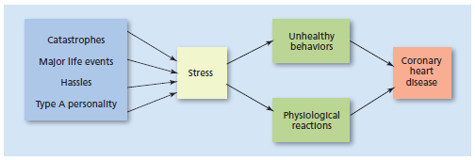
Figure 4.7 Stress and Coronary Heart Disease
The blue box on the left represents various sources of stress (Type A personality refers to someone who is ambitious, always working, and usually hostile)
In addition to the physical
reactions that accompany the stress reaction, an individual under stress may be more
likely to engage in unhealthy behavior such as overeating, drinking alcohol or taking other
kinds of drugs, avoiding exercise, and acting out in anger or frustration
This kind of behavior also contributes to an increased risk of coronary heart disease
Notes:
39

Slide 40
Module 5
The Brain

Slide 41
Learning Objectives
  5.1 Describe tools used to study the brain and nervous system.
  5.2 Understand the structures and functions of the various parts of the central nervous system.
  5.3 Explain how lateralization differentiates the hemispheres of the brain.
  5.4 Describe various issues and advances in neuroscience and genetics.

Slide 42
Peeking Inside the Living Brain
Learning Objective 5.1: Describe tools used to identify the brain and nervous system.
Studying humans and animals with brain damage or manipulated brain tissue
Three methods:
  Lesioning: sending an electrical current strong enough to destroy the target neurons through the tip of the wire surgically inserted into the brain
  Brain stimulation: temporarily disrupting or enhancing the normal functioning of specific brain areas through electrical stimulation, resulting in changes in behavior or cognition
  Neuroimaging techniques: directly imaging the brain’s structure or its function

Slide 43
Manipulation Techniques (1 of 2)
Learning Objective 5.1: Describe tools used to identify the brain and nervous system.
Lesioning:
  Anesthetize animals.
  Purposefully damage part of animal's brain through electrical current to study that area scientifically.
  Test the animal to see what has happened to its abilities.

Slide 44
Manipulation Techniques (2 of 2)
Learning Objective 5.1: Describe tools used to identify the brain and nervous system.
Brain Stimulation:
  Invasive techniques: Stimulating from the inside
    Deep brain stimulation (DBS): electrodes placed in specific deep-brain areas and electrode wires are then routed to an impulse generator that sends impulses to specific brain areas of interest
  Noninvasive techniques: Stimulating from the outside
    Transcranial magnetic stimulation (TMS): magnetic pulses are applied to the cortex using special copper wire coils positioned over the head
Notes:
44

Slide 45
Mapping Brain Structure
Learning Objective 5.1: Describe tools used to identify the brain and nervous system.
Computed tomography (C T): brain-imaging using computer-aided series of X- rays; shows stroke damage, tumors, injuries, and abnormal brain structure
Magnetic resonance imaging (M R I): more detailed than CT; shows effects of very small strokes

Slide 46
Mapping Brain Function (1 of 2)
Learning Objective 5.1: Describe tools used to identify the brain and nervous system.
Electroencephalogram (E E G):
  Records electric activity of the cortex below specific areas of the skull using an electroencephalograph
  Small metal-disk or sponge-like electrodes placed directly on the scalp with a special solution to help conduct electrical signals
  Electrodes are connected to an amplifier in turn connected to a computer to view the information
  Resulting electrical output forms waves indicates stages of sleep, seizures, and even the presence of tumors; determination of active areas of brain during mental tasks

Slide 47
Mapping Brain Function (2 of 2)
Learning Objective 5.1: Describe tools used to identify the brain and nervous system.
Positron emission tomography (PET):
  brain-imaging through injection of a radioactive glucose into the subject; computer detects activity of brain cells consuming the glucose
  a color-coded image of the brain with lighter colors indicates greater activity
Functional magnetic resonance imaging (fMRI):
  Computer tracks changes in the oxygen levels of the blood
  Active brain areas are identified by superimposing the scan over the picture of the brain’s structure

Slide 48
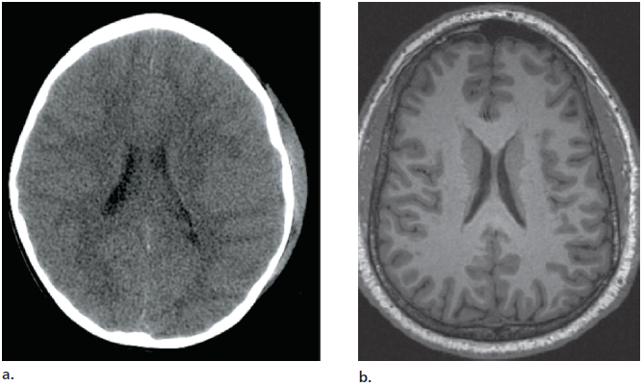
Figure 5.1: Mapping Brain Structure
a. CT scan from a 5-year-old girl with a head injury and skull fracture
b. In an adult individual

Slide 49
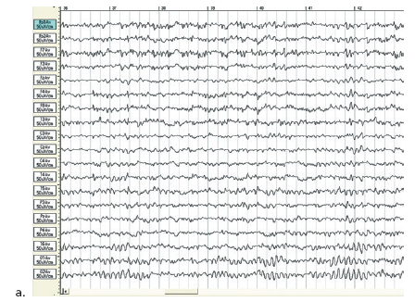
Figure 5.2: Mapping Brain Function
a. EEG record b. PET scan image c. fMRI image

Slide 50
Structure of Human Brain
Learning Objective 5.2: Understand the structures and functions of the various parts of the central nervous system.
Brain: three primary divisions
  The forebrain
    Cortex
    Basal ganglia
    Limbic system
  The midbrain
    Involved in sensory and motor functions
  The hindbrain
    Medulla
    Pons
    Reticular formation
    Cerebellum

Slide 51
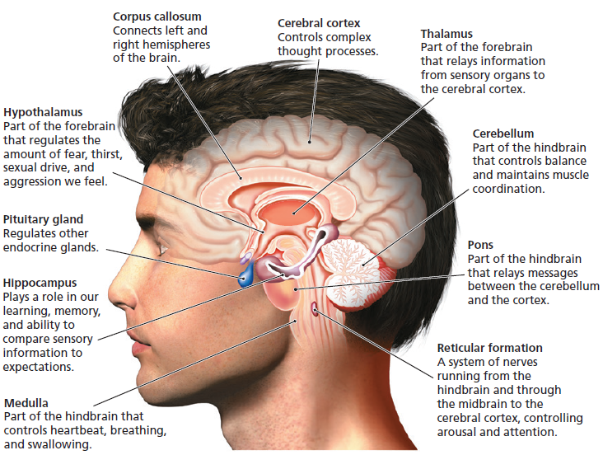
Figure 5.3: Major Structures of the Human Brain

Slide 52
The Hindbrain (1 of 2)
Learning Objective 5.2: Understand the structures and functions of the various parts of the central nervous system.
The Hindbrain
  Medulla: means “the deep inside region or marrow”
    First large swelling at the top of the spinal cord, forming the lowest part of the brain
    Point where sensory nerves from the left and right sides of the body crossover
    Controls life-sustaining functions such as breathing, swallowing, and heart rate
  Pons: means “bridge”
    Larger swelling above the medulla that connects the lower sections of the brain to the upper sections
    Plays a part in sleep, dreaming, left–right body coordination, and arousal

Slide 53
The Hindbrain (2 of 2)
Learning Objective 5.2: Understand the structures and functions of the various parts of the central nervous system.
  Reticular formation (R F): area of neurons running through the middle of the medulla and the pons and slightly beyond
    Responsible for selective attention and ignoring constant unchanging information
    Reticular activating system (RAS): stimulates the upper part of the brain, keeping people awake and alert
  Cerebellum: means “little brain”
    Part of the lower brain located behind the pons
    Controls involuntary, rapid, fine motor movement and coordinates voluntary movements that have to happen in rapid succession

Slide 54
The Limbic System (1 of 3)
Learning Objective 5.2: Understand the structures and functions of the various parts of the central nervous system.
Limbic system: subcortical structures located in the inner margin of the upper brain; involved in learning, emotion, and motivation
It includes:
  Thalamus
  Hypothalamus
  Hippocampus
  Amygdala
  Cingulate cortex

Slide 55
The Limbic System (2 of 3)
Learning Objective 5.2: Understand the structures and functions of the various parts of the central nervous system.
Thalamus:
  Somewhat round structure in the center of the brain
  Receives sensory information from the lower part of the brain, processes it, relays it to the proper areas of the cortex
  Damage to the thalamus might result in the loss or partial loss of sensations
Hypothalamus:
  Small structure in the brain located below the thalamus and directly above the pituitary gland
  Responsible for motivational behavior such as sleep, hunger, thirst, and sex; regulates homeostasis

Slide 56
The Limbic System (3 of 3)
Learning Objective 5.2: Understand the structures and functions of the various parts of the central nervous system.
Hippocampus: meaning “seahorse”
  Curved structure located within each temporal lobe
  Responsible for the formation of long-term declarative memories
Amygdala: meaning “almond”
  Located near the hippocampus
  Responsible for fear responses and the memory of fear
  Information from the senses goes to the amygdala before the upper part of the brain stimulating quicker response

Slide 57
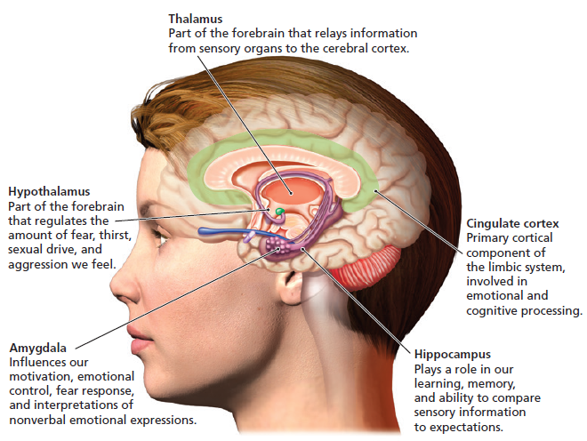
Figure 5.4: The Limbic System

Slide 58
Cortex
Learning Objective 5.2: Understand the structures and functions of the various parts of the central nervous system.
Outermost covering of the brain consisting of densely packed neurons
One-tenth of an inch thick on average
Wrinkled surface allows for more surface area for neurons to fit in the small space inside the skull
Responsible for higher thought processes and interpretation of sensory input
Notes:
58

Slide 59
Cerebral Hemispheres (1 of 2)
Learning Objective 5.2: Understand the structures and functions of the various parts of the central nervous system.
Two hemispherical sections of the brain cortex
Corpus callosum: meaning “hard bodies”
  Tough, thick band of neural fibers that connects the right and left cerebral hemispheres
Contralateral organization:
  For specific regions, each hemisphere is responsible for the opposite side of the body, for control or for receiving information
  Plays a role in information coming from many of the sense organs to the brain, and in the motor commands originating in the brain going to the rest of the body

Slide 60
Cerebral Hemispheres (2 of 2)
Learning Objective 5.2: Understand the structures and functions of the various parts of the central nervous system.
Each hemisphere can be divided into four lobes:
  Occipital
  Parietal
  Temporal
  Frontal
Notes:
60

Slide 61
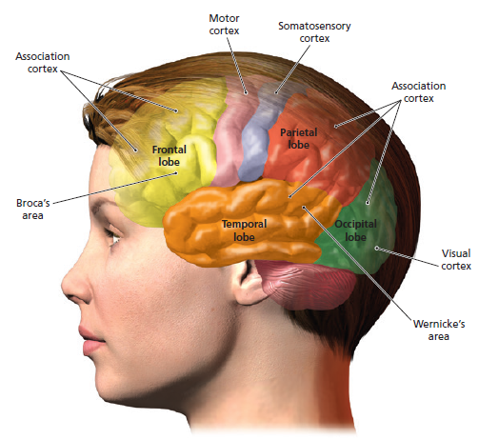
Figure 5.5: The Lobes of the Brain: Occipital, Parietal, Temporal, and Frontal

Slide 62
Four Lobes of the Brain (1 of 5)
Learning Objective 5.2: Understand the structures and functions of the various parts of the central nervous system.
Occipital lobe:
  Section of the brain located at the rear and bottom of each cerebral hemisphere
  Contains the visual centers of the brain
    Primary visual cortex: processes visual information from the eyes
    Visual association cortex: helps identify and make sense of the visual information from the eyes

Slide 63
Four Lobes of the Brain (2 of 5)
Learning Objective 5.2: Understand the structures and functions of the various parts of the central nervous system.
Parietal Lobes
  Sections of the brain located at the top and back of each cerebral hemisphere just under the parietal bone
  Comprises the somatosensory cortex:
    Area of cortex at the front of the parietal lobes
    The cells at the top of the brain receive information from the bottom of the body and vice versa
    Responsible for processing information from the skin and internal body receptors for touch, temperature, and body position

Slide 64
Four Lobes of the Brain (3 of 5)
Learning Objective 5.2: Understand the structures and functions of the various parts of the central nervous system.
Temporal lobes:
  Areas of the cortex located just behind the temples
  Responsible for the sense of hearing and meaningful speech
  Comprises:
    Primary auditory cortex
    Auditory association area
    An area involved in language in the left temporal lobe

Slide 65
Four Lobes of the Brain (4 of 5)
Learning Objective 5.2: Understand the structures and functions of the various parts of the central nervous system.
Frontal lobes:
  Areas of the brain located in the front and top
  Responsible for higher mental functions of the brain –planning, personality, memory storage, impulse control, complex decision making and the production of fluent speech
  Helps control emotions through its connection to the limbic system

Slide 66
Four Lobes of the Brain (5 of 5)
Learning Objective 5.2: Understand the structures and functions of the various parts of the central nervous system.
Frontal lobes (continued): It comprises
  Prefrontal cortex: most forward part of the frontal lobes; responsible for performing mental and motor tasks
  Motor cortex:
    Rear section of the frontal lobe; resembles the somatosensory cortex
    Controls the movements of the body’s voluntary muscles by sending commands out to the somatic division of the peripheral nervous system
    Comprises mirror neurons that fire when an animal performs an action or when an animal observes that same action being performed by another
Notes:
66

Slide 67
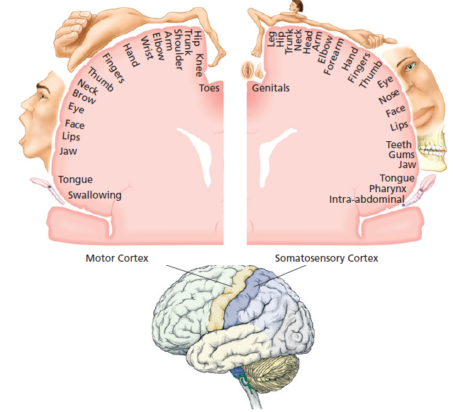
Figure 5.6: The Motor and Somatosensory Cortex
The motor cortex controls the voluntary muscles of the body.
Body parts are drawn larger or smaller according to the number of cortical cells devoted to that body part.
The somatosensory cortex receives information about the sense of touch and body position.

Slide 68
Association Areas of Cortex (1 of 4)
Learning Objective 5.2: Understand the structures and functions of the various parts of the central nervous system.
Areas within each lobe of the cortex responsible for the coordination and interpretation of information, as well as higher mental processing
Make connections between the sensory information coming into the brain and stored memories, images, and knowledge
Majority of these areas present in the frontal lobe

Slide 69
Association Areas of Cortex (2 of 4)
Learning Objective 5.2: Understand the structures and functions of the various parts of the central nervous system.
Broca’s area:
  Present in the left frontal lobe of most people; allows smooth and fluent speech
  Broca’s aphasia: Condition resulting from damage to the area causes broken speech – halting with mispronounced words

Slide 70
Association Areas of Cortex (3 of 4)
Learning Objective 5.2: Understand the structures and functions of the various parts of the central nervous system.
Wernicke’s area:
  Part of the left temporal lobe; involved in understanding the meaning of words
  Wernicke’s aphasia: Damage to the area leads to a condition where the affected person is able to speak fluently and pronounce entirely wrong words correctly

Slide 71
Association Areas of Cortex (4 of 4)
Learning Objective 5.2: Understand the structures and functions of the various parts of the central nervous system.
Spatial neglect or unilateral neglect:
  Condition produced by damage to the right parietal and occipital lobes
  Results in an inability to recognize objects or body parts in the left visual field

Slide 72
Split-Brain Research (1 of 2)
Learning Objective 5.3: Explain how lateralization differentiates the hemispheres of the brain.
Hemispheric specialization experiment:
  Roger Sperry cut through the corpus callosum, creating a split brain, to cure epilepsy; initial success in animal and human subjects
  Special testing conducted by sending messages to only one side of the brain in patients with a split brain

Slide 73
Split-Brain Research (2 of 2)
Learning Objective 5.3: Explain how lateralization differentiates the hemispheres of the brain.
Results:
  Left hemisphere specializes in language, speech, handwriting, calculation (math), sense of time and rhythm, and thought analysis
  Right hemisphere specializes in processing involving perception, visualization, spatial perception, recognition of patterns, faces, emotions, melodies, expression of emotions, and comprehension of simple language
Notes:
73

Slide 74
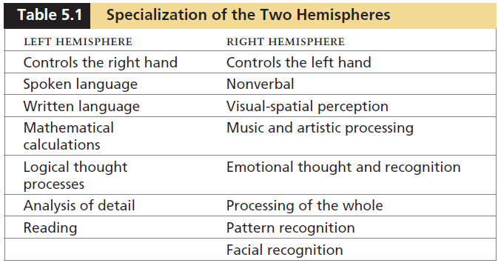
Table 5.1: Specialization of the Two Hemispheres

Slide 75
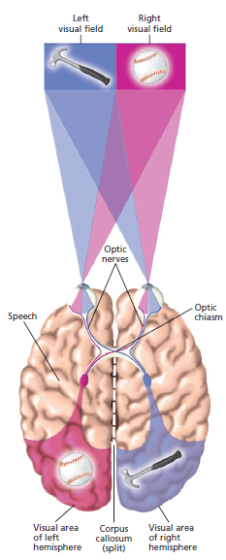
Figure 5.7: The Split-Brain Experiment (specialization of the left and right hemispheres of the brain)

Slide 76
Attention-Deficit/Hyperactivity Disorder (ADHD)
Learning Objective 5.4: Describe various issues and advances in neuroscience and genetics.
A developmental disorder involving behavioral and cognitive aspects of inattention, impulsivity, and hyperactivity
Causes with specific markers: biological, cognitive, or behavioral
Majority of the research focuses on cognitive attention problems: lack of vigilance and lack of control of one’s own cognitive processes
Current research focuses on environmental, biological, genetic, and personality factors

Slide 77
Module 6
Heredity, Environment, and Adaptation

Slide 78
Learning Objectives
  6.1 Explain the relationship between heredity and environmental factors in determining development.
  6.2 Understand the role of chromosomes and genes in determining the transmission of traits and the inheritance of disorders.
  6.3 Describe the influence of evolved tendencies on behavior.
Notes:
78

Slide 79
Nature versus Nurture (1 of 2)
Learning Objective 6.1: Explain the relationship between heredity and environmental factors in determining development.
Nature: refers to heredity, the influence of inherited characteristics on personality, physical growth, intellectual growth, and social interactions
Nurture: the influence of the environment on personality, physical growth, intellectual growth, and social interactions
Notes:
79

Slide 80
Nature versus Nurture (2 of 2)
Learning Objective 6.1: Explain the relationship between heredity and environmental factors in determining development.
Most psychologists believe that both nature and nurture play important roles in human development
Behavioral genetics: a new field in which researchers try to determine how much of behavior is the result of genetic inheritance and how much is because of a person’s experiences
Notes:
80

Slide 81
Role of Chromosomes and Genes (1 of 2)
Learning Objective 6.2: Understand the role of chromosomes and genes in determining the transmission of traits and the inheritance of disorders.
Genetics: the science of heredity
DNA (deoxyribonucleic acid)
  Special molecule that contains the genetic material of an organism
  Consists of two very long sugar–phosphate strands, each linked together by amines or bases arranged in a particular pattern
  Amines contain the genetic code for building proteins
Notes:
81

Slide 82
Role of Chromosomes and Genes (2 of 2)
Learning Objective 6.2: Understand the role of chromosomes and genes in determining the transmission of traits and the inheritance of disorders.
Gene: section of DNA having the same arrangement of chemical elements
Chromosome: tightly wound strand of genetic material or DNA; found in the nucleus of a cell
  Humans have 46 chromosomes in each cell (except the egg and the sperm) – 23 pairs
  Most characteristics are determined by 22 such pairs, called autosomes
  The two chromosomes of the 23rd pair are called the sex chromosomes: XX being female and XY being male
Notes:
82

Slide 83
Dominant and Recessive Genes
Learning Objective 6.2: Understand the role of chromosomes and genes in determining the transmission of traits and the inheritance of disorders.
Dominant gene: a gene that actively controls the expression of a trait
Recessive gene: a gene that influences the expression of a trait only when paired with an identical gene

Slide 84
Genetic Problems
Learning Objective 6.2: Understand the role of chromosomes and genes in determining the transmission of traits and the inheritance of disorders.
Diseases carried by recessive genes are inherited when a child inherits two recessive genes, one from each parent
Examples: cystic fibrosis, sickle-cell anemia, Tay-Sachs disorder, phenylketonuria (PKU), etc.
Phenylketonuria: condition in which an infant is born without the ability to break down phenylalanine that controls coloring of skin and hair
  Inappropriate levels could damage brain and hamper intellectual capabilities

Slide 85
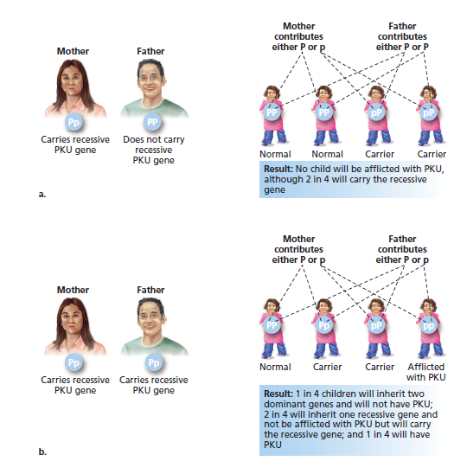
Figure 6.1: Dominant and Recessive Genes and PKU
  The variation of parents carrying zero, one, or two recessive genes and the result of this in their offspring is shown.
  a) If only one parent carries the PKU gene, the children might be carriers but will not have PKU.
  b) Only if both parents are carriers of PKU will a child have the one in four possibility of having PKU.

Slide 86
Chromosome Problems
Learning Objective 6.2: Understand the role of chromosomes and genes in determining the transmission of traits and the inheritance of disorders.
Problem with the number of chromosomes
  Chromosome can end up in the wrong cell, creating imbalance: one cell with only 22 and the other with 24
  Can cause mild to severe problems in development
  Example: Down syndrome
    Developmental delay caused by an extra chromosome in the 21st pair
    Symptoms include the physical characteristics of almond-shaped, wide-set eyes; intellectual disability

Slide 87
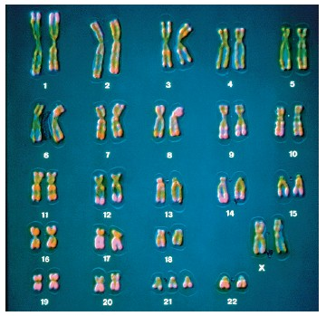
Down Syndrome

Slide 88
Charles Darwin and Natural Selection
Learning Objective 6.3: Describe the influence of evolved tendencies on behavior.
Common belief that human behavior is shaped by biology, environment, and evolutionary forces
Charles Darwin
  19th-century British scientist
  Theory of evolution: principle stating that species of plants and animals change gradually over the course of many generations
  Natural selection: traits that contribute to survival are more likely to be passed on

