Slide 1
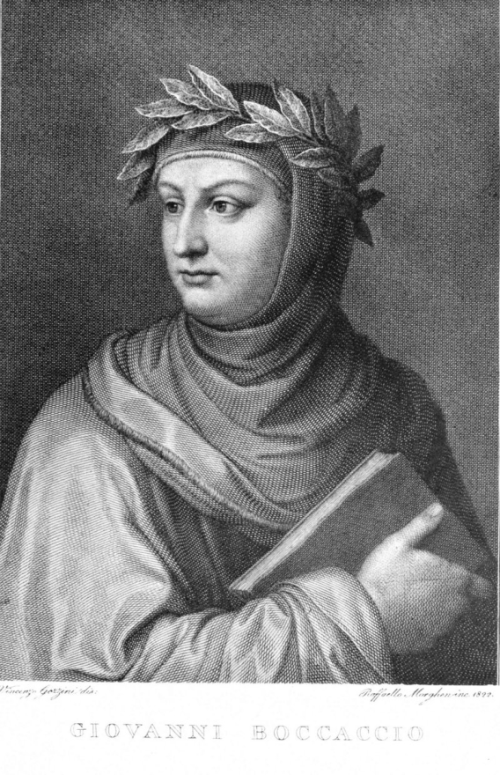
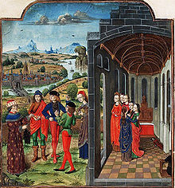
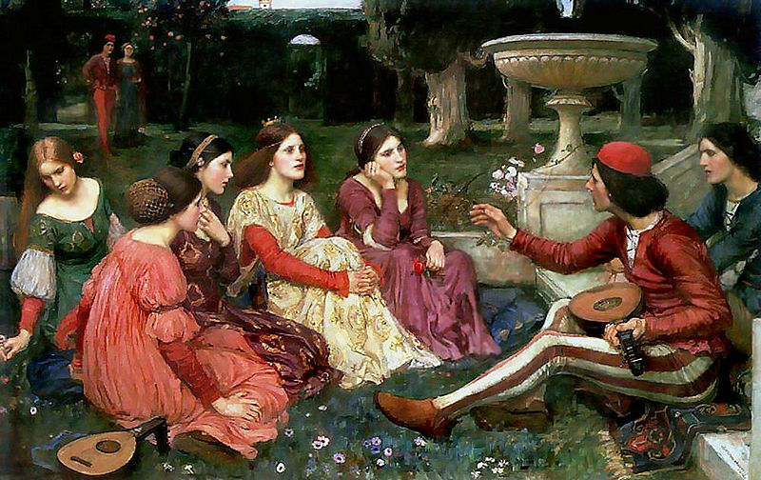

Slide 2
The Decameron
Before beginning the story-telling sessions, the ten young Florentines, 7 women and 3 men gather and together decide to escape the Black Death by leaving the city to stay in a villa in the countryside for the next two weeks. Each agrees to tell one story each day for ten days. The stories are told in the garden of the first villa that the company stays at, which is located a few miles outside the city.

Slide 3
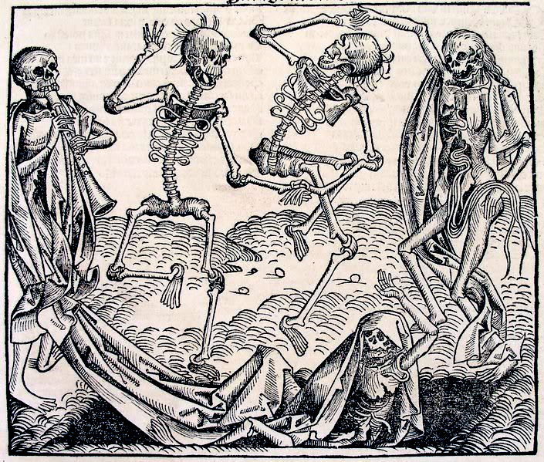
Dance of the Dead

Slide 4
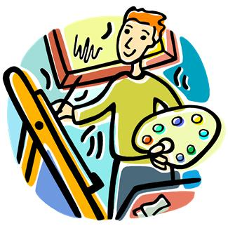
Renaissance Defined
Renaissance- “rebirth” of learning with an emphasis on the classics (Greek and Roman literature)

Slide 5
For example, Agnolo d Tura, of Siena, records his experience:
Father abandoned child, wife husband, one brother another; for this illness seemed to strike through the breath and sight. And so they died. And none could be found to bury the dead for money or friendship. Members of a household brought their dead to a ditch as best they could, without priest, without divine offices ... great pits were dug and piled deep with the multitude of dead. And they died by the hundreds both day and night... And as soon as those ditches were filled more were dug ... And I, Agnolo di Tura, called the Fat, buried my five children with my own hands. And there were also those who were so sparsely covered with earth that the dogs dragged them forth and devoured many bodies throughout the city. There was no one who wept for any death, for all awaited death. And so many died that all believed it was the end of the world. This situation continued [from May] until September.

Slide 6
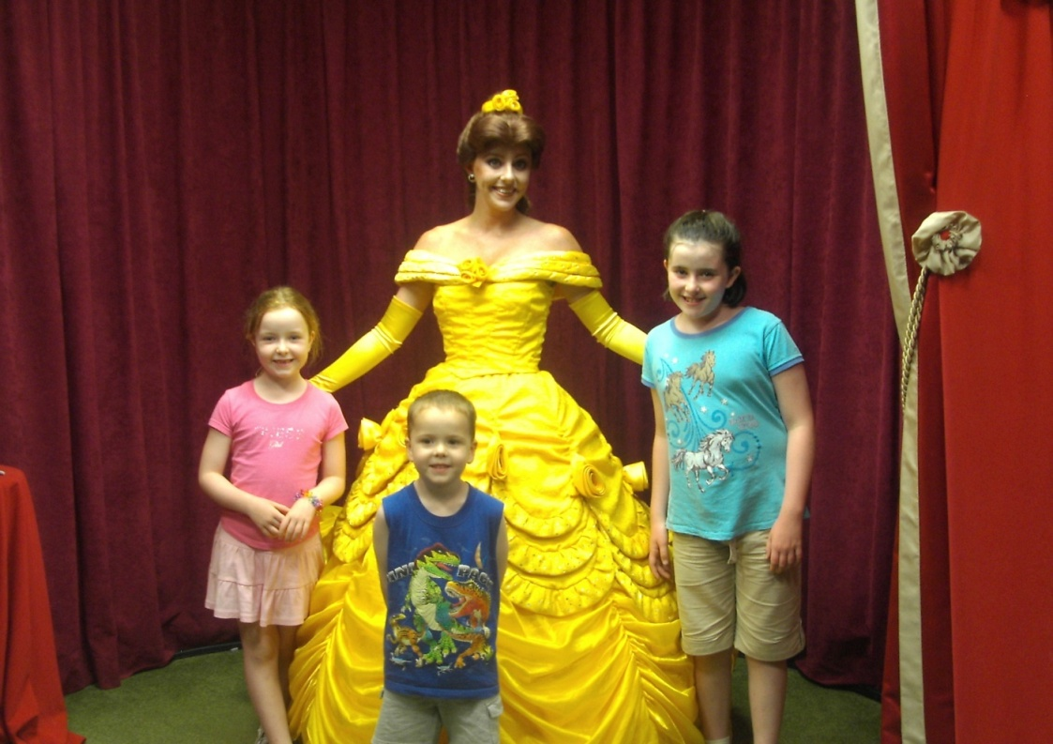
The Ideals of the Renaissance

Slide 7
Ideals of the Renaissance
Humanism- human beings and their lives are important
Well-Roundedness- being good at a great number of areas (examples: da Vinci- inventor, sculptor, painter)
Skepticism- does not believe on faith alone; needs evidence
Inquisitiveness- desire for knowledge

Slide 8
Renaissance Beginnings: Where and Why?
The Renaissance begins in Italy.
Location
Money
Stability
Remains of Roman Empire

Slide 9
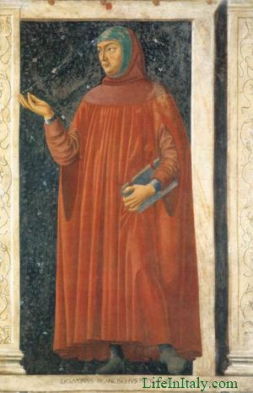
Petrarch
Italian scholar and poet
Father of Humanism
Collected and studied old Greek manuscripts

Slide 10
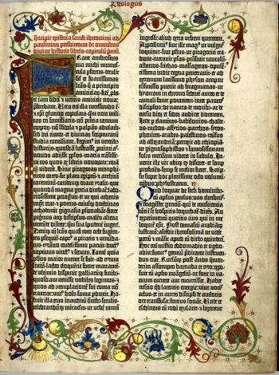
Renaissance Literature
Johann Gutenberg
  Invention of the printing press
  Goal was to create an incredible bible
  Went broke and lost his printing press

Slide 11
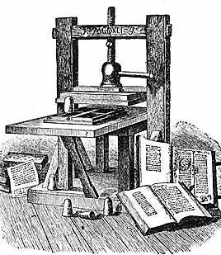
Printing Press
  Lowered cost of books
  Improved quality of books
  Increased numbers/availability of books
  Impacted the vernacular (common language

Slide 12
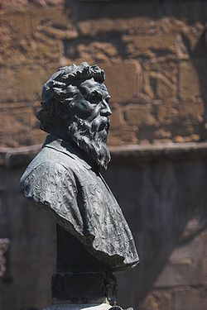
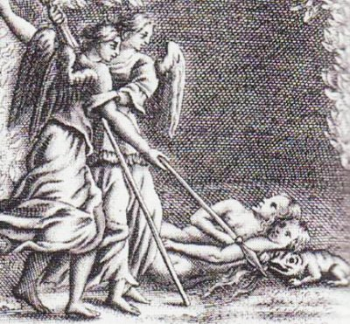
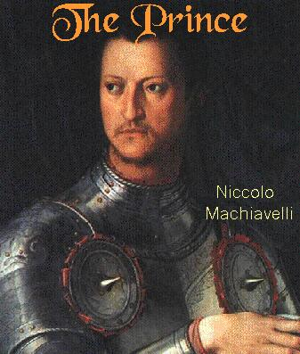
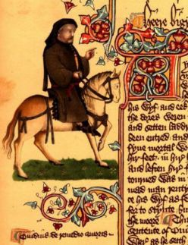
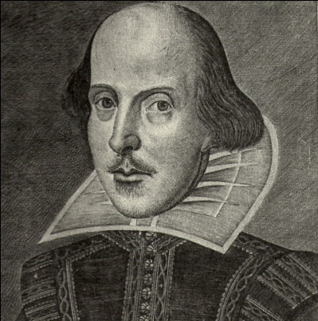
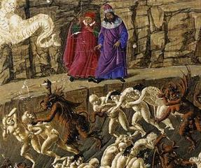
Renaissance Literature
Autobiography- Cellini
The Prince- Machiavelli
Don Quioxte- Cervantes
Paradise Lost- Milton
Divine Comedy- Dante
Canterbury Tales- Chaucer
Romeo & Juliet- Shakespeare

Slide 13
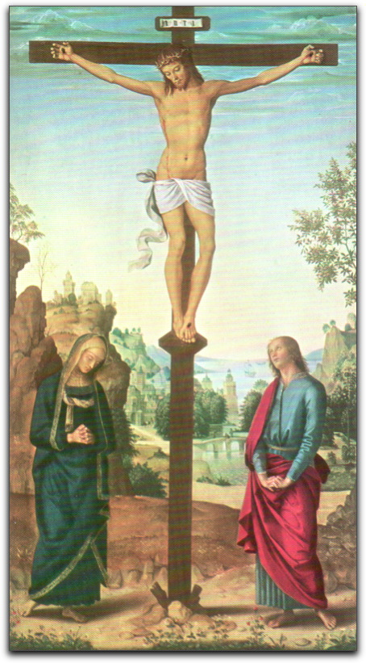
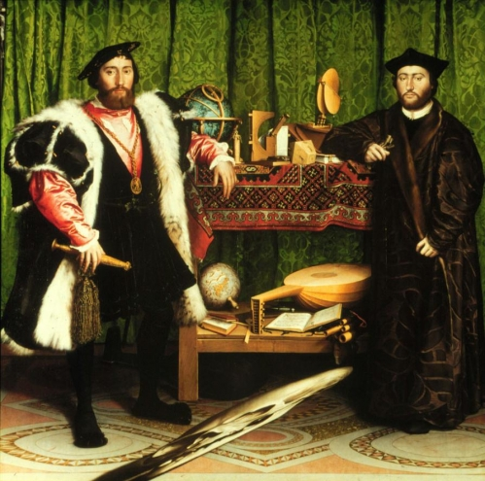
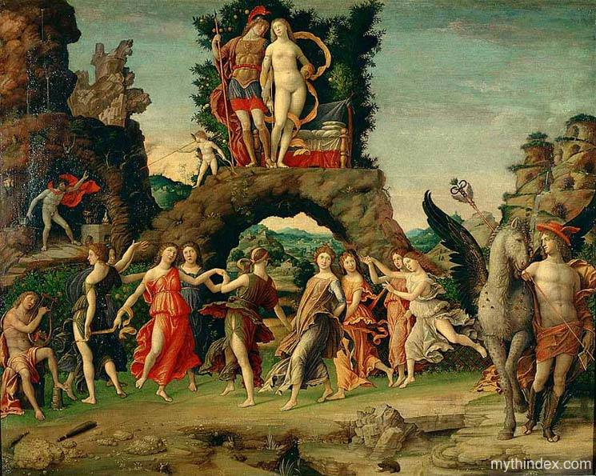
Renaissance Art: Topics
Religion
Greek/Roman Mythology
Everyday Events

Slide 14
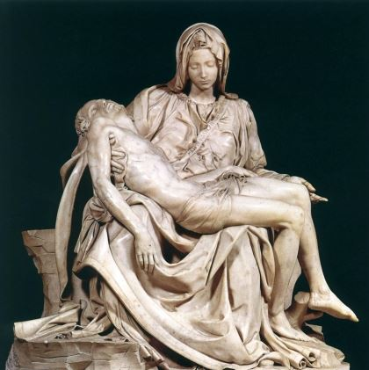
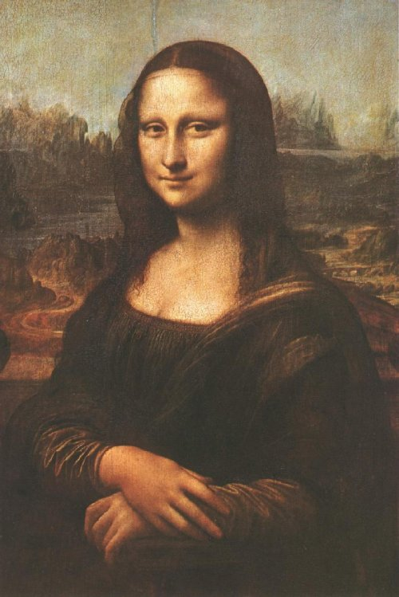
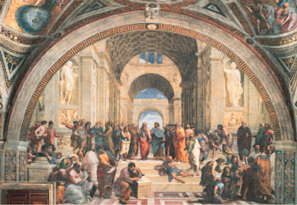
Renaissance Art: Form
Sculpture- expression of the human body; knowledge of muscles, joints and other body parts (la Pieta)
Paintings- realistic; biblical; classical; mythological; landscapes and everyday life (Mona Lisa)
Frescoes- paintings done in wet plaster, usually on walls (School of Athens)

Slide 15
Renaissance Artists
World History II

Slide 16
Leonardo da vinci
1452-1519
A “True Renaissance Man”
  The Ideal Renaissance Man
  considered the greatest painters of all time
  Architect, engineer, painter, sculptor, and scientist
    Had drawings for submarines, parachutes, helicopters, weapons
Some of his more famous works
Mona Lisa
The Last Supper
Notes:
He was an architect, engineer, painter, sculptor, and scientist. Inventions of his were extremely advanced for his time. E.g. submarines, helicopters, flying machines.

Slide 17

Da Vinci

Slide 18
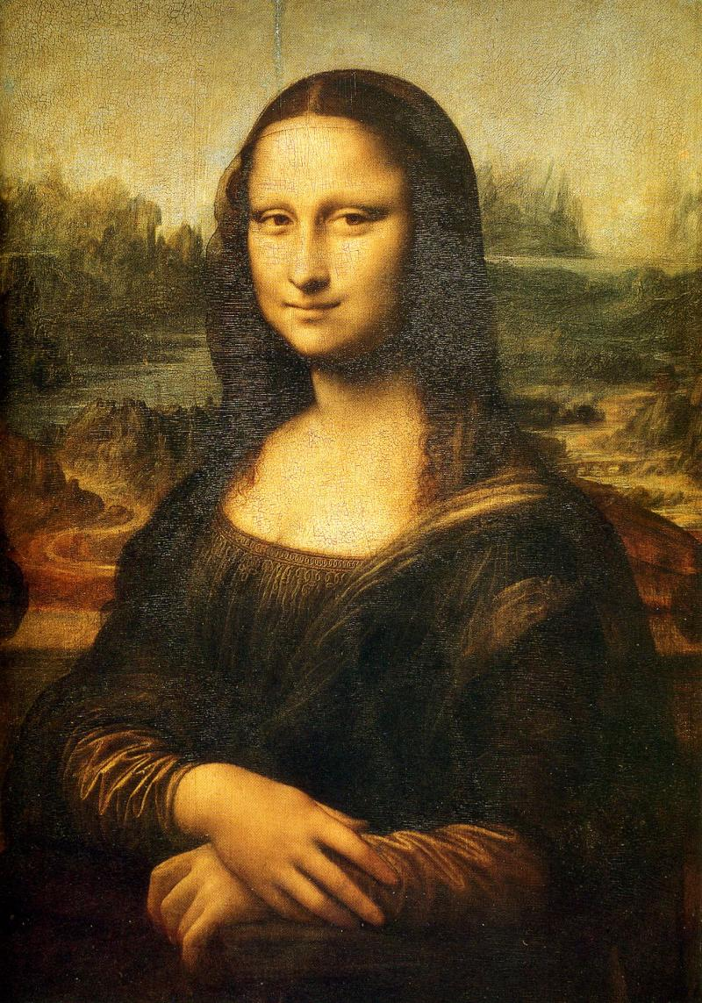
Notes:
-literally translates as “the laughing one”….the mysterious smile on the woman’s face is one of its most revered characteristics

Slide 19
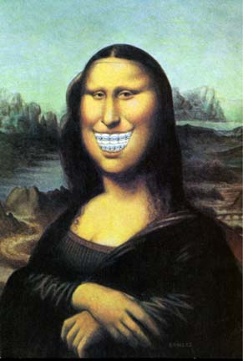

Slide 20
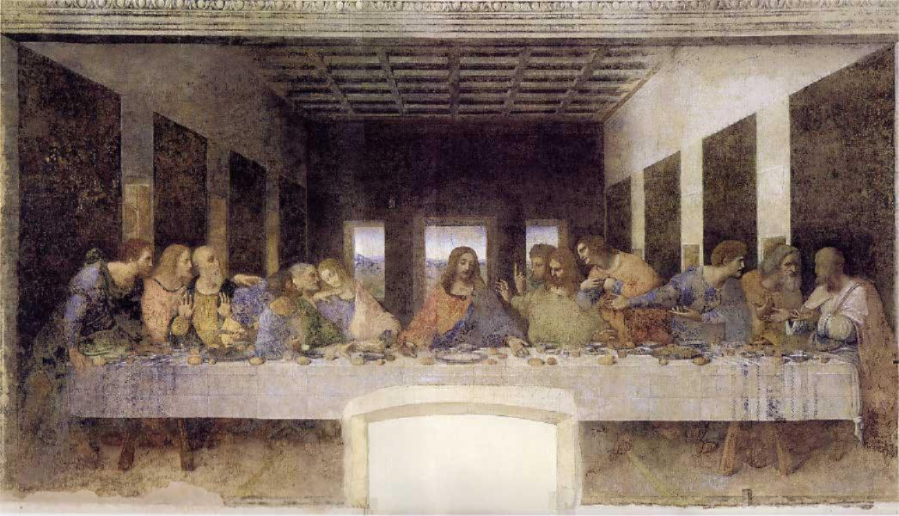
Notes:
-his most famous painting. An account of the last meal that Jesus has with his apostles. This painting helped to spark the Da Vinci Code→ belief that the figure to the right of Jesus is Mary Magdalene, and not the apostle John.

Slide 21
Michelangelo
1475-1564
Arguments with Pope Julius II
Sistine Chapel ceiling
-4 yrs to complete
Famous Works of Art
The statue of David
The painting of the Sistine Chapel
  Creation Stor
The Pieta
Notes:
-after finishing the Sistine Chapel, Michelangelo took Pope Julius II and his ambassadors to see his masterpiece. Reactions from everyone were positive, except from the Pope. Pope Julius II said the ceiling lacked “the final touch”. Michelangelo disagreed and convinced the Pope that no adjustments needed to be made.

Slide 22
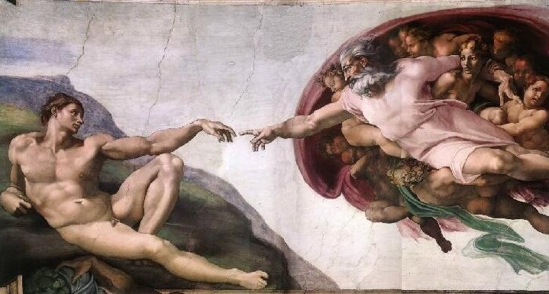
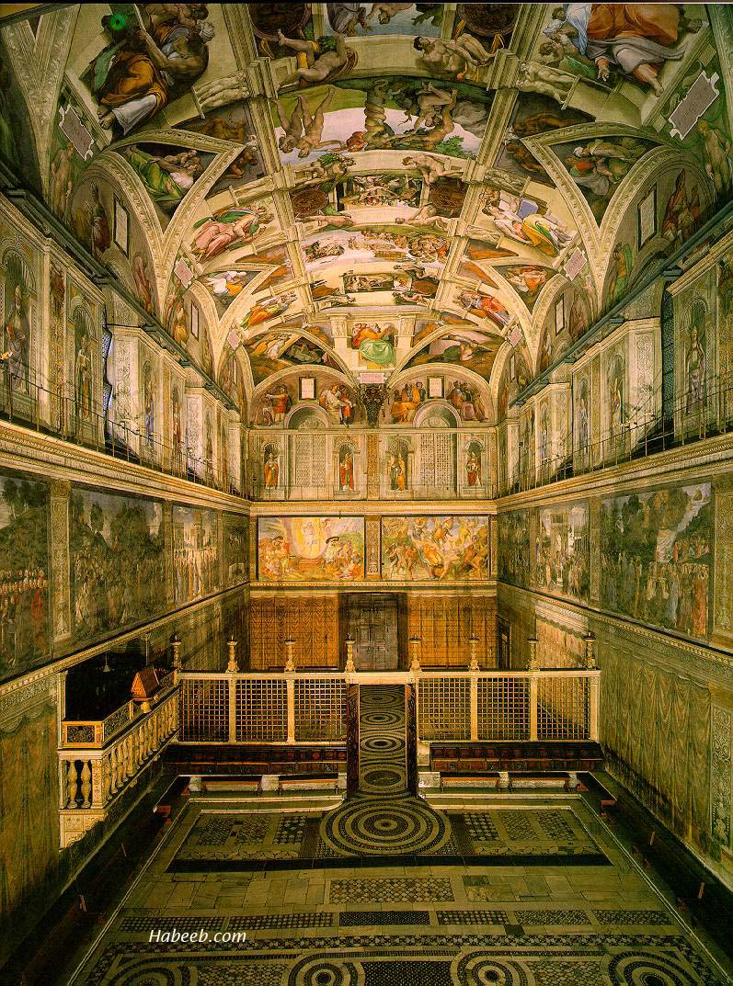
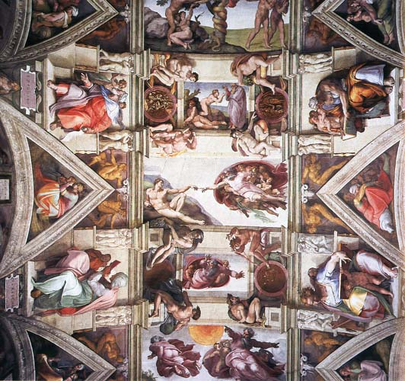
Notes:
-painted between 1508 and 1512
-extreme detail
-had to use his scientific advances to help in painting the ceiling

Slide 23

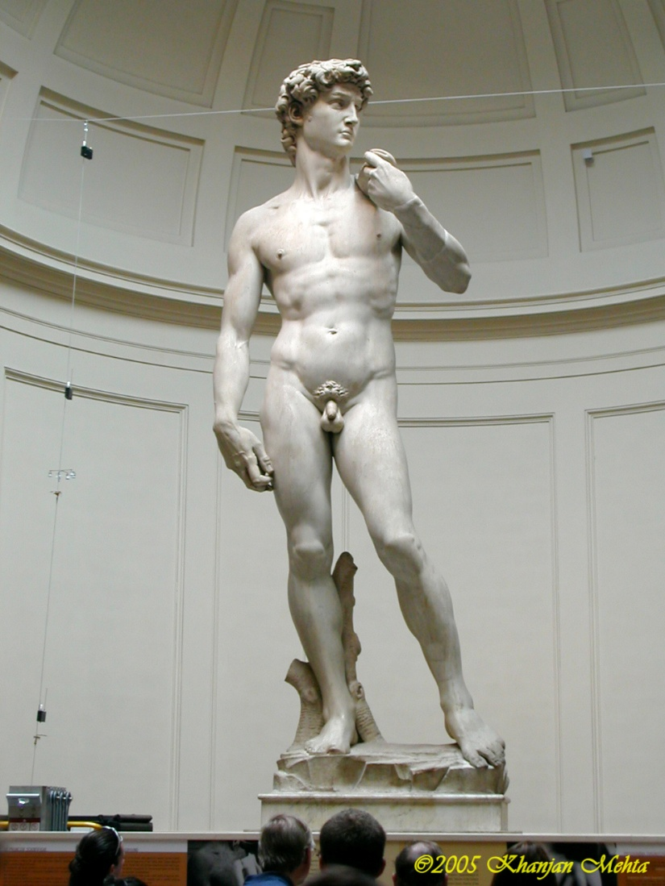
Notes:
-the Pieta→ depicts the Virgin Mary cradling Jesus’ dead body
-the statue of David→ depicts David as he contemplates his fight with Goliath. Also has come to symbolizes the defense of civil liberties in the Florentine Republic

Slide 24
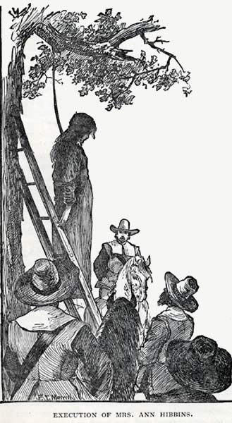
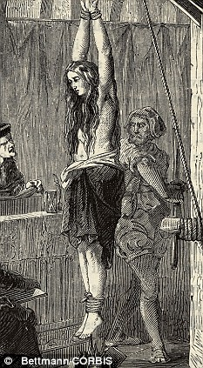
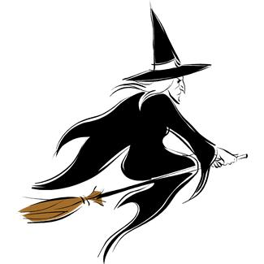
The Dark Side of the Renaissance

Slide 25


Slide 26
Witchcraft and Occult
Persons accused of practicing the witchcraft were labeled as heretics.
Once caught, the victim was forced into confessing his crime through torture and was either hanged or burnt alive during the inquisition.
Modern estimates suggest perhaps 100,000 trials between 1450 and 1750, with something between 40,000 and 50,000 executions, of which 20 to 25 per cent were men (Briggs, Witches & Neighbours)

Slide 27
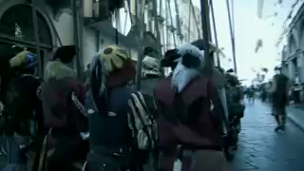
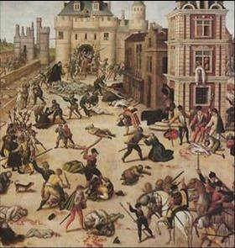
Warfare

Slide 28
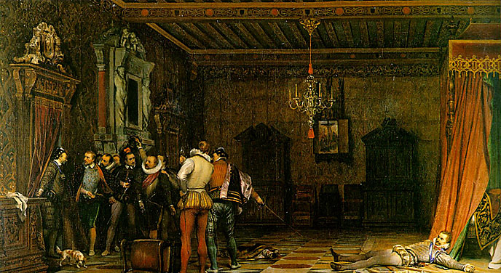
Politics
Machiavelli “The Prince”
  Quotes
  Intentions
The art of assassination

Slide 29
Spread of the Renaissance

