Slide 1
Is Your Job Satisfying?
The Results of Salary.com's 4th Annual Job Satisfaction Survey.

Slide 2
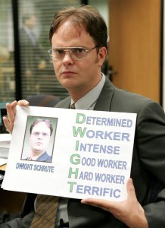

Slide 3
Employee vs. Employer: Who’s Happy in their Job? Employees are resilient... The economic downturn still hasn’t depressed the majority of population, but it has made people lukewarm about their jobs. Most people report they are "somewhat" satisfied in their job – roughly 65 percent – but very few say they were "extremely" satisfied (less than 15 percent). Employers are a bit out of touch... Employers think nearly 30 percent of people are "extremely" satisfied. That number is double the amount employees reported. Of course, many factors affect job satisfaction.

Slide 4
The most satisfied workers are the Working Retirees and those in the Healthcare and Internet industries.
The least satisfied workers are the Millenials (those under 30) and those in the Financial Services industry (no shocker there).

Slide 5
65% of employed survey respondents said they are looking around (up more than 17% this year). 60% said they plan to intensify their job search over the next three months despite the economy.
Nearly 80% of responding managers do not believe that their employees will initiate a job search in the next three months.

Slide 6
Why People Stay Good Relationship with Co-workers Job Security Desirable Commute Why People Leave Inadequate Compensation Inadequate Development Insufficient Recognition

Slide 7
Unemployment Stats
http://www.google.com/publicdata?ds=usunemployment&met=unemployment_rate&idim=state:ST170000:ST150000:ST060000&tdim=true&tstart=631152000000&tunit=M&tlen=237

