Slide 1
Spain & Portugal
Chapter 16 Section 3

Slide 2
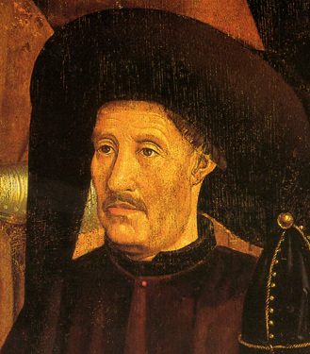
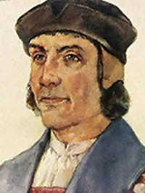
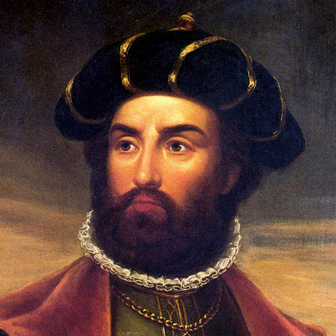
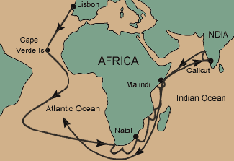
First to explore
Curiosity, __________, economy
________________(The Navigator) – Find gold for Portugal
Europe’s best geographers and navigators
Atlantic and Africa
Bartolomeu Dias - __________________
______________– Used Dias’ knowledge to sail to India
Cut out middleman, cheaper, no tolls
Notes:
Henry - On 25 May 1420, Henry gained appointment as the governor of the very rich Order of Christ, the Portuguese successor to the Knights Templar, which had its headquarters at Tomar. Henry would hold this position for the remainder of his life, and the order was an important source of funds for Henry's ambitious plans, especially his persistent attempts to conquer the Canary Islands, which the Portuguese had claimed to have discovered before the year 1346.

Slide 3
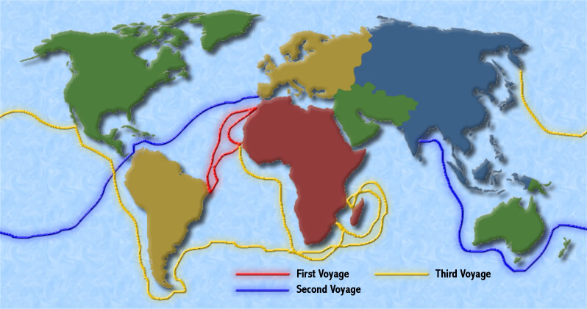
Bartolomeu Dias Voyages

Slide 4
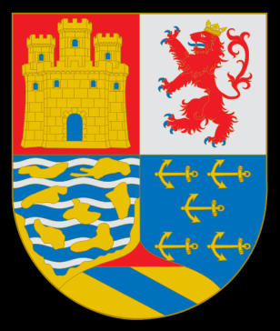
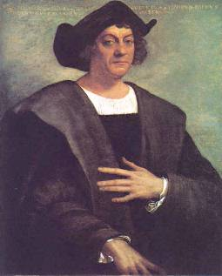
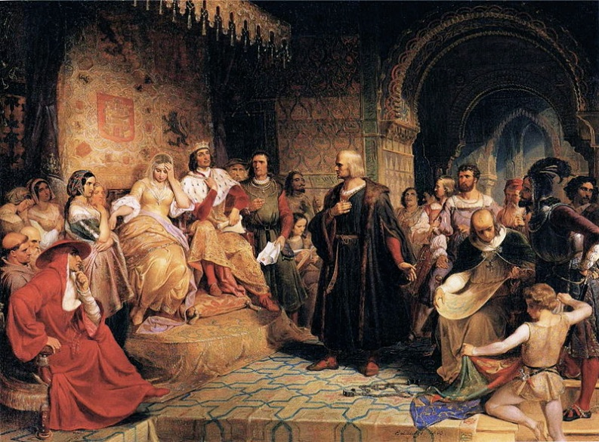
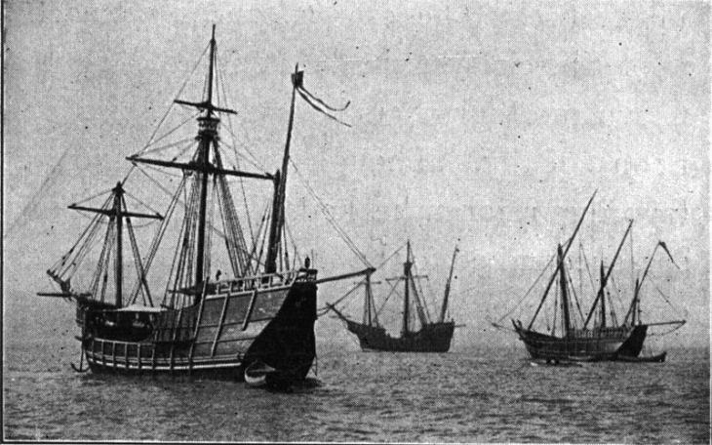
Christopher Columbus
Spanish navigator
Marco Polo & Ptolemy’s concept of a round earth
Quicker trade route to the east (round earth)
King _____________ and Queen ___________
August 1492 – Niña, Pinta, _______________
October 12 – San Salvador
West Indies (3 more trips)
Thought it was Asia

Slide 5
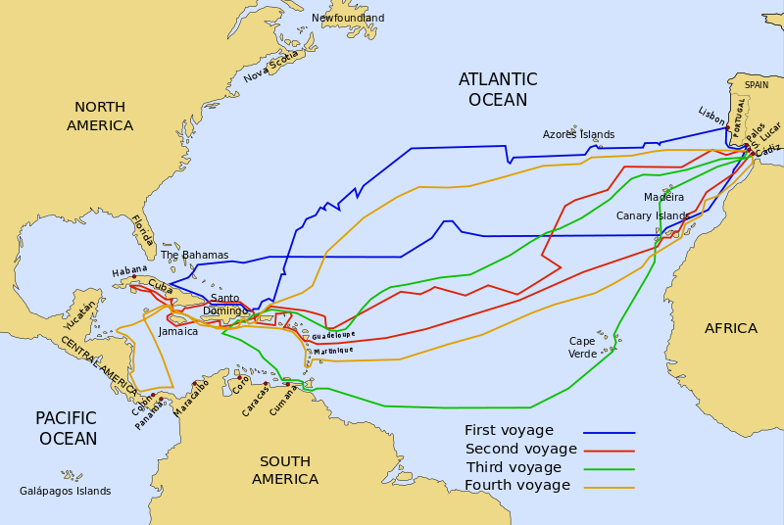
Voyages of Columbus

Slide 6
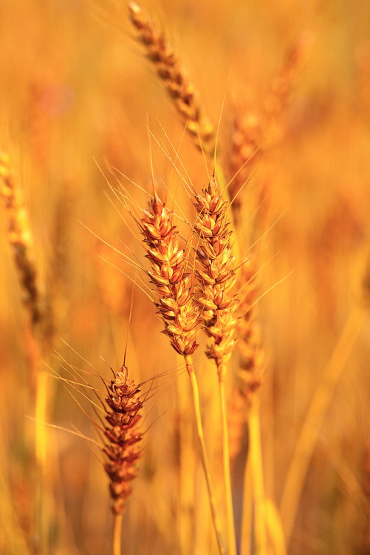
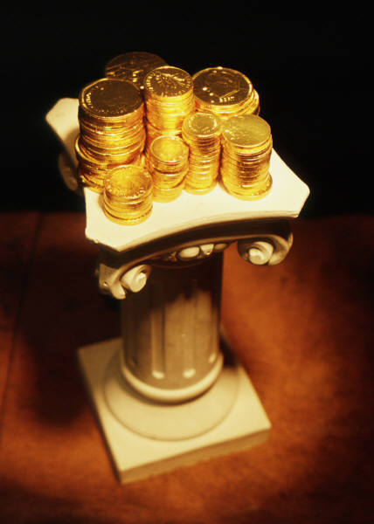
Columbian Exchange
Products
Gold and silver mined in S. America shipped eastward to Spain
Spain = ________________
Plants
Potatoes, tomatoes, bean corn a _____________
Animals
Horses a ____________
Diseases
Small Pox a __________

Slide 7
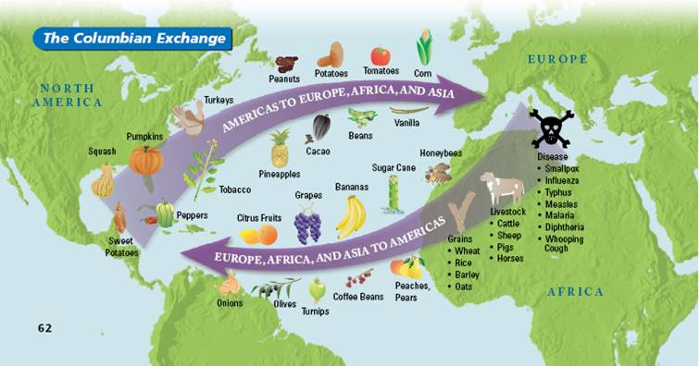

Slide 8
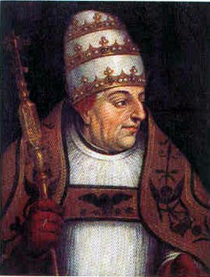
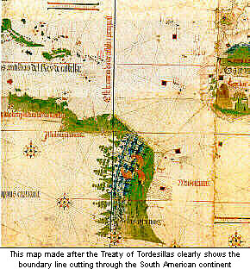
Treaty of Tordesillas
1493 Pope _______________edict – imaginary line from north to south through the middle of the Atlantic Ocean.
Spain west, Portugal east, cannot claim land already held or held by another ______________________
Tordesillas moved line further west
Portugal’s Cabral got blown off course and landed in Brazil – able to claim because of the treaty

Slide 10
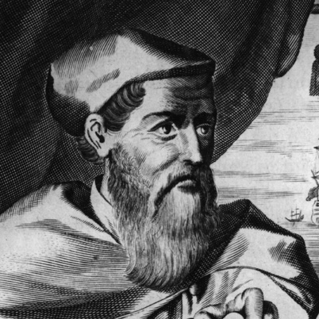
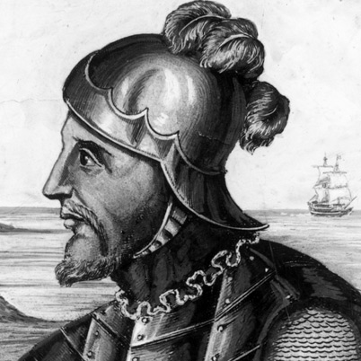
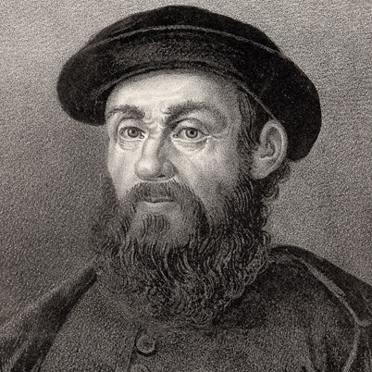
Vespucci, Balboa, Magellan
____________________________(Italian)
First to argue it as a New Land
Mapmaker named it America
Vasco Núñez _________________(Spanish)
________________– Vast Ocean named it South Sea
Clear the new land is not part of Asia
Ferdinand Magellan (_____________)
Sailed around the Tip of Africa
Named it Pacific Ocean (pacificus) peaceful
Died in the Philippines
Officer and 18 crew members made it home
First one to sail around the world

Slide 11
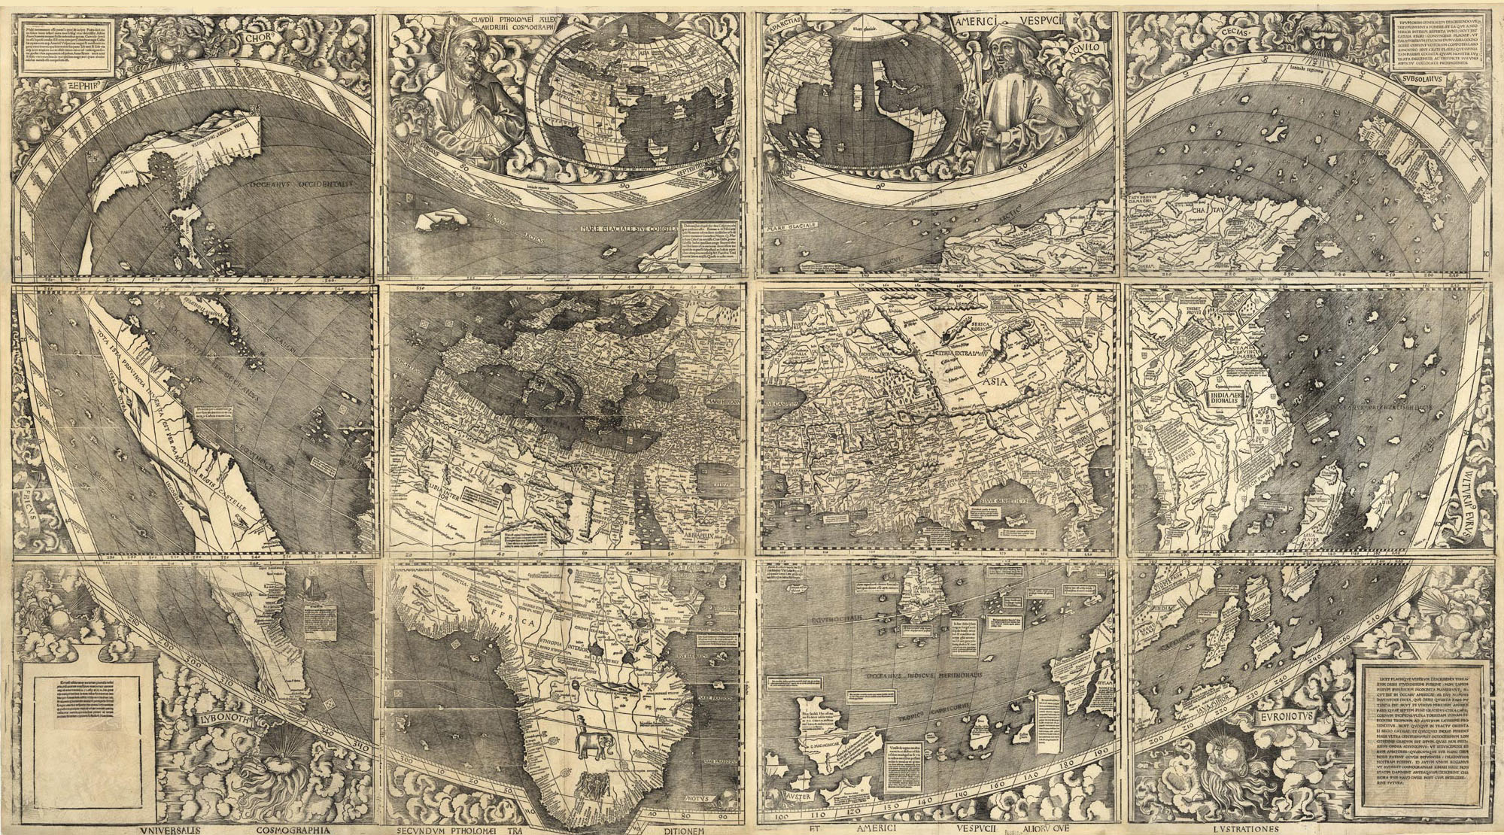

Slide 12
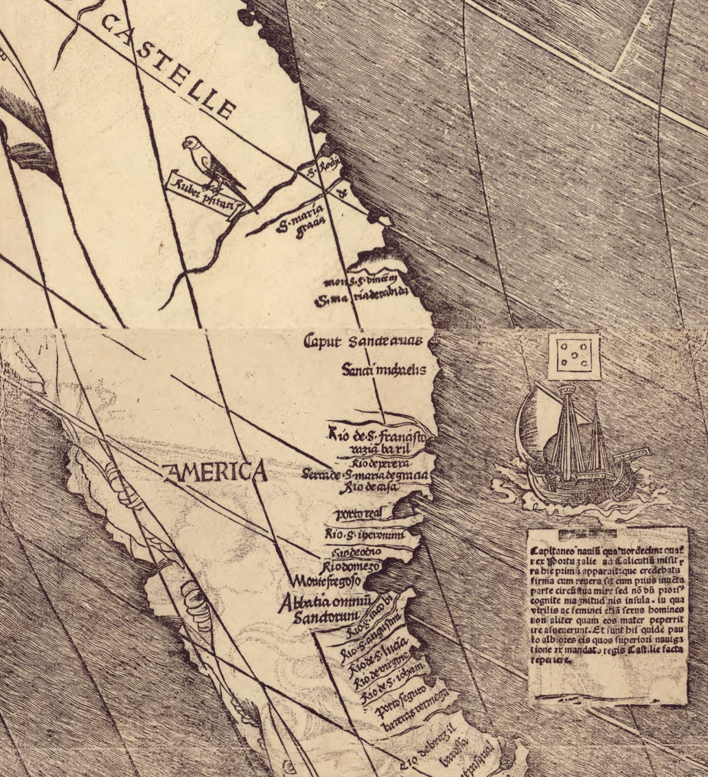

Slide 13
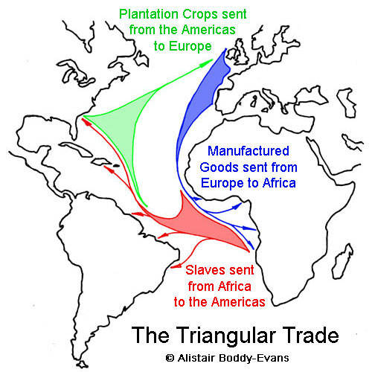
Portugal and Slave Trade
Portugal expanded very fast
Went to Africa to trade
Friendly, Missionaries
Enslaved Africans
American’s Native American population devastated by disease
English, French, Dutch

