Slide 1
Chapter 2
Small Kingdoms and Mighty Empires in the Near East, CA 1100–513 B.C.

Slide 2
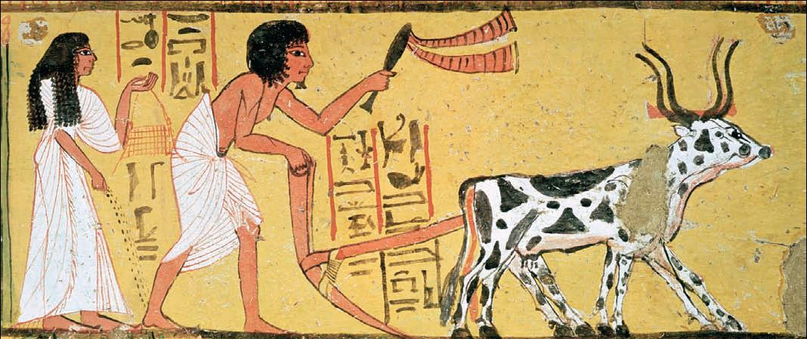
Disruption and Diffusion
The End of Egyptian Power
Despite Egyptian political defeat, ordinary life went on as usual. Here a farmer and his pair of oxen still plow the field as before. His wife follows behind sowing seeds, preparing for the new harvest.

Slide 3
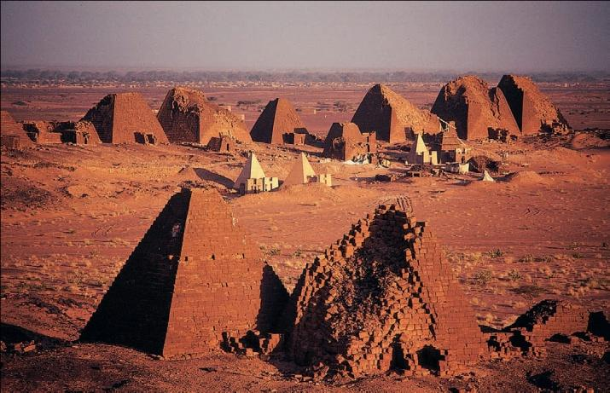
The invasions of the Sea People brought the period of Egyptian Power to an end.
Egypt concentrated on self-defense
Egyptian decline opened the way for the rise of the Nubians (see article)
The Kushites reunified Egypt in the eighth century BC
Egyptian culture remained a powerful regional force

Slide 4
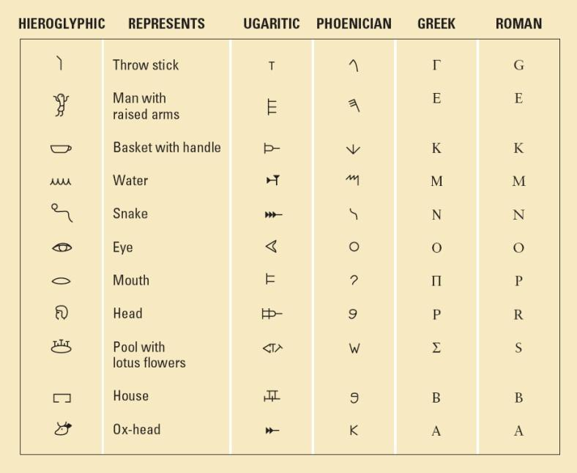
The Rise of Phoenicia
The Phoenicians inhabited several cities along the coast of Lebanon.
They built their civilization around seafaring and trade, planting trading posts around the Mediterranean.
The Phoenician’s most important cultural contribution was the development of an alphabet.

Slide 5
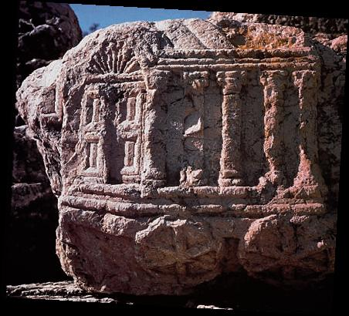
The Children of Israel

Slide 6
Political History of the Hebrews
The only source for much of the History of the Hebrews is the Bible
Moses led the Hebrews out of Egypt and into Palestine in the 13th Century BC
The greatest threat to the Hebrews was the Philistines
Saul established a monarchy over the twelve Hebrew tribes.

Slide 7
Saul’s work was carried on by David and his son Solomon
After his death, Solomon’s kingdom broke into two halves: Israel and Judah.
Israel was wiped out by the Assyrians and Judah was conquered by the Babylonians

Slide 8
The Evolution of Jewish Religion
The Covenant was a kind of contract between Yahweh and the Hebrews
Yahweh was the Jew’s only god (monotheism)
The 10 Commandments were a step in the evolution of Hebrew Law.
The Hebrews had a very different understanding of the nature of the divine than the Mesopotamians.
Religious leaders were important in in Judaism but not as important as the sacred texts they interpreted.

Slide 9
Family Life in Israel
As the Hebrews moved from nomadism to settled agriculture, common ownership of land gave way to family ownership.
The development of urban life created new economic opportunities.
Social and economic developments prompted the compilation of the Torah and the Talmud.

Slide 10
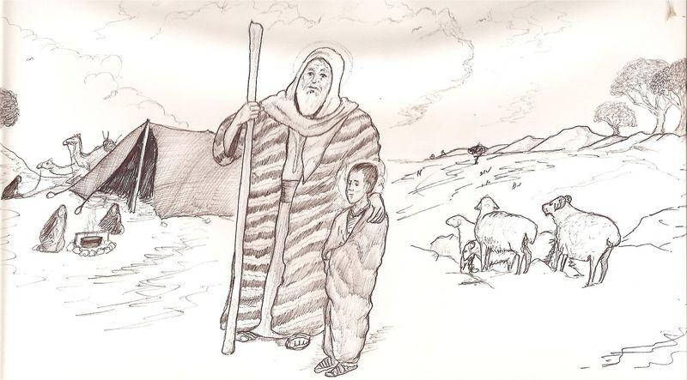

Slide 11
The Power of Assyria
Many Near Eastern kingdoms fell to Tiglath-Pileser III and Sargon II
Assyria’s success was due to sophisticated military organization
The Assyrians developed a wide variety of siege machinery and sapping techniques for attacking fortifications.

Slide 12
Assyrian Rule and Culture
The Assyrian kings organized their conquests into an empire
Despite their apparent invincibility, its fall came quickly in the seventh century BC
Assyrian art, in particular the sculptures and sculpted friezes, influenced Persian, and thus, Western art.

Slide 13
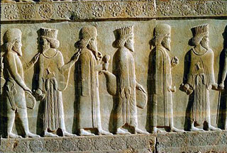
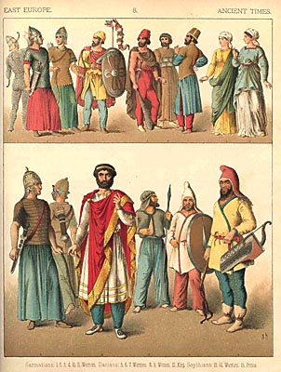
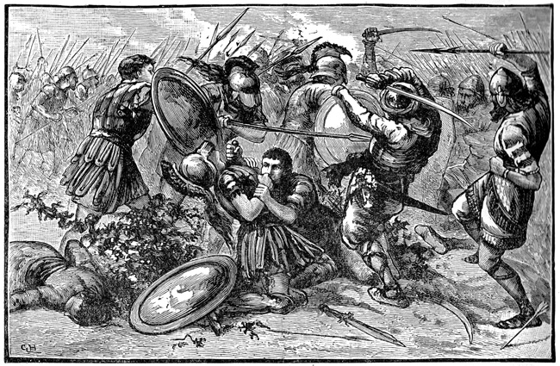
The Empire of the Persian Kings

Slide 14
The Land of the Medes and Persians
Persians (or Iranians) were Indo-European Nomads, like the Aryans who conquered India in the second millennium BC.They arrived in present day Iran about 1000BC
Two groups of Iranians coalesced into larger units: the Persians in Persia and the Medes in Media.
In 612 BC the Medes joined with the Babylonians to overthrow the Assyrians

Slide 15
The Rise of the Persian Empire (550–540 B.C.)
The Persian ruler Cyrus the Great (r. 559-530 BC) created the largest empire yet to exist in the Near East
Cyrus had an enlightened view of empire, practiced religious tolerance, and allowed the subject peoples of his empire great autonomy.

Slide 16
Thus Spake Zarathustra
Early Iranian religion remained close to nature
The Persian Emperor Darius (r. 521-486 BC) adopted the Zoroastrian religion.
Zoroaster preached a new concept of divinity and human life.
He described the cosmos as a battle between opposing forces of good and evil, represented by the gods Ahuramazda and Ahriman.

Slide 17
Thus Spake Zarathustra (continued)
Zoroaster taught that individuals must choose Ahuramazda or Ahriman.
Zoroaster preached there was a last judgment.
Zoroastrian thought influenced Judasim, Christianity, and Islam.

Slide 18
Persia’s World Empire
Although the Persians never established a permanent foothold in Europe, Darius and his son Xerxes created a world empire.
The Persians knew how to preserve the peace.
Persian kings took their responsibilities seriously.

