Slide 1
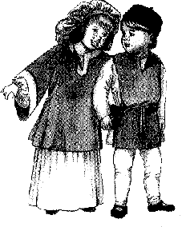
Childbirth and child abandonment

Slide 2
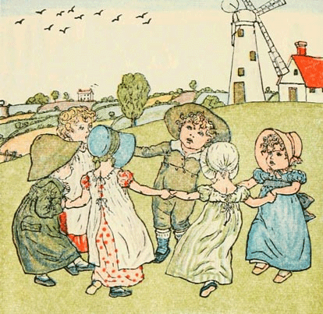
Infancy and early childhood
This was an exceedingly dangerous period of life.
For not only peasants, but nobles as well.
In a normal year, 1/3 of all children would die before the age of 5.
In years with plagues, droughts, or famines this number rose.

Slide 3
Infancy and early childhood
Child often died from…
Malnutrition.
Illness.
Wandering into cooking fires.
Drowning in potholes, exc.
Getting in the way of horses or oxen.
Reaching adulthood meant you had survived the most dangerous time of your life.
Many that survived childhood lived to see the ages of 50-60.

Slide 4
Infancy and early childhood
Childbirth was dangerous for not only infants but women as well.
Every woman knew someone who had died in childbirth.
Women developed…
Prayers
Rituals
Special sayings
They also helped friends and relatives through childbirth.
In larger cities, many who were greatly skilled in midwifery were soon paid for their duties.
Notes:
These prayers, rituals, and special sayings were said to ensure safe and speedy childbirth.

Slide 5
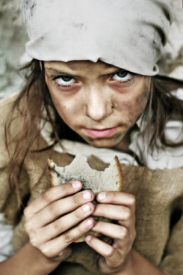
Child abandonment
Most favored form of family limitation.
Was greatly practiced in the Middle Ages.
Parents usually…
Left the children somewhere
Sold them
Legally gave authority over the children to another person or institution.

Slide 6
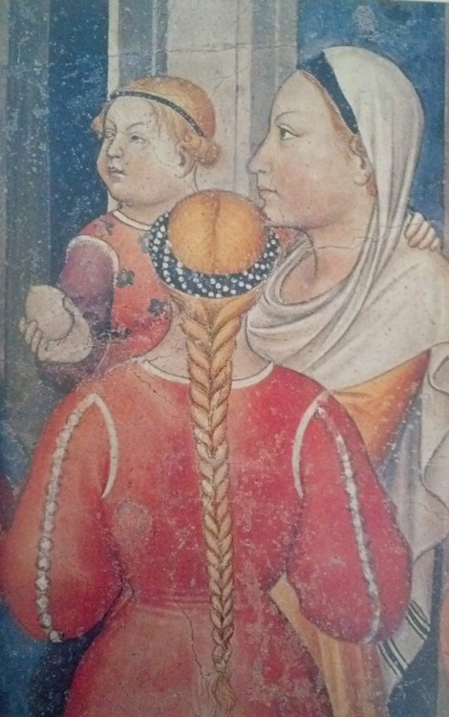
Child Abandonment
But why would parents do this?
Poverty
Local natural disaster
Food was scarce
The child was illegitimate
Caused by incest, rape, exc.
The sex of the child
Physical weakness of the child
Deformity

Slide 7
Child Abandonment
Instead of abandoning the child, some parents chose to give him/her to a monasteries as an oblate.
Oblate: meaning offering.
That’s right! Parents gave their child as a GIFT.
Oblation has actually been called the “most humane form of abandonment”.

Slide 8
More on oblation
Boys and girls both could be offered as gifts.
However, they did have to be at least ten years old.
Oblation was seen as a religious act.
Child was given to God in response for a sin the parents had committed.
Although religious, it also served many social and economic functions.
Monasteries educated and nurtured the child
Provided career opportunities for the future

Slide 9
Oblation cont.
Abandonment was very popular among the poor.
In the year 1000, this changed.
The 200 years following saw agricultural change.
With this, the number of poor children being abandoned dropped.
In the 12th & 13th centuries, the amount of noble parents giving their YOUNGER children to religious establishments increased.
This happened because they wanted to preserve their estates for their older children.

Slide 10
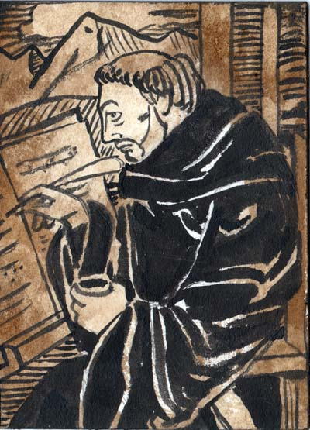
cont.
Because of the sudden increase of noble children being given as oblates, oblates made up a very large percentage of the population in monasteries.
At Winchester in England…
Between 1030 and 1070.
85% of the new monks were oblates.

Slide 11
Conclusion
Today, we view child abandonment as awful.
The people of the Middle Ages thought differently…
Civil and ecclesiastical authorities never legislated against child abandonment.
It remained socially acceptable in the Middle Ages.

Slide 12
Writing Assignment
You are a parent of five children. You can not afford to take care of them all and need to make some choices. Write a one page paper discussing your choices and what you will eventually decide. Use the information from the ppp to help provide support. Write the paper in 1st person narrative.

