Slide 1
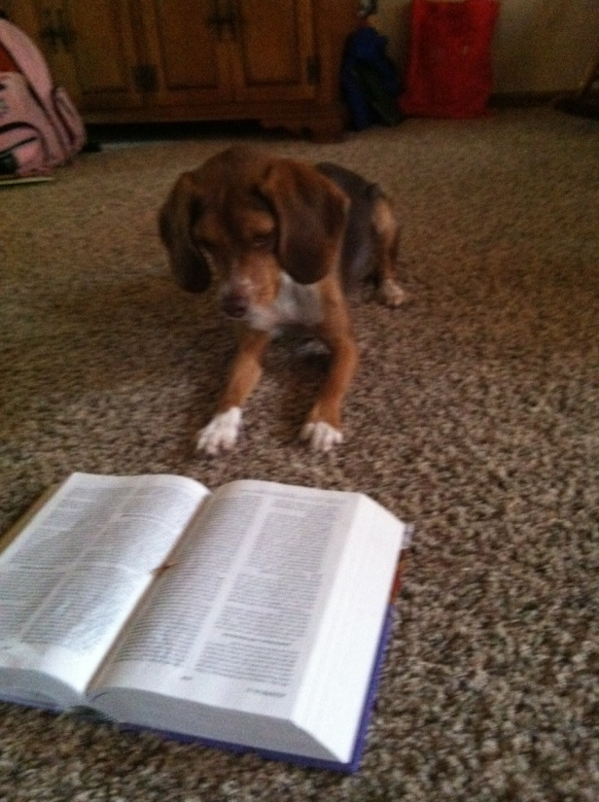
Classical and Operant Conditioning

Slide 2
Classical Conditioning
A neutral stimulus is paired with a stimulus that elicits a reflex (response) until the neutral response alone elicits a similar response.

Slide 3
Pavlov’s Experiments
Pavlov was researching digestion
Noticed dogs would be “conditioned” by a neutral stimulus (bell)
UCS (meat powder) >>>>> UCR (salivation)
CS (buzzer) >>>>>>CR (Salivation)

Slide 4
Terms to Remember
Generalization- conditioned learning, when two or more stimuli are similar, the response to them is the same
Example- fire alarm vs. dismissal bell
Discrimination- in conditioned learning, the ability to recognize the differences between 2 similar stimuli
Example- fire alarm vs. dismissal bell

Slide 5
Terms to Remember
Reflex- automatic reaction to a stimulus
Example- jumping when stabbed with a needle
Acquisition- process through which a CS begins to produce a CR
Example- when a toddler develops a fear of doctors (needles)
Intensity- as the UCS strengthens, it increases the speed and strength of the CR
Example- meat powder versus a raw steak

Slide 6
Terms to Remember
Extinction- the weakening of the process after the UCS has been removed
Example- dog is no longer rewarded for “shake” and eventually stops on command.
Spontaneous Recovery- the revival of an extinquished behavior after a period of nonresponding

Slide 7
Terms to Remember
Relevance/ Biological Predisposition-conditioning process suggests that organisms may be “biolgically” prepared to learn some associations more easily than others
Example- snakes vs. cd players
Study (Garcia & Koelling, 1966)
Rats and Saccharin- flavored water, buzzer, and light paired with electric shock or x-rays(nausea)

Slide 8
Taste Aversion Studies
Timing- longer the delay, the weaker the CR; optimal time is _____ seconds; the one exception is _
Rats and Radiation (Garcia, 1956)
Rats exposed to radiation; refused to drink in the chamber which had plastic h2o bottles but glass in home cages
Sheep Study (Garcia, Rusiniak & Brett; 1977)
Wolves and Lithium chloride
Ice Cream & Cancer patients (Bernstein, 1978)
3 groups (ice cream prior to chemo, ice cream with no chemo, no ice cream)

Slide 9
Conditioned Response and Drug Abuse
Study of Heroin users (Reed, 1980) 1% of users od
Why??
70% interviewed that had od, did not take more of the drug, but had been in unfamiliar settings
Classical Conditioned Response

