Slide 1
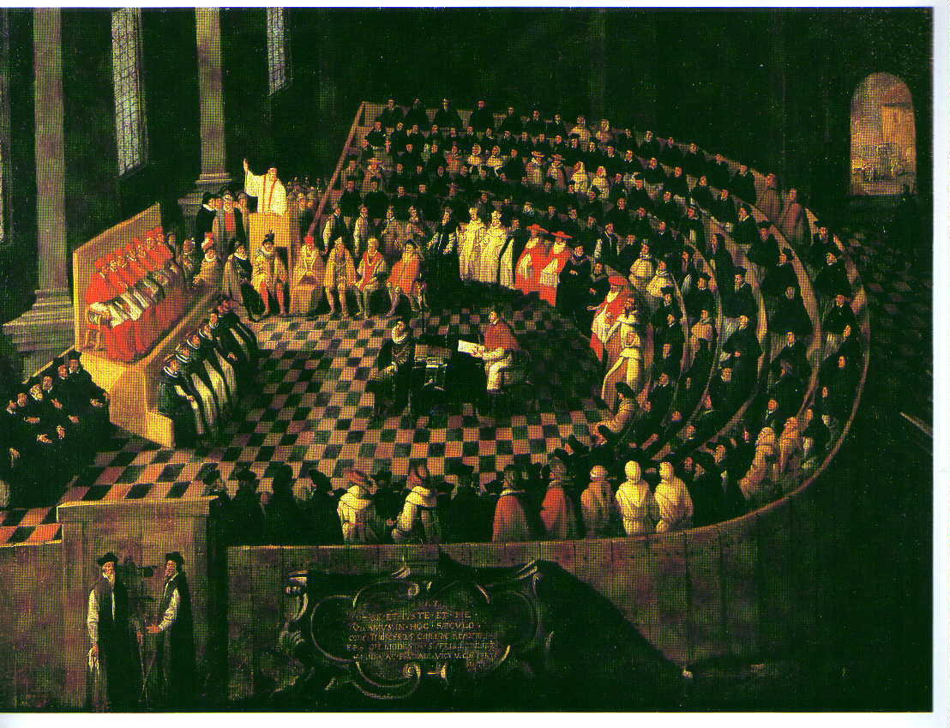
The Catholic Reformation
Reform and Renewal

Slide 2
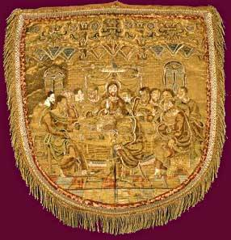
Internal Reform
During the 16th century, the Roman Catholic Church undertook to reform itself. This reform movement:
Raised the standards of the clergy
Inspired the church with a renewed zeal and morale
Contributed significantly to producing the Catholic Church as we know it today.

Slide 3
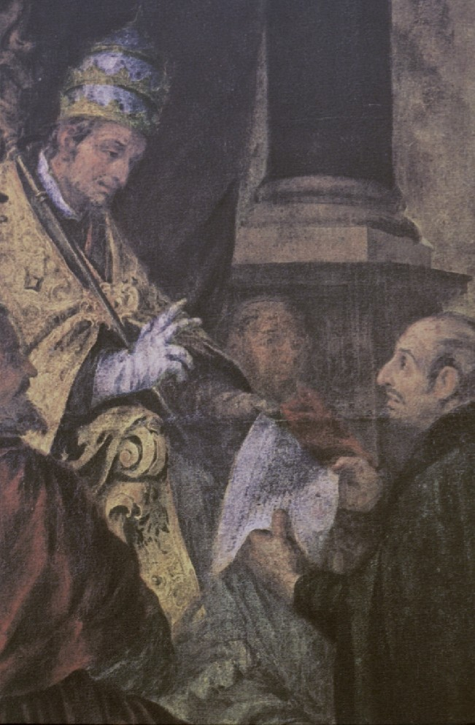
Agencies of Reform
The chief agencies in carrying out this work were:
The papacy
A group of religious orders, especially the Society of Jesus or Jesuits
The Council of Trent
The Inquisition
The Index of Prohibited Books

Slide 4
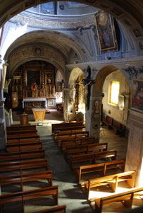
Spirit of the Catholic Reformation
The spirit of the Catholic Reformation was:
A spirit of zeal and ardor for the faith
A recognition of abuses in the Church
A dedication to the work of reform
An attitude of intolerance toward heresy

Slide 5
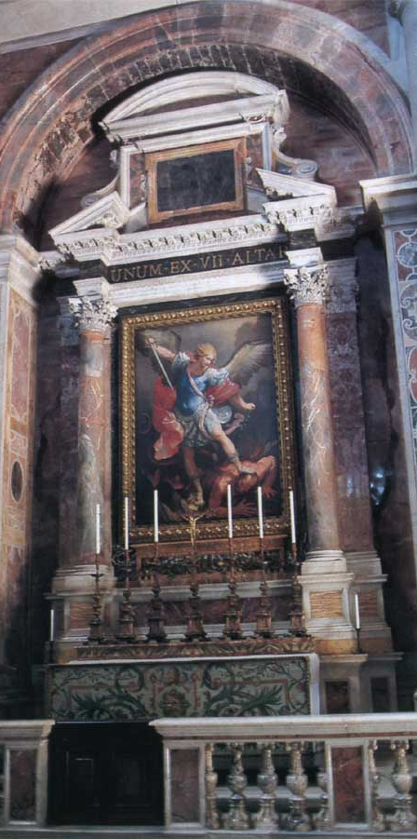
Against All Compromise
The forces in the church that desired conciliation with the Protestants and that might have been willing to make concessions to secure unity were defeated by those who:
Set their minds against all compromise
Rejected any thought of concession
Suppressed heresy where they could

Slide 6
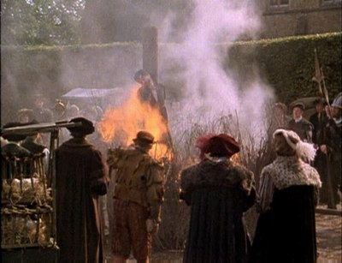
Intolerance
Despite its achievements, the period of reform and renewal was tarnished by widespread intolerance:
Of Catholics toward Protestants
Of Protestants toward Catholics
Of the various Protestant groups toward one another

Slide 7
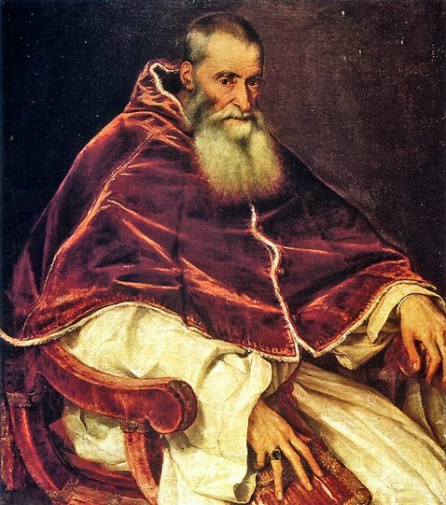
The Papacy
The first agency of Catholic reform was the papacy. Paul III’s pontificate (1534-1549) witnessed the founding of the Jesuit order, the opening of the Council of Trent, and the revival of the Inquisition.

Slide 8
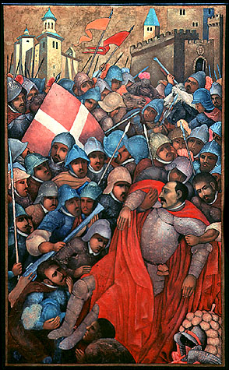
The Society of Jesus
The second agency of Catholic reform was religious orders, most notably, the Society of Jesus. The Jesuits were the creation of St. Ignatius Loyola. He was a Spanish soldier, injured in battle, who experienced a conversion during his convalescence.

Slide 9
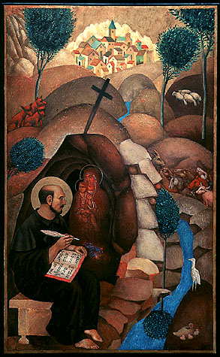
St. Ignatius Loyola
As a consequence, he felt a new desire to devote his life to the service of God and carried his military ideals with him. Henceforth, he would be a Soldier of Christ.

Slide 10
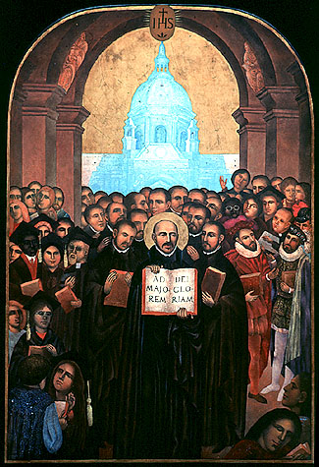
New Religious Order
After obtaining baccalaure-ate and graduate degrees, Loyola decided to found a new religious order. In 1540, Pope Paul III officially recognized the Society of Jesus. In addition to the vows of poverty, chastity, and obedience, they took an additional vow of special obedience to the pope.

Slide 11
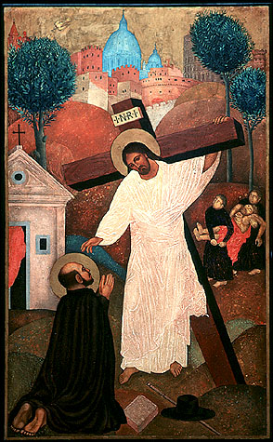
Purposes of the Order
The original purpose of the Jesuits was to reach and convert the masses of people who had strayed from the church. Thus preaching was their fundamental task. They also served as doctors, social workers, and teachers.

Slide 12
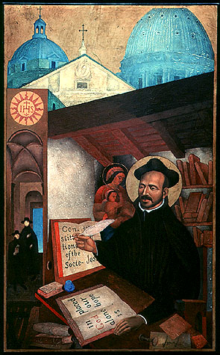
Education
In addition to being spiritual advisers, Jesuits devoted themselves to teaching, fighting heresy, and converting the heathen. The Jesuits came to be the most successful educators in the church. They were interested primarily in higher education, and came to dominate many universities and seminaries.

Slide 13
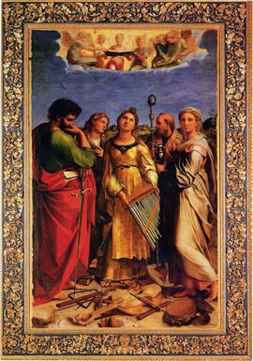
Council of Trent
The third agency of Catholic reform was the Council of Trent which met over a period of eighteen years (between 1545-63). It met the challenge of the Protestant Reformation by clarifying doctrine and by instituting reforms that improved the quality of the clergy. It also helped the church to hold on to what it had retained, regain much of what it had been in danger of losing, and remain a powerful force in the life of Christendom.

Slide 14
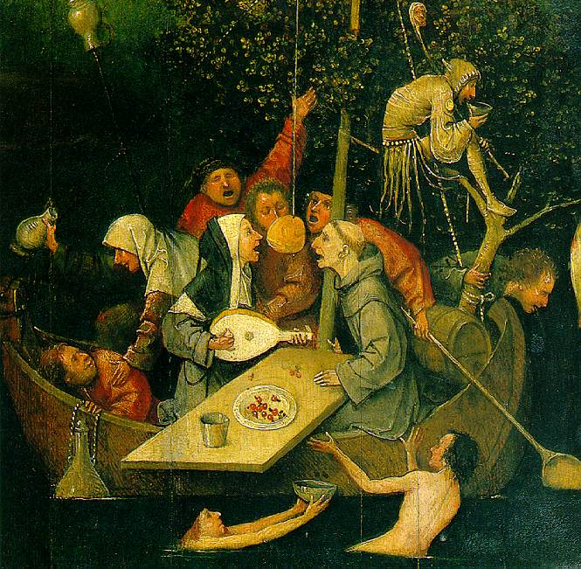
Split Remained
The council failed to reunite the church. Reconciliation with the Protestants proved impossible. Even after the abuses had been corrected, the split remained.

Slide 15
Doctrinal Decrees
In the meetings of 1545-47, important doctrinal decrees were passed:
The Latin Vulgate was accepted as the official text of the Bible.
The Protestant doctrine that the Bible was the sole basis for religious authority was superseded by the doctrine that church tradition was equal in authority to Scriptures.
The Protestant doctrines of justification by faith alone, the bondage of the will, man's utter depravity and helplessness, and the doctrine of predestination were rejected. Faith and good works were declared necessary for salvation.
All seven of sacraments were declared to be true sacraments instituted by Christ.

Slide 16
Reform Decrees
The council insisted on the duty of Bishops to reside in their dioceses. They must never be absent for more than three months, and not at all during advent and lent.
Pluralism (multiple offices) was forbidden. Bishops were required to preach every Sunday and Holy Day, and to visit every church within their diocese at least once a year.
Each bishop was to exercise careful supervision over his clergy, ordaining only worthy priests and severely disciplining those guilty of misconduct.

Slide 17
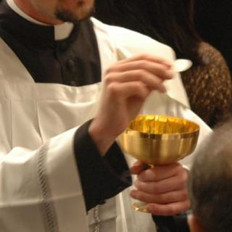
Priestly Responsibilities
Priests also were held to the obligation of residence and were required to preach. To improve the level of priestly education, the council proposed the establishment of a theological seminary in every diocese. Priests were to exercise care for their flocks, explaining the Bible, the sacraments, and the liturgy.

Slide 18
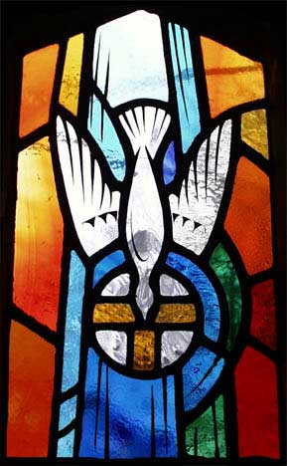
Outcome of Decrees
The decrees were not adopted universally, enthusiastically, or unanimously. Nevertheless, the work of the council eventually succeeded in infusing a new spirit in the church, which strengthened it immensely and made it capable of defense and further conquest.

Slide 19
Suppression of Heresy
The fourth agency of Catholic reform was the Holy Office of the Roman Inquisition intended to suppress heresy.
It had six Inquisitors-General independent of the Bishops in their jurisdiction
They could degrade priests from their offices
They could exercise censure, call in the aid of the secular arm, and delegate powers.
While they could punish, only the pope could pardon.
The Dominicans, long associated with the suppression of heresy, were put in charge of the courts of the Inquisition.

Slide 20
Persecution and Repression
The states of Europe were asked to facilitate the work of the Inquisition.
In France, the request was denied.
In Spain, however, the activities of the Inquisition, long vigorous, were stimulated even further.
Persecution reached a new peak.
Even St. Teresa came under suspicion, and the archbishop of Toledo was arrested.
In 1562, two thousand Waldensian heretics were massacred.
Burnings were common in Rome, and cardinals and ambassadors were compelled to attend.
Throughout Italy the same policy of repression was carried out.

Slide 21
The Index
The fifth agency of Catholic reform was the Roman Index of Prohibited Books, another means of suppressing heretical doctrines.
It included a wide variety of books, including not only heretical ones but also obscene books and books on witchcraft.
In addition, the pope appointed a Congregation of the Index, to keep the Index up to date and to publish revised editions periodically.

Slide 22
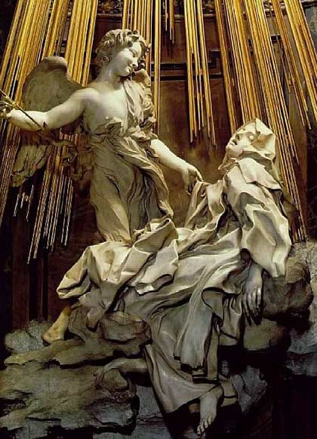
Religious Revival
In addition to these agencies of Catholic reform, both positive and negative, there was a genuine revival of Catholic piety led by men and women of outstanding devotion and sanctity (e.g., Charles Borromeo, Teresa of Avila, and John of the Cross). Throughout Catholic Europe, inspired by such leaders as these, there was a renewal and revival of Christian feeling.

