Slide 1
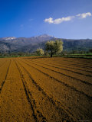
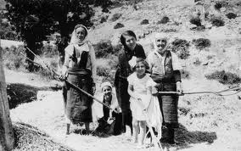
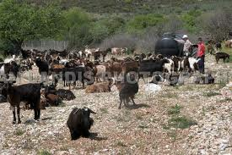
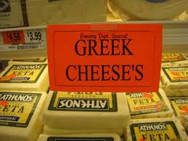
Description of Greece:
Moderate Temperatures
Crops could grow- but needed advanced technology (terracing)
Along the coastline, the soil was not very fertile, but the ancient Greeks used systems of irrigation and crop rotation to help solve that problem. They grew
olives
grapes
Figs
Wheat
They kept goats, for milk and cheese. Fish, seafood, and home-made wine were very popular food items.

Slide 2
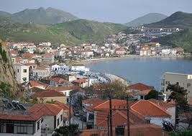
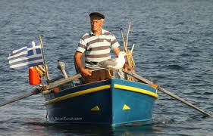
Geography
Geography played a major role in the development of Greek city-states.
The islands of the Aegean served to link the Greek peninsula and Asia Minor.
Mountains regions meant good protection but little transportation between cities. Result was little cooperation between city-states.
Good Harbors- careers at sea (fishing and trade)

Slide 3
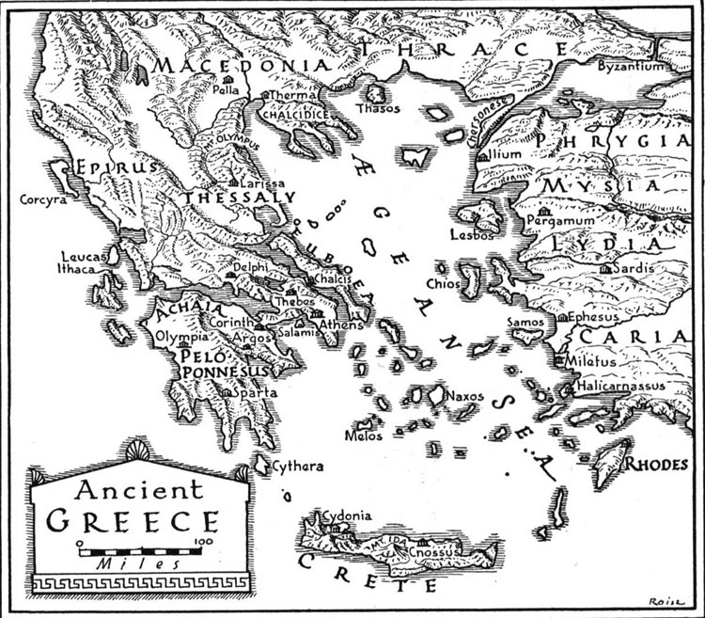

Slide 4
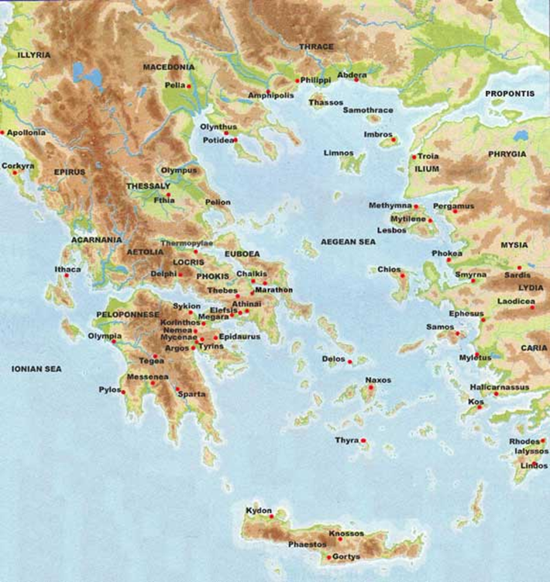

Slide 5
The Minoans
A civilization with writing and a noble class appeared on Crete by about 2000 b.c. (Minoans).
Crete is a mountainous island with natural harbors. There are signs of earthquake damage at Minoan sites. The oldest signs of inhabitants on Crete are ceramic remains that date to approximately 7000 BC. The beginning of the Bronze Age, around 3100 BC, was a period of great unrest in Crete, but it also marks the beginning of Crete as an important center of civilization.

Slide 6
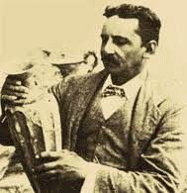
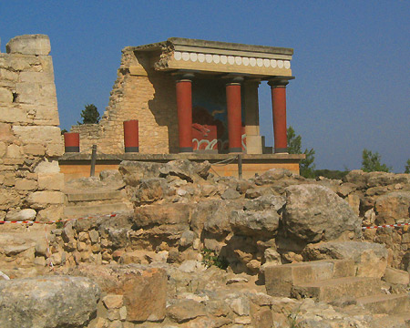
Minoans
Knowledge of this civilization
comes from the work of Sir Arthur Evans, an archeologist who unearthed some ruins from the palace of Knossos. For years no one knew Knossos existed but Sir Arthur Evans used the legend of King Minos (the legend of the Minotaur and Theseus).

Slide 7
Elements of Minoan Civ.
royal palace
drainage system
hot and cold running water
ac
Crete Industry
overseas trade (strong navy)
manufacturing
Sports
boxing (world’s first boxing arena);
bulljumping- religious implications

Slide 8
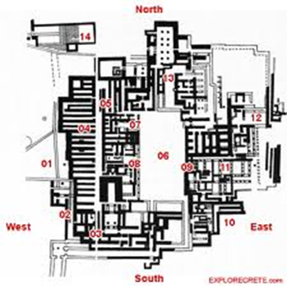

Slide 9
End of Minoans
Around 1450 BC (still debated), the volcanic island Thera, at about 70 km distance, erupted. The volcanic eruption and fallout was quite possibly the largest historical eruption on record. The eruption has been identified by ash fallout in eastern Crete, Egypt, and cores from the Aegean and Eastern Mediterranean seas. The sulfur dioxide and ash clouds emitted by the volcano are thought to have destroyed some settlements and resulted in volcanic winters and poor harvests for several years.

Slide 10
End of the Minoans
The massive eruption of Thera also led to the volcano's collapse, causing massive tsunamis which destroyed naval installations and settlements near the coasts. Some archeologists believe the Minoans may have lost their religious faith in the ability of the priests to control nature, possibly leading to the fall of Minoan civilization.

Slide 11
Mycenaeans
About 1650 b.c., Greek-speaking immigrants to the Balkans had formed the kingdom of Mycenae in southern Greece. Around 1450 b.c., the Mycenaeans attacked Crete.
Mycenaeans were warlike and influential.
The collapse of Mycenae (probably due to internal conflict) was followed by the Dark Age (1100 b.c.−800 b.c.).

Slide 12
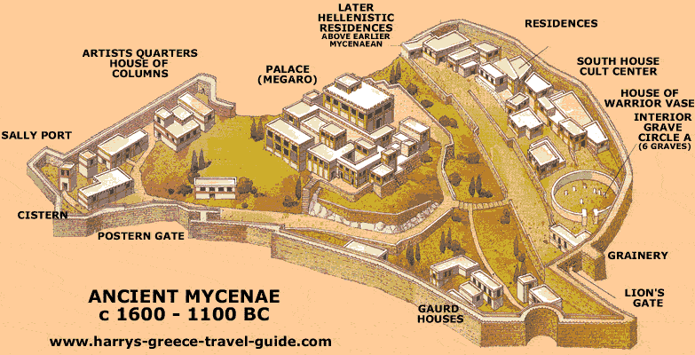

Slide 13
Greek Mythology
Myth- a story passed on from generation to generation that attempts to explain something
Man’s origins
Natural phenomena
Unexplained events
Aspects of Culture
Samples of Greek Myths- Demeter and Persephone; Theseus and the Minotaur; Daedalus and Icarus; Achilles; Troy; Pandora; Prometheus; Apollo and his chariot; Atlas; Medusa, Fates;

Slide 14
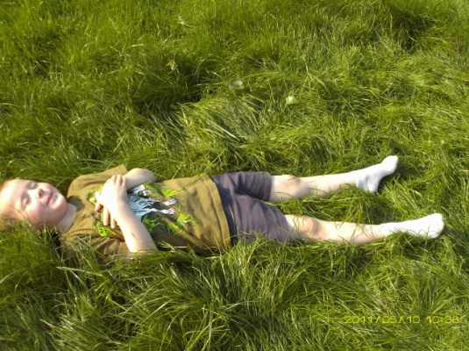
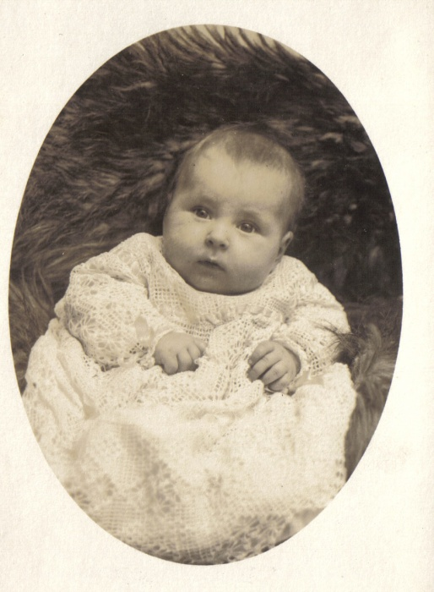
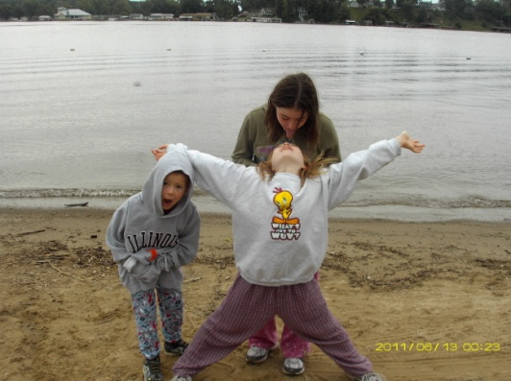
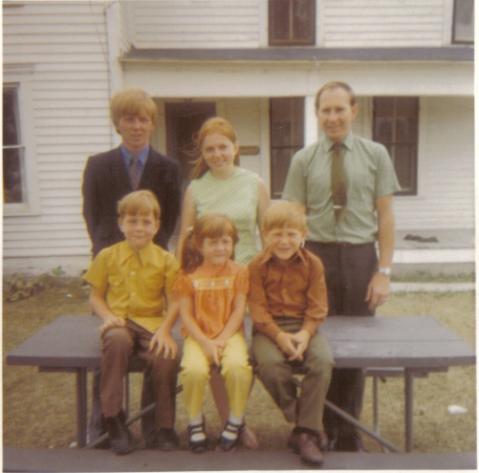
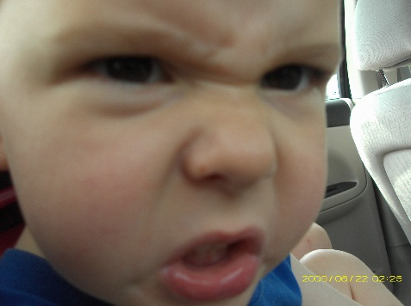
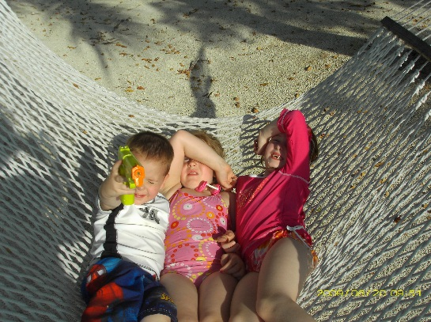
Myth #1
Myth #3
Myth #2
Create a “myth” using ONE of theses images as a starting point. Remember, the 4 pts of myths and what they are attempting to illustrate.
Myth #4
Myth #5

Slide 15
Homer, Hesiod, Gods, and Heroes
Homer’s Iliad and Odyssey
The poems of Homer idealized the Greek past: The Iliad describes the expedition against the Trojans. The Odyssey tells of the adventures of Odysseus.
Hesiod’s Theogony and Works and Days. The Theogony traces the origins of Zeus. The Works and Days tells of Hesiod’s own village life.

Slide 16
The Origins of the Polis
Even during the late Mycenaean period, towns had grown up around palaces.
These villages and towns administered political affairs of the community.
Each had its local cult to its own deity.
They exchanged goods and developed a social system.
Each polis shared a number of key features.

Slide 17
City and Chora
Life in the polis demanded the integration of the chora and the city.
Since the Neolithic Period, agriculture had provided the basis for Greek society.
Farmers were the economic basis of the polis and they were also involved in the politics of the city.
Most Greek religious practices were rooted in the country.
The polis did not have a standing army, but depended on its citizens for protection.
The polis was fundamental to Greek life.

Slide 18
Governing Structures
Greek city-states had several different types of governments.
Only democracy and oligarchy played lasting roles in Greek political life.
Greek democracy meant the rule of citizens.
Most Greek states were oligarchies.
The fierce independence of Greek city-states led to almost constant warfare.

Slide 19
Persian Threat
Cyrus of Persia
Ionia
Darius I.
Miletus
Greek victories at Marathon
Xerxes
Greek victories at Salamis
Results of the Persian defeat
Rise of Athens
Delian League
Peloponnesian League
Pericles

