Slide 1
Perception
Selective Attention focus of conscious awareness on a particular stimulus

Slide 2
Experience and Perception
Perceptual Set- the influence of past experiences on what a person expects
Star Spangled…
Ready, Set,…..
Perception and Needs
Hungry person and food
Thirsty person and water
Santa Clause Effect (children’s artwork)

Slide 3
Perception and Moods
Person’s Mood and Its Impact on Perceptions
Maslow and Mintz Exp.
Room 1- beautiful room
Room 2- average room
Room 3- ugly room
Face Ratings

Slide 4
Muller-Lyer Illusion pg. 36 text

Slide 5
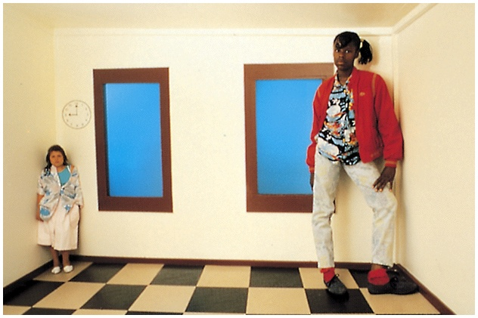
Perceptual Illusions

Slide 6
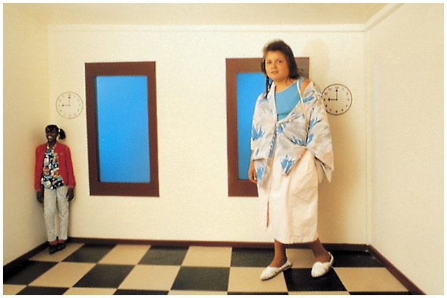
Perceptual Illusions

Slide 7
Perceptual Organization: Gestalt
Visual Capture
tendency for vision to dominate the other senses
Gestalt--an organized whole
tendency to integrate pieces of information into meaningful wholes

Slide 8
Perceptual Organization: Gestalt
Grouping
the perceptual tendency to organize stimuli into coherent groups
Grouping Principles
proximity--group nearby figures together
similarity--group figures that are similar
continuity--perceive continuous patterns
closure--fill in gaps
connectedness--spots, lines, and areas are seen as unit when connected

Slide 9
Perceptual Organization
Figure and Ground--organization of the visual field into objects (figures) that stand out from their surroundings (ground)

Slide 10
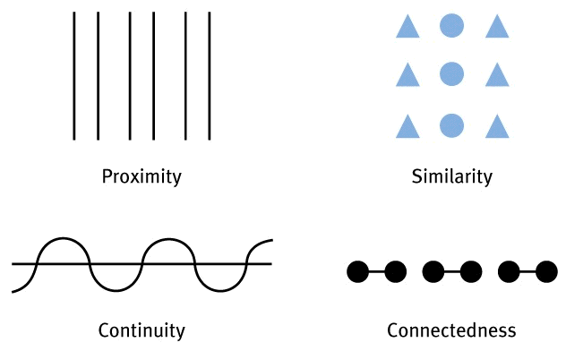
Perceptual Organization: Grouping Principles

Slide 11
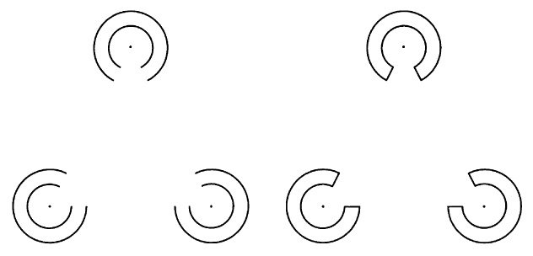
Perceptual Organization: Closure
Gestalt grouping principles are at work here.

Slide 12
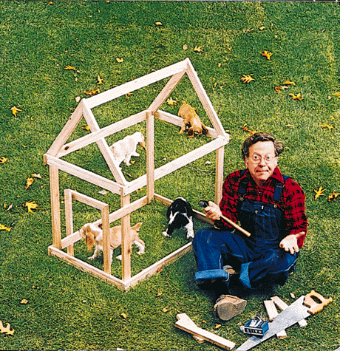
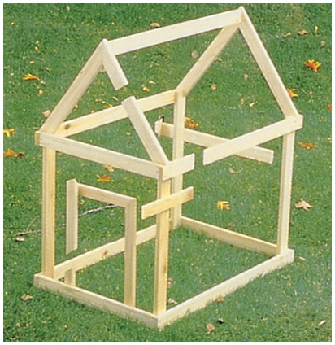
Perceptual Organization: Grouping Principles
Gestalt grouping principles are at work here.

Slide 13
Perceptual Organization: Depth Perception
Depth Perception
ability to see objects in three dimensions
allows us to judge distance
Binocular cues
retinal disparity
images from the two eyes differ
closer the object, the larger the disparity
convergence
neuromuscular cue
two eyes move inward for near objects

Slide 14
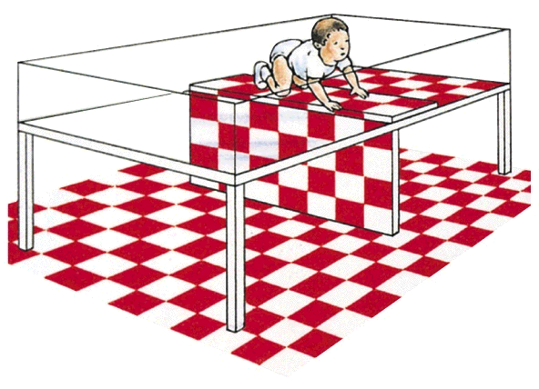
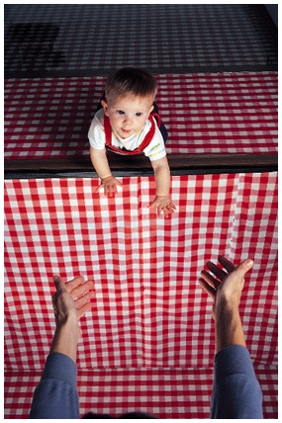
Perceptual Organization: Depth Perception
Visual Cliff

Slide 15
Perceptual Organization: Depth Perception
Monocular Cues
relative size
smaller image is more distant
interposition
closer object blocks distant object
relative clarity
hazy object seen as more distant
texture coarse --> close fine --> distant

Slide 16
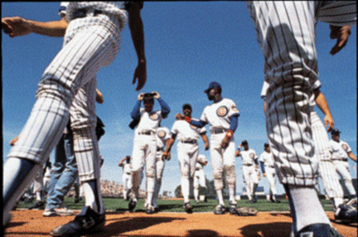
Perceptual Organization: Depth Perception
Relative Size

Slide 17
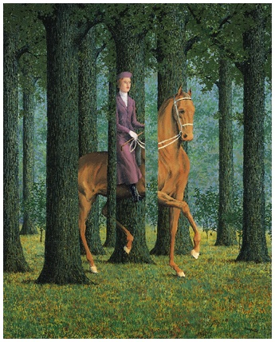
Perceptual Organization: Depth Perception
Interposition

Slide 18
Perceptual Organization: Depth Perception
Monocular Cues (cont.)
relative height
higher objects seen as more distant
relative motion
closer objects seem to move faster
linear perspective
parallel lines converge with distance
relative brightness
closer objects appear brighter

Slide 19
Perceptual Organization: Depth Perception
Relative Height

Slide 20
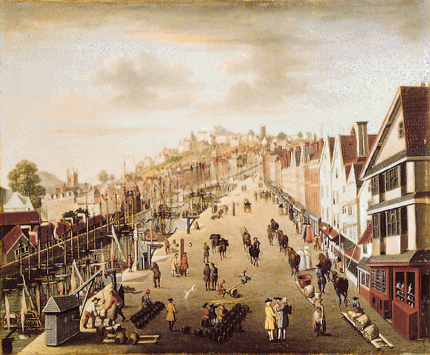
Perceptual Organization: Depth Perception
Perspective Techniques

Slide 21
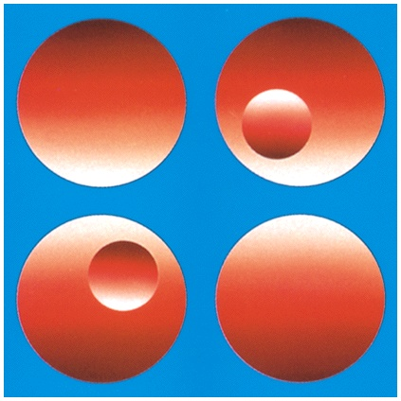
Perceptual Organization: Depth Perception
Light and Shadow

Slide 22
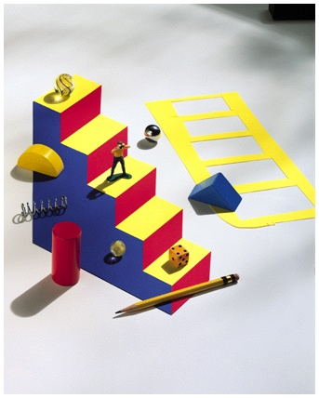
Perceptual Organization: Depth Perception
Illusory Depth

Slide 23
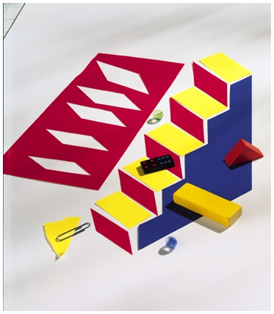
Perceptual Organization: Depth Perception
Illusory Depth Explanation

Slide 24
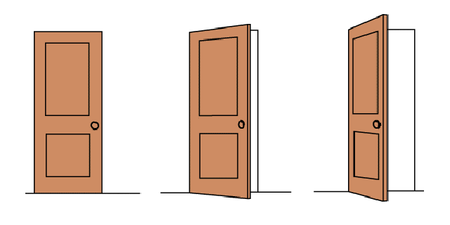
Perceptual Constancy
Perceptual Constancy
perceiving objects as unchanging even as illumination and retinal image change
color
shape
size

Slide 25
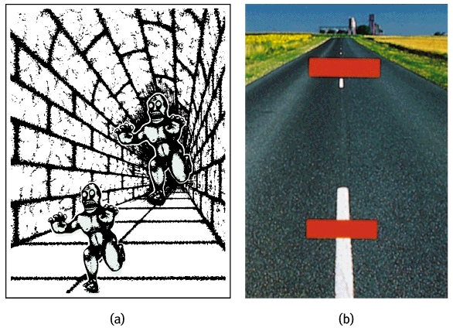
Perceptual Organization

Slide 26
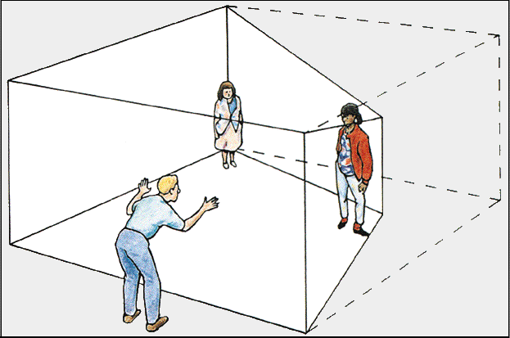
Perceptual Organization: Size-Distance Relationship

Slide 27
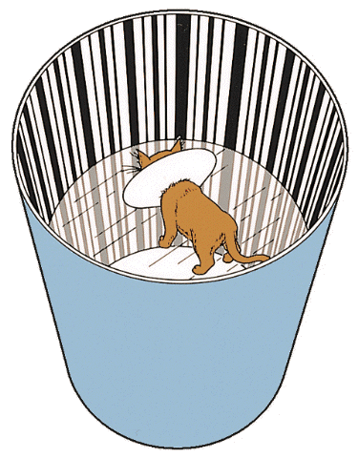
Sensory Restriction: Blakemore & Cooper, 1970
Kittens raised without exposure to horizontal lines later had difficulty perceiving horizontal bars.

Slide 28
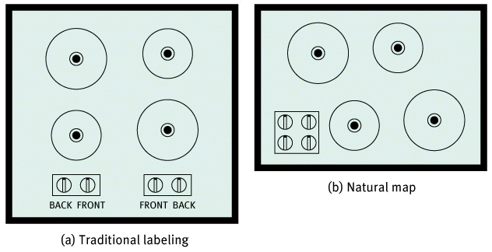
Perception and the Human Factor
Human Factors Psychology
explores how people and machines interact
explores how machine and physical environments can be adapted to human behaviors

Slide 29
Perceptual Set: Human Factors
10
8
6
4
2
0
Altitude
(thousands
of feet)
Pilot’s perceived
descent path
Altitude looks
this much higher
Actual
descent
path
20 18 16 14 12 10 8 6 4 2
Distance from runway (miles)

Slide 30
Is There Extrasensory Perception?
Extrasensory Perception
controversial claim that perception can occur apart from sensory input
Telepathy-
Clairvoyance-
Precognition-
Parapsychology
the study of paranormal phenomena
ESP-
Psychokinesis-

