Slide 1
Science and the Age of Reason
Bacon
Galileo
Kepler
Boyle
Franklin
Harvey
Ptolemy
Newton
Diderot
Hobbes
Locke
Rousseau
Montesquieu
Voltaire
Kant
.

Slide 2
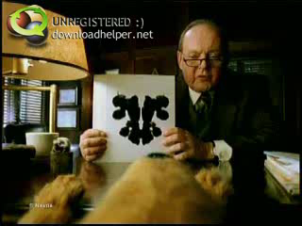
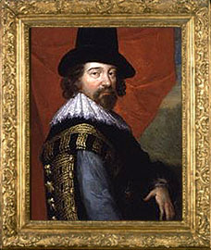
Development of the Scientific Method
Sir Francis Bacon
  16th century English philosopher
  Urged all scientists to experiment, observe, and write results
  Info found this way led to explanations that could be tested by repeating the experiment

Slide 3
The Heliocentric Theory vs. The Geocentric Theory
Heliocentric Theory- “sun-centered” --the sun is the center of the universe
Geocentric Theory- “earth-centered”--the earth is the center of the universe

Slide 4

Copernicus
16th Century Pole
Developed own idea of how sun and planets moved
  Sun is the center of the Universe
  Earth and planets move around it
  Earth turns on axis each day as it makes yearly trip around the sun

Slide 5
Copernicus
These ideas upset many
Many astronomers didn’t believe this because Copernicus didn’t explain other things well (like why didn’t things fly off earth if it was in motion)

Slide 6
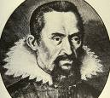
Kepler
1st astronomer to agree with Copernicus
He formed 3 laws of planetary motion
  Planet moves in an oval path called an ellipse- not a circle- while sun stays in place
  Planet speeds up when it comes closer to the sun
  Time it takes planet to move around sun depends on how close it is to the sun
Couldn’t explain why planets stayed
fixed in their paths and did not fly off
into space

Slide 7


Slide 8
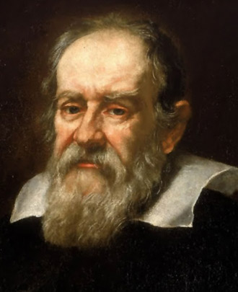
Galileo
Born in Pisa, Italy in 1564
Became math teacher at Pisa University
Experimented in his lab to prove that things of different weights fall at same speed in absence of air
Went from Pisa University to Padua University
  Heard about the telescope and built one
    Saw mountains on the moon and stars of the Milky Way

Slide 9
Galileo
Convinced that Copernicus was correct
  One reason was because he discovered the moons moving around Jupiter
    This proved not all heavenly bodies moved around the earth, so he felt some planets could move around the sun
Told by the Church not to teach or defend the Theory of Copernicus
In his book “Dialogue on the Two Great Systems of the World” he says Copernicus was correct
  He was called before the Church court as a result and interrogated. He broke under threat of torture and recanted.

Slide 10


Slide 11
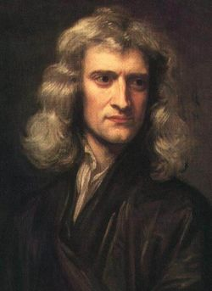
Newton
Born in England in 1642- the year Galileo died
Taught math at Cambridge University

Slide 12

Newton’s Laws
Worked out math formulas that explained gravity
  Every planet has a force called gravity that pulls it toward it
  Gravity strength depends on mass of planet (size and weight) and how far it is from another object
  Since earth has more mass than moon it has more gravity, so things weigh more
  Gravity is the reason planets stay in orbit
  Sun’s gravity holds earth near it and keeps it from flying into space

Slide 13
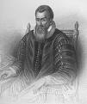
Several Branches of Science Move Forward
Improved Mathematics
  Modern Math began in Christian world after 1100 AD
    Merchants and scholars began using Arabic numbers
    Decimal system was perfected
    Math symbols (+, -, X, /, =, ) came into use
  John Napier
    A Scotsman who invented logarithms- short way of doing calculations with very large numbers
    Reduced the time needed to solve hard problems

Slide 14
During the 17th Century science was becoming more exact because of new and more accurate tools for observing and measuring
  Mercury barometer used to measure air pressure- began being used in forecasting weather
  Mercury thermometer used for accurate temperature gauge (Fahrenheit)

Slide 15
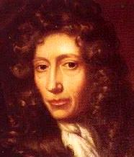
Experiments in Modern Chemistry
No scientific base until the 17th century
Medieval alchemists believed there were only 4 elements
  Earth, fire, water, and air
  Element- object that can not be chemically broken down any further
Robert Boyle- 1st to use scientific method in chemistry
  Proved air wasn’t an element because it was made of several gases
Notes:
Medieval alchemists believed there were only 4 elements
Earth, fire, water, and air
Element- object that can not be chemically broken down any further

Slide 16
Physicists
William Gilbert- doctor to Queen Elizabeth I
  Wrote book about how a compass needle works
  Studied static electricity
Ben Franklin- 1st important American scientist
  Believed lightning like static electricity
  Proved with kite and key in electrical storm

Slide 17
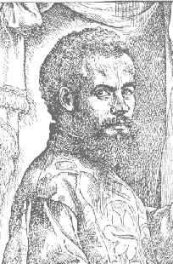
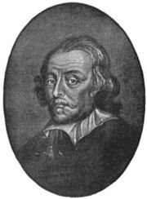
Medical Knowledge Grew
Vesalius- began study of anatomy
  Gathered dead bodies to study anatomy- sometimes robbed gallows
  1st to correctly describe anatomy of humans
  Became personal doctor of Charles V (HRE)
William Harvey- explained blood circulation
  Experimented with fish, frogs, and birds to see
  how heart works and if blood moves in continuous stream
  Wrote a book describing how heart pumps blood thru body

Slide 18
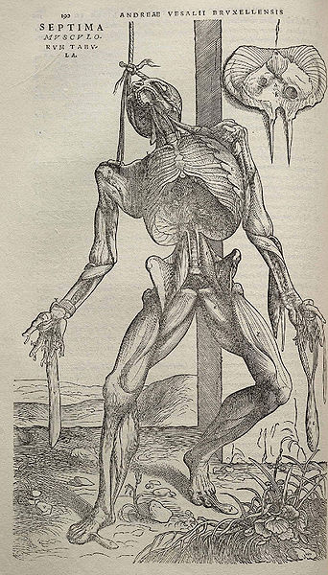

Slide 19
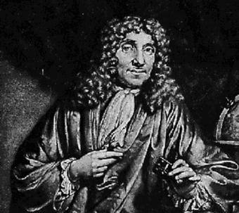


Leeuwenhoek
  Saw first bacteria
  Made his own microscope
  Saw red blood corpuscles, bacteria, and other tiny forms of life

Slide 20
Scientific Method Used in Many Fields
John Locke- English
  Believed progress was certain if people used minds to reason things thru
  Wrote about inalienable rights of life, liberty and property
  American Revolution based the Declaration of Independence on his beliefs

Slide 21
Montesquieu
French founder of political science
called for separation of powers in government on which the US Constitution is based on
  executive
  legislative
  judicial

Slide 22
Voltaire
attacked the follies of his time in books and plays
influenced religious toleration
  accepted the Deistic Movement- (God is like a clockmaker)-
  God made the universe and set it up to work by natural laws
  he leaves it alone-
  God stays out of daily lives so praying was useless

Slide 23
Rousseau
born in Switzerland
stated that before people were “civilized” they were good and pure but society corrupted them
could become good by getting back to nature (simplifying their lives)
wrote Social Contract
influenced Marie Antoinette

Slide 24

Diderot
felt knowledge would improve the life of mankind
spoke out about ignorance and superstition
put new learning into a book and called it Encyclopedia

Slide 25
John Howard
improvements in public health and dealing with the insane
partly responsible for prison reform
believed prisons should be for rehabilitation and not punishment alone

