Slide 1
Sumerian Civilization

Slide 2
Take a Moment…
How did geography/society in Sumner differ from geography/society in Egypt?
How were they the same?
How was it similar to US? How was it different?
Notes:
In your notebooks, take a few moments to answer this question.
A: geography→ less isolation, less predictable river flooding, greater fertile land (differ)
society→ didn’t believe in afterlife (differ), polytheism, education (same), writing

Slide 3
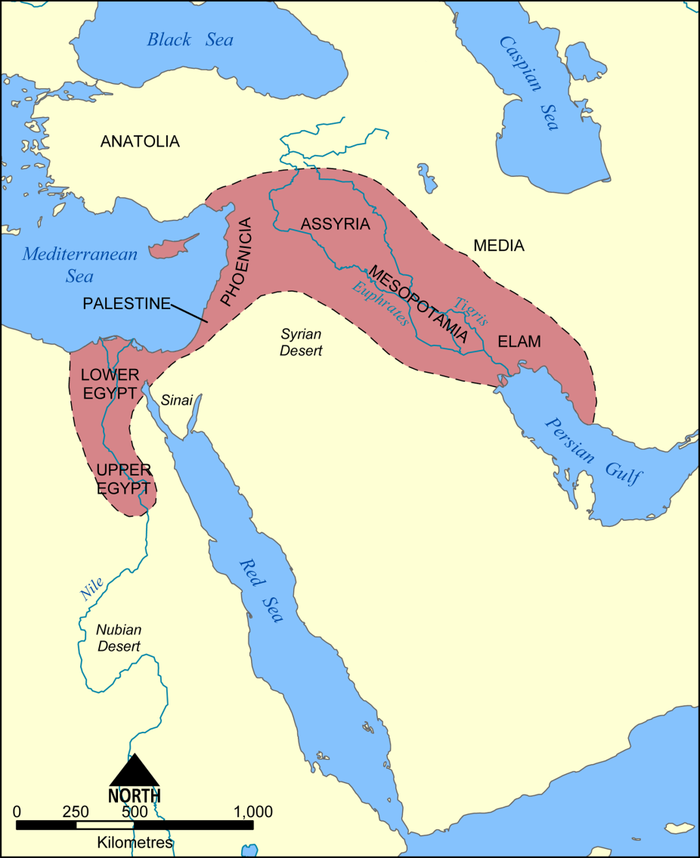
Geography of Fertile Crescent
A strip of fertile land which is well suited for farming
Much like Egypt, societies revolved around flooding waters to irrigate fields
No isolation→ invaders of many kinds
Notes:
*The Fertile Crescent begins at the Isthmus of Suez and arcs through Southwest Asia to the Persian Gulf
*the Fertile Crescent had no isolation of natural barriers, unlike Ancient Egypt, which made it prone to many invaders. What about this areas location made it so suitable for invasion?

Slide 4
Fertile Crescent
Major geographic features of this area?
-Tigris and Euphrates Rivers
Mesopotamia→ the Tigris-Euphrates Valley
Tigris-Euphrates flooding
A time of repeated migration and conquest
Notes:
*The flooding of the Tigris and Euphrates Rivers was very unpredictable, unlike the Nile. How would this impact religion of the people of the Fertile Crescent?
*tribes of wandering herders would travel throughout the Fertile Crescent, living off the grasses and other plant life. They would invade the areas of the valley, building empires along the way. As the people of these empires grew weak, new invaders would conquer them, building their own new empires.

Slide 5
Sumerian Society
City-States: a town or city and the surrounding land controlled by it
Ur, Erech, and Kish
Top→ Kings, high priests, nobles
Middle→ lower priests, merchants, scholars
Bottom→ peasant farmers, slaves
Notes:
*Sumerians developed city-states, a form of community
-believed the land in each city-state belonged to one or more gods

Slide 6
Sumerian Society
city state- city and its surrounding area; ruled by a king; King had both gov't and rel. powers.
monarchy- rule by a king or queen
theocracy- political and religious leadership is combined

Slide 7
Sumerian Society
Farming and trade: grew dates, grains, and vegetables; raised domestic animals; grew flax for linen and wove woolen goods; worked as artisans and traders
Education and Religion: only upper-class boys were educated; practiced polytheism; afterlife??
Notes:
*Most Sumerians farmed. Abundance of farmers allowed for people to work as artisans and traders
*Sumerians learned to write and spell by copying religious books and songs; Sumerian gods and goddesses guarded individual cities; buried food and tools with their dead, didn’t believe in a detailed afterlife, but believed in a kind of shadowy lower world, didn’t believe in rewards and punishments after death

Slide 8
Religion
Life was centered around religion.
Sumerians believed in and worshiped many gods (polytheism).
Each city had its own main god and a temple dedicated to that god. Everything belonged to that god.
Temple became the center of activities.

Slide 9
Daily life
Very harsh and violent---enemies threatened constantly.
Geographically, there were few natural barriers so there were constant invasions.
Famine and drought were constant worries.
Male-dominated society; women and children had few rights.

Slide 10
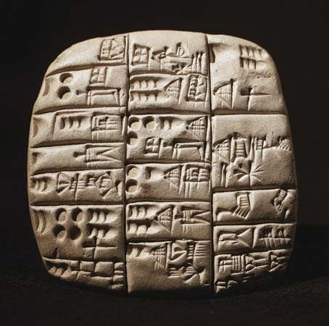
Sumerian Discoveries
Writing
Clay tablets were also used to keep written records.
Form of writing by the Sumerians was known as cuneiform writing. This meant "wedge-shaped" writing. Called this because the Sumerians used a pointed instrument to make wedge-shaped characters in clay.
This writing used about 550 different characters.
Notes:
*not a lot is known about the origins of the people of Sumner, but most likely nomadic people migrated into the area and mingled with the people already there
*Writing: pictographs→ one of the earliest forms of writing
cuneiform→ writers used a wedge-shaped tool called a stylus. As a result most signs were wedge shaped.
Sumerians had about 600 cuneiform signs
*Architecture: arch→ invented one of the strongest forms in a building; curved structure over an opening
ziggurats→ most striking Sumerian buildings were temples known as ziggurats; made of baked brick in layers much like a wedding cake. The top served as a shrine to a Sumerian god.
*Science: wheels→ may have been the first people to develop and use the wheel; used a system of numbers based on 60
lunar calendar→ had to add a month every few years to make it work (360 days in a year)

Slide 11
Sumerian Discoveries
Architecture
-arch
-ziggurats
Science
-wheels→ watch, compass
-lunar calendar
Number system based on sixty (we still use it today– how??)

Slide 12
