Slide 1
Sumerian Civilization

Slide 2
Take a Moment…
Why do the earliest civilizations develop around rivers or lakes?
How does geography affect a civilization?

Slide 3
Take a Moment…
How did geography/society in Sumner differ from geography/society in Egypt?
How were they the same?
Notes:
In your notebooks, take a few moments to answer this question.
A: geography→ less isolation, less predictable river flooding, greater fertile land (differ)
society→ didn’t believe in afterlife (differ), polytheism, education (same), writing

Slide 4
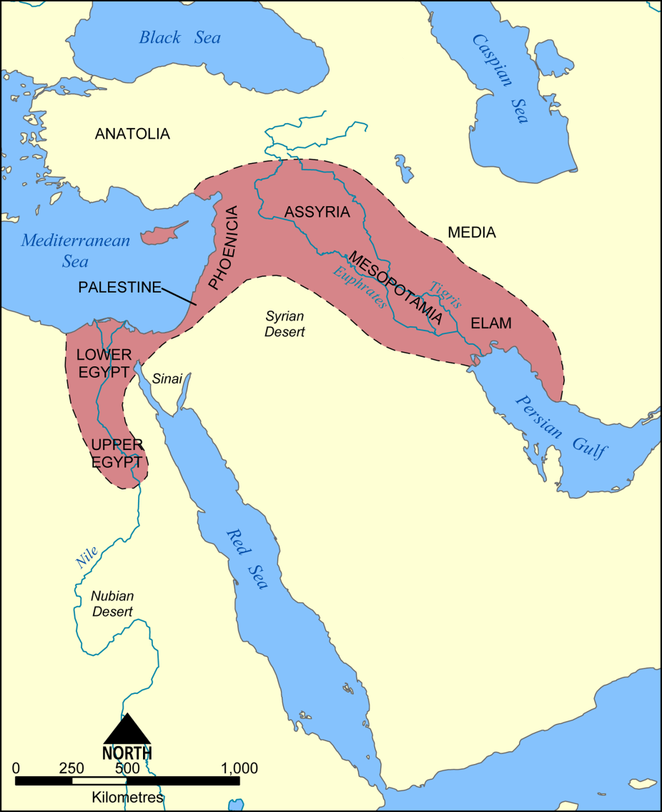
Geography of Fertile Crescent
A strip of fertile land which is well suited for farming
Much like Egypt, societies revolved around flooding waters to irrigate fields
No isolation→ invaders of many kinds
Notes:
*The Fertile Crescent begins at the Isthmus of Suez and arcs through Southwest Asia to the Persian Gulf
*the Fertile Crescent had no isolation of natural barriers, unlike Ancient Egypt, which made it prone to many invaders. What about this areas location made it so suitable for invasion?

Slide 5
Fertile Crescent
Major geographic features of this area?
-Tigris and Euphrates Rivers
Mesopotamia→ the Tigris-Euphrates Valley
Tigris-Euphrates flooding
A time of repeated migration and conquest
Notes:
*The flooding of the Tigris and Euphrates Rivers was very unpredictable, unlike the Nile. How would this impact religion of the people of the Fertile Crescent?
*tribes of wandering herders would travel throughout the Fertile Crescent, living off the grasses and other plant life. They would invade the areas of the valley, building empires along the way. As the people of these empires grew weak, new invaders would conquer them, building their own new empires.

Slide 6
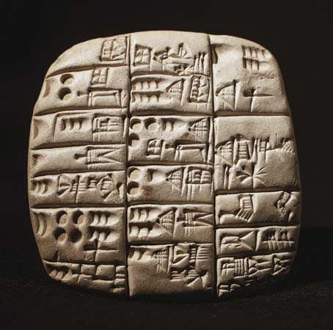
Sumer
Origins→ nomadic people migrated to Sumner
Writing
-pictographs: picture writing
-cuneiform: wedge shaped
Architecture
-arch
-ziggurats
Science
-wheels→ watch, compass
-lunar calendar
Notes:
*not a lot is known about the origins of the people of Sumner, but most likely nomadic people migrated into the area and mingled with the people already there
*Writing: pictographs→ one of the earliest forms of writing
cuneiform→ writers used a wedge-shaped tool called a stylus. As a result most signs were wedge shaped.
Sumerians had about 600 cuneiform signs
*Architecture: arch→ invented one of the strongest forms in a building; curved structure over an opening
ziggurats→ most striking Sumerian buildings were temples known as ziggurats; made of baked brick in layers much like a wedding cake. The top served as a shrine to a Sumerian god.
*Science: wheels→ may have been the first people to develop and use the wheel; used a system of numbers based on 60
lunar calendar→ had to add a month every few years to make it work (360 days in a year)

Slide 7
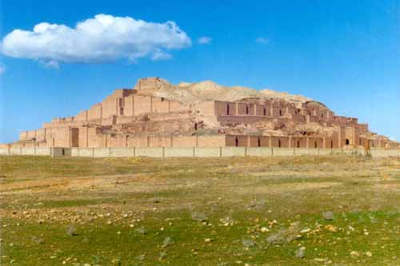
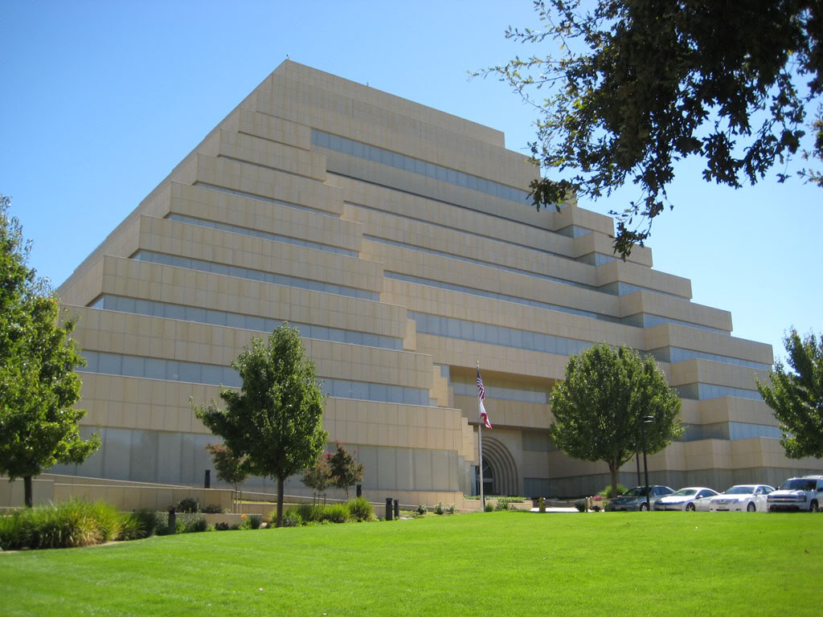
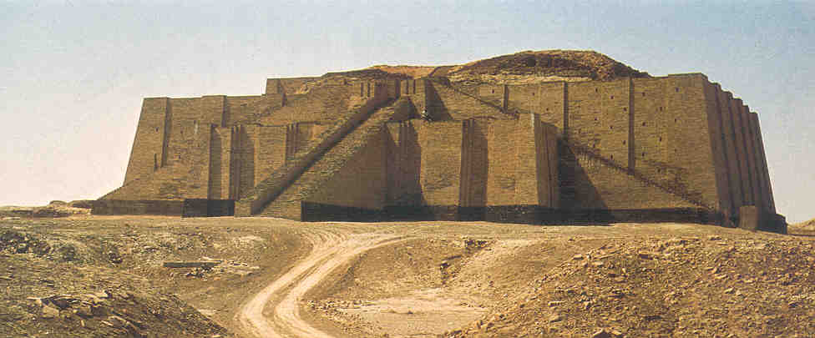

Slide 8
Sumerian Society
City-States: a town or city and the surrounding land controlled by it
Ur, Erech, and Kish
Top→ Kings, high priests, nobles
Middle→ lower priests, merchants, scholars
Bottom→ peasant farmers, slaves
Notes:
*Sumerians developed city-states, a form of community
-believed the land in each city-state belonged to one or more gods

Slide 9
Sumerian Society
Farming and trade: grew dates, grains, and vegetables; raised domestic animals; grew flax for linen and wove woolen goods; worked as artisans and traders
Education and Religion: only upper-class boys were educated; practiced polytheism; afterlife??
Notes:
*Most Sumerians farmed. Abundance of farmers allowed for people to work as artisans and traders
*Sumerians learned to write and spell by copying religious books and songs; Sumerian gods and goddesses guarded individual cities; buried food and tools with their dead, didn’t believe in a detailed afterlife, but believed in a kind of shadowy lower world, didn’t believe in rewards and punishments after death

Slide 10
The Ancient Middle East: Debating Hammurabi’s Code
Hammurabi’s Code is one of the oldest written records that we have (ca. 1728 – 1686 BC). The Code is actually a series of laws written by a Babylonian king named Hammurabi. These laws were engraved on a huge stone pillar that was excavated in the early 20th century. Hammurabi claimed the gods called on him to “make justice visible in the land.” There are 282 laws, organized by subjects. They cover a wide range of offenses. Hammurabi made an effort to make the laws fair, but different standards of justice and “fairness” applied to different people. In other words, status counted.

Slide 11
The Ancient Middle East: Debating Hammurabi’s Code
Divide class into two groups: one pro and one con. Give students 5-6 minutes to get together to work on prepping debate. Think about the pros and cons of each. Begin formal debate. (handout on HC)

Slide 12
Debate: Hammurabi’s Code
Consider the following questions and be able to support your answers logically: Where the laws appropriate for the time period? How were they fair or unfair? Which people were favored by the laws and which where not? How is the Code of Hammurabi similar to or different from the Ten Commandments? Have society’s problems changed or remained the same?

